Slide 1
Legislative Overview & 2024 Legislative Session Darielle Dannen| Government Relations Director

Slide 2
The Biennial Cycle
Year 1 (Budget Year)
Longer session (January-May) (see Constitution, Article 4, Sec. 12).
Required to pass a balanced budget (or we shut it DOWN!).
Follows an election year.
Year 2 (Policy Year)
Shorter session (February-May).
Used primarily for non-budget policy changes.
Capital Investment bill usually passes in the policy year.
Supplemental budget items may be considered.

Slide 3
The Rules of the Session
Governor is required to present a budget early in session.
February Forecast – a revenue estimate prepared by MMB giving a sense of how much money we can spend. This year, the Governor’s Supplemental Budget will be introduced after the February Forecast.
Deadlines
Help to narrow down the list of bills the legislature is working on to bills that have had hearings.
Targets
The House, Senate, and Governor decide how much in total to spend over two years and how much to dedicate to each area (education, workforce, transportation, etc.).
Committees work out the details of how that funding is used.

Slide 4
Key Dates - 2024
Feb. 12 – Legislative Session Starts
Late Feb/Early March - February Forecast
March – Governor's Supplemental Budget Released
March 27 – April 2 - Easter Break
April 9 – 11 – Eid Break
April 22 – 24 – Passover Break
May 20 - Session Ends – Sine Die
Committee Deadlines:
First deadline — March 22, 5:00 p.m. Committees in both chambers must act on bills that are not major appropriation or finance bills by this date.
Second deadline — April 19, end of day. Committees in both chambers must act on major appropriation or finance bills by this date.

Slide 5
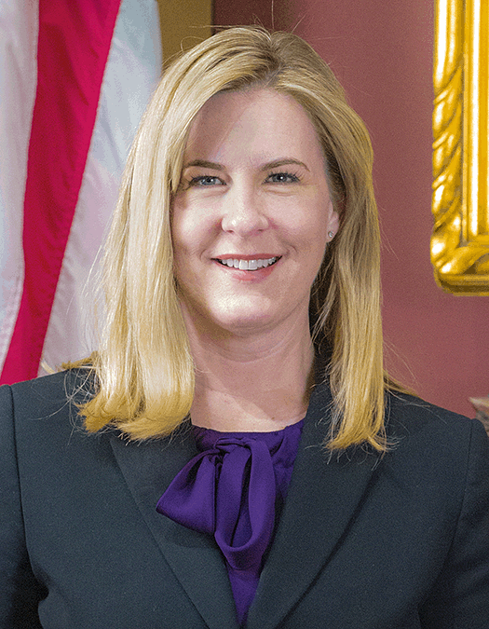
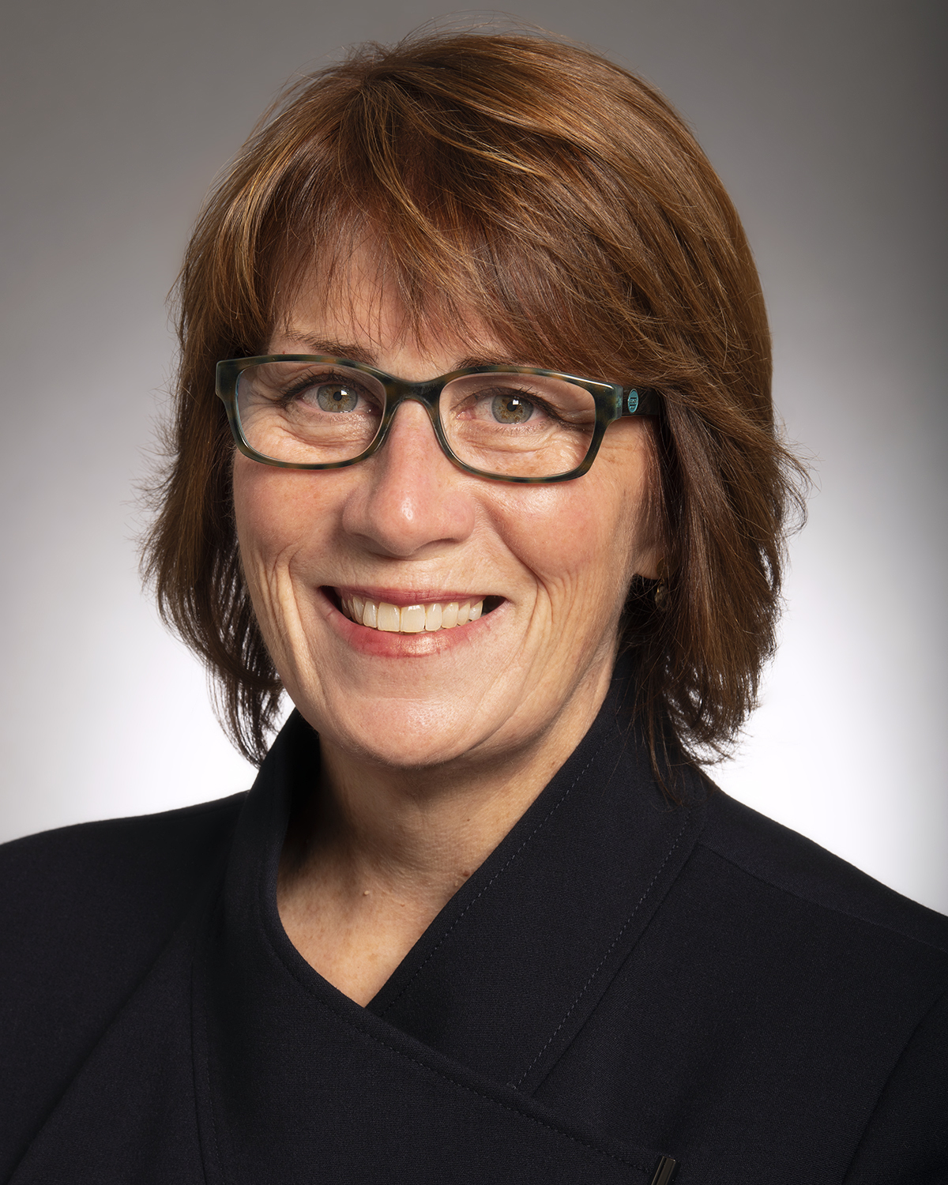
Legislators
Minnesota is a bicameral legislature, having a House of Representatives and a Senate.
The House of Representatives has 134 members and the Senate has 67 members.
The House is currently made up of 70 DFL and 64 R members.
The Senate is currently made up of 34 DFL and 33 R members.
House members serve two year terms and Senate members serve four year terms in years ending in 2 and 6 and for two-year terms in years ending in 0.
Legislators serve on legislative committees (typically three committees each session).
The legislature is essentially DEED’s board of directors. They can give us raises, create new programs, or defund programs.
Who represents you?

Slide 6
Bills
Bills are instructions. They may fund programs, create statutes, establish regulatory schemes, etc.
A bill may be very short (a few lines) or very long (cannabis legalization – 319 pages!).
Only a lawmaker can introduce a bill, but bills are written by lawmakers, lobbyists, advocacy organizations, government staff, etc.
Bills may be amended throughout the legislative process.
An identical version of a bill must pass in both the House and Senate in order to be presented to the Governor for final signature.
Types of bills: companion bill, clone bill, omnibus bill, standalone bill, session law/statute.
3,342 bills were introduced in 2023.
Usually the first bills introduced are the agenda items for a party.

Slide 7
Committees
Comprised of select lawmakers from each party and cover a particular topic (workforce, education, transportation, etc.).
There are 29 House committees and 20 Senate committees.
This is where lawmakers and the public weigh in on bills through debate, testimony, and letters of support or opposition.
Committee chairs are appointed by the House/Senate leadership (usually seniority a major factor).
Committee members are also appointed by House/Senate leadership (usually guaranteeing a majority of members from the majority party).
The committee chair controls the agenda for the committee and determines what bills get a hearing.
Bills may be: “Laid over for possible inclusion,” “Laid on the table,” “Referred to XX Committee,” or “Sent to General Register.”

Slide 8
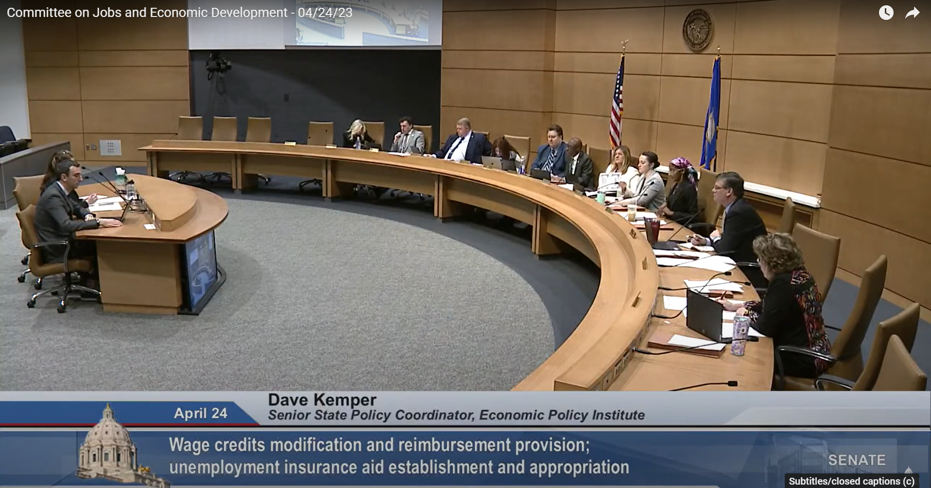
DEED Committees
Oversight over Broadband:
Senate – Agriculture, Broadband and Rural Development, chaired by Senator Putnam, Republican lead Senator Westrom
House – Agriculture Finance and Policy, chaired by Rep. Vang, Republican lead Rep. Anderson
Most committees are available to stream on the House and Senate YouTube channels. The Legislative Calendar usually gives you a sense of what the committee agendas will be about one week in advance.

Slide 9
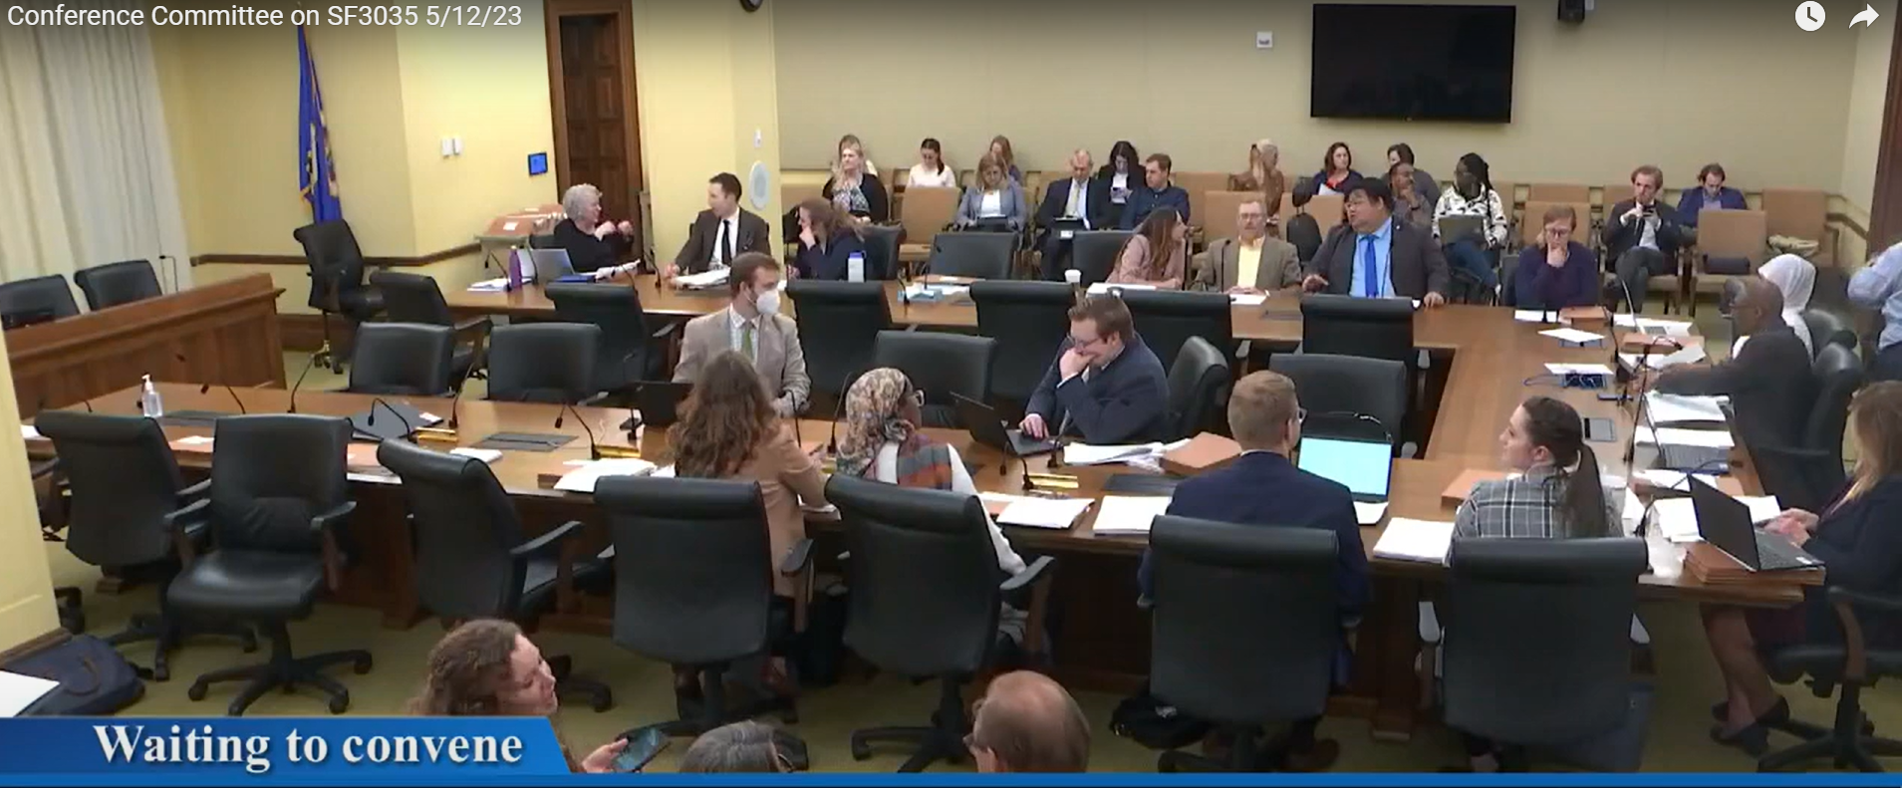
Conference Committees
A joint committee made up of both House and Senate members.
Used to negotiate and reconcile differences between bills that are similar but not identical.
No set schedule.
Traditionally, conference committees include ten members:
Five from the House (four from the majority party and one from the minority party).
Five from the Senate (four from the majority party and one from the minority party).
Conference committees are most common at the end of session to negotiate omnibus bills.

Slide 10
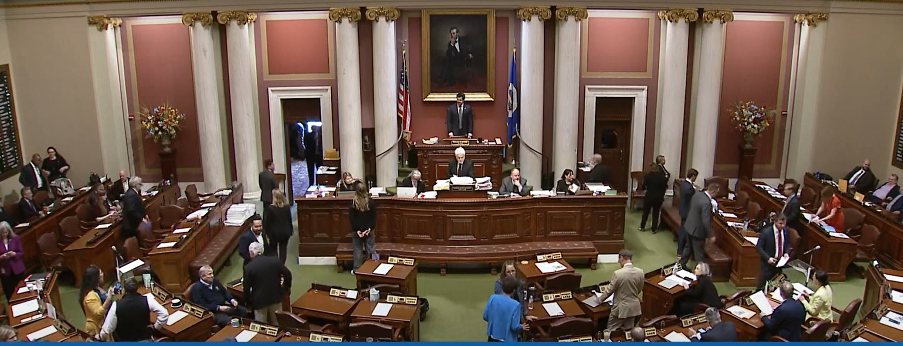
Floor Hearings
When a bill has passed through all of the necessary committees, it is heard on the floor where all members may debate.
Lawmakers may offer amendments to the bill while it is being heard on the floor (during Second Reading).
House requires all amendments to be submitted 24 hours in advance. Senate has no such deadline.
No amendments may be offered during Third Reading.
This is where lawmakers do their “performances.”

Slide 11
How it all fits together
About two thousand bills are introduced each year of the biennium.
Each committee meets regularly (about twice each week) to hear bills (typically anywhere from 3-5 bills per hearing).
DEED Commissioner presents the DEED policy bills and budget recommendations.
Targets are agreed upon between the House, Senate, and Governor (could be announced at any time).
The House and Senate pass their own versions of omnibus bills.
Conference Committees are appointed to negotiate bills that are not identical (and these committees then make their own meeting schedules).
The House, Senate, and Governor’s Office negotiate the final omnibus bills.
House and Senate pass identical bills.
Governor signs final bills.

Slide 12
Preview of the 2024 Legislative Session
DEED has almost $1.8 billion in total funding in FY24-25 following historic investments in our legislative priorities in 2023.​
Effective and efficient implementation of the programs supported by these investments has been the agency’s highest priority since the end of the 2023 legislative session.​
For the 2024 session, we anticipate a more limited scope of proposals as part of what Gov. Walz has called an "implementation session." ​

Slide 13
Broadband and the 2024 Legislative Session
During the 2023 Legislative Session:
$100 Million for broadband deployment for the biennium​
$30 Million (per year) for Traditional Border to Border Grant Program​
$20 Million (per year) for Low Population Density Program​
Grant Round 9 applications due Dec. 7, 2023​.
Technical Change​ - 2023 Session
Raises the maximum Border-to-Border grant award from $5 million to $10 million​
2024 Legislative Session:
Expecting some budget-neutral policy language in 2024 around broadband
Additional discussion about the federal funds

Slide 14
Questions?

