Slide 1
Main Street COVID Relief Grant Program
MSCRG.DEED@state.mn.us

Slide 2
Agenda
Overview
Eligibility
Funding
Application
Resources
Q and A

Slide 3
Program Overview
$64.2 million available in grants for Minnesotan owned and operated businesses that can demonstrate financial hardship due to the COVID-19 pandemic.
Grant amounts between $10,000 and $25,000 based on the number of full-time equivalent (FTEs) employees on staff
Application will be received and randomly selected by the State
Grants will be administered by local and regionally based nonprofit agencies
Notes:
Awards will be disbursed and administered by qualified local and regionally based nonprofit organizations. Grant funds received by individual businesses shall be used for working capital to support payroll expenses, rent, mortgage payments, utility bills, and other similar business expenses that occur or have occurred since March 1, 2020, in the regular course of business. These are grants and no repayment will be required.
Awards will be allocated between the 7-county metropolitan area and Greater Minnesota with 50% to the metro and 50% to Greater MN. Businesses receiving these grants will be chosen using a random selection process (do not use the word lottery-means different things in some communities). 11 Non-profit agencies will administer the grant awards in the Metro area with the 6 Initiative Fdtns administering them in Greater MN.
This is a grant program and therefore no repayment is required. However, the state reserves the right to audit the use of funds and may conduct an audit check on a random selection of grant recipients. Grant recipients who are found to have violated the terms of the application process or grant agreement may be required to refund the state.
If you are selected, a grant administrator will confirm your eligiblilty and you will have to sign a document certifying you are eligible to receive this grant and that the grant will be used for eligible uses only.

Slide 4
Program Overview
ONLINE applications will be accepted from September 20 to September 29
Applications will be selected through a randomized selection process
Applications selected for consideration will be notified in October
Grants will be disbursed between late October 2021 and June, 2022

Slide 5
Who is Eligible?
Businesses or non-profit organizations (that earn revenue in ways similar to a business)
With primary operations located in the state of Minnesota
Be at least 50% owned by one or more resident(s) of Minnesota
Employee the equivalent of 200 full-time workers or fewer
Minimum total sales or revenue of at least $10,000 for the 2020 or 2019 tax year
Demonstrate financial hardship due to the COVID-19 outbreak
Are currently operating and have plans to continue operating

Slide 6
Who is Eligible?
Also includes the following types of businesses
Sole proprietorships
Independent contractors
Businesses without a permanent physical location
Home-based businesses
Businesses with no employees besides the owner

Slide 7
Financial Hardship Considerations
A business needs to show Financial Hardship
The business was DIRECTLY restricted by Executive Orders to reduce the spread of COVID-19
OR
10% decrease in annual revenue between 2019 and 2020
Special case: Businesses that started in 2020 can qualify for financial hardship if they were directly restricted by Executive Orders

Slide 8
Executive Orders
Some, but not all, relevant Executive Orders are listed below
EO 20-04 March 26-May 17 Temporarily closed bars, restaurants, and other public places. Extended by later EOs.
EO 20-09 March 23- Delayed non-essential or elective medical/dental surgery and procedures during COVID-19 Peacetime Emergency.
EO 20-20 March 27-April 10 Directed Minnesotans to stay home. Defined critical sectors exempt from this executive order.
EO 20-51 May 10 Permitted some non-essential medical/dental procedures to resume.
EO 20-56 Phase I, May 18-June 1: Safely re-opening Minnesota's economy. Restaurants/bars: delivery, take out only. Non-critical customer-facing: may re-open at capacity of 50% or less. Some areas still closed.
EO 20-74 June 9 Gradual measures to safely reopen Minnesota’s economy.
EO 20-96 Nov. 13 Revised restrictions on social gatherings, celebrations, bars, restaurants, venues.
EO 20-99 Nov. 20-Dec. 18: Reinstated restrictions for four weeks to dial back on certain activities.

Slide 9
The Effect of Executive Orders
SOME businesses were DIRECTLY restricted by Executive Orders to reduce the spread of COVID-19
The business typically requires customers to be physically present to receive goods or services
Non-critical sector businesses
But ALMOST ALL businesses were INDIRECTLY impacted by Executive Orders related to the COVID-19 outbreak
Critical sector businesses (i.e. grocery stores, auto shops)
Business that don’t typically require customers to be physically present (i.e. online retail)
Businesses whose supply chain includes business directly restricted by Executive Order (restaurant supply business)

Slide 10
Examples of Indirect Impacts from Executive Orders
Direct Restrictions | Indirect Impacts
A bar or restaurant that could not operate above 50% customer capacity due to EO 20-56 | A restaurant supply company that experienced a reduction in orders from their customers
A dental or medical office that was restricted by EO 20-09 and could only provide emergency dental or medical services | A supplier of dental materials and equipment that had a reduction in sales A medical transportation business that had a reduction in customers
An organization that organizes youth sports leagues and was restricted by EO 20-20 from hosting practices or events | An apparel or equipment manufacturer whose orders for jerseys or balls were cancelled or reduced.

Slide 11
Who is NOT Eligible?
Majority ownership of a business is owned by one or more residents outside of Minnesota
Non-profit organizations that do not earn revenue in similar ways to a business
Business that started operating after December 31, 2020
Businesses that had less than $10,000 in revenue per year for each 2019 and 2020
Cannot demonstrate financial hardship due to COVID 19 outbreak
Are not currently operating or plan to close soon
Notes:
On the list of additional ineligible businesses:
A business manufacturing, distributing, selling or conducting related activities of sexually explicit materials. - A business deriving income from passive investments without operational ties to operating businesses. - A business primarily focusing on speculative activities based on fluctuations in price rather than the normal course of trade. - A business earning more than half of its annual net revenue from lending. - A business engaging in pyramid sales, where a participant's primary incentive is based on the sales of an ever-increasing number of participants. - A business engaging in activities prohibited by federal law or applicable law in the local jurisdiction of the business. - A business engaging in gambling enterprises, unless the business earns less than 50% of its annual net revenue from lottery sales.

Slide 12
Prioritization of Applications
Priority will be given to businesses that did not receive assistance from one or more the following State programs:
Small Business Emergency Loan program
Small Business Relief Grant Program
Movie Theater and Convention Center Relief Grant program
State-funded County Relief Grant program
If a business received a grant from one of these programs, they are still eligible to apply to be considered for an award.

Slide 13
Prioritization of Applications
Geography
50% of funds will be available for businesses based in Greater Minnesota
50% of funds will be available for businesses based in the 7-county metro
Business/Owner Characteristics
$18 million for businesses with six-full time workers or less
$10 million for Black, Indigenous and/or People of Color owned businesses
$2.5 million for businesses that are majority owned and operated by women
$2.5 million for businesses that are majority owned and operated by veterans
Notes:
Priority considerations: Businesses that are majority-owned by military veterans, women, and ethnic or racial minorities; that employ 6 people or fewer; and that were significantly impacted by Executive Order 20-56 (i.e. with their operations restricted to 50% or less of normal capacity) will receive some priority in the selection process. In making awards there are minimum set asides for various targeted groups and categories of businesses.
Awards will be selected through a randomized selection process
If a business qualifies into more than one of the targeted groups, they can potentially be entered into more than one drawing - unless they are selected in one of the rounds.
One grant per business even if they qualify in additional categories.
More details coming on $300,000 for operators of indoor retail and food markets with an ethnic cultural emphasis. It will be a separate application process that the operators will apply to (not the tenants).

Slide 14
What can funds be used for?
Working capital to support the business
Payroll expenses
Rent
Mortgage payments
Utility bills
Other similar expenses that occur or have occurred since March 1, 2020, in the regular course of business.
Notes:
Grant funds shall be used for working capital to support payroll expenses, rent, mortgage payments, utility bills, and other similar expenses that occur or have occurred since March 1, 2020, in the regular course of business. All uses must be exclusively for Minnesota operations.
Payroll includes the owners own salary.
Grant funds cannot be used for:
Taxes
Business acquisition and/or the purchase of land or building
Operation expenses outside of MN

Slide 15
Application, Selection, Review and Award Process
Between September 20 and 29 apply online at https://mn.gov/deed/mscrg
All application will be reviewed for completeness and validity
Complete and valid applications will proceed to the randomized selection process
Selected applicants will be notified that their application has been randomly selected for consideration
Applications will be assigned to one of the nonprofit administrators
Applications will be reviewed and confirmed to be eligible
Administrators will email applicants that they have been approved for a grant and will request applicants sign an award acceptance agreement
Applicants will sign the award acceptance agreement then receive the proceeds of the grant

Slide 16
Administration of the Grants
Metro:
African Development Center
African Economic Development Solutions
Hmong American Partnership
Latino Economic Development Center
Metropolitan Consortium of Community Developers
Metropolitan Economic Development Association
Neighborhood Development Center
NextStage
New American Development Center
Northside Economic Opportunity Network
WomenVenture
Greater Minnesota
West Central Initiative
Northwest Minnesota Foundation
Northland Foundation
Southern Minnesota Initiative
The Initiative Foundation
Southwest Initiative Foundation
Notes:
Due to the large volume of applications and awards, DEED is partnering with these organizations to administer and distribute the awards. These organizations are mandated by law to administer these funds.
FYI (if asked) -After your application as been selected for consideration, the award administrator will review your documentation to confirm you are eligible to receive a grant. Some examples of documentation you may be asked to provide include – but are not limited to – the following: sales tax reporting, period statements from third-party sales platforms, merchant services statements, point of sale or register reports, third-party payroll processor reports, federal form 941/employer's quarterly federal tax return, or other state or federal payroll-related filings.

Slide 17
Application Questions
Eligibility questions on the grant application include:
Who owns the business?
Is the owner a resident of Minnesota?
Where is the business located?
What was your business’ revenue in 2020?
Was your business directly restricted by Executive Orders related to COVID-19?
Documents verifying your information will include:
2019, 2020 tax returns
Driver's license, state issued IDs, etc.
And more…
Notes:
The above questions are sample ones that are on the application. There is a total of 18 questions (no attachments are necessary) – As you answer the questions, the application will let you know immediately if you do not qualify based on your response.
The questions asked are to determine eligibility for the grant.
This section will help us know how Governor Walz's Executive Orders (EO) impacted your business. In particular we want to know the impact of EO 20-56, effective on May 18, 2020, which permitted limited re-opening of some types of businesses, but restricted their operations to 50% or less of normal capacity. Awards will prioritize businesses adversely impacted by relevant Executive Orders.
Relevant Executive Orders (EO): EO 20-04 March 26-May 17 Temporarily closed bars, restaurants, and other places of public accommodation. Extended by later EOs. EO 20-08 Clarifies places of public accommodation for EO 20-04 EO 20-09 March 23- Delayed non-essential or elective medical/dental surgery and procedures during COVID-19 Peacetime Emergency. EO 20-20 March 27-April 10 Directed Minnesotans to stay home. Defined critical sectors exempt from this executive order. EO 20-51 May 10 Permitted some non-essential medical/dental surgery and other procedures to resume. EO 20-56 Phase I, May 18-June 1: Safely re-opening Minnesota's economy. Telework if possible. Restaurants/bars: delivery, take out only. Non-critical customer-facing: may re-open but at 50% or less of normal occupant capacity (workers and customers). Some areas still closed. A useful reference is available at the Stay Safe MN website: https://staysafe.mn.gov . Scroll down to view table, see Phase I to current phase.)
Optional questions at the end are not required for your grant application. Any information you provide on this page does not affect your eligibility or chances of receiving a grant. However, we would appreciate your responses so that we can measure how well we are reaching our equity goals for outreach and financial assistance.

Slide 18
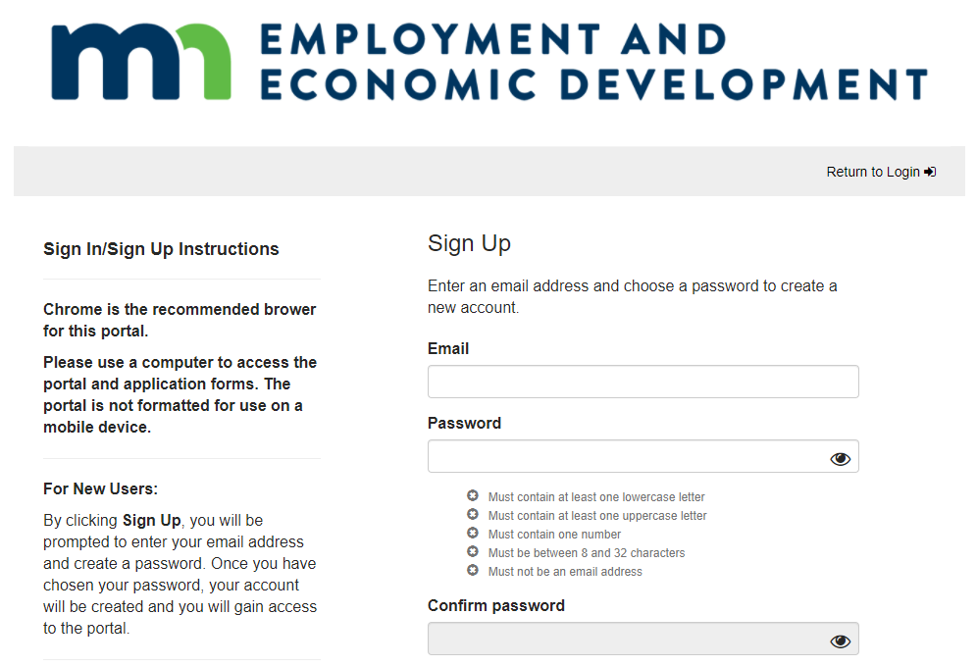
Completing the Application
Step 1: Sign-up
You will need a CORRECT email unique to you or your business
It is not recommended to use a mobile device
Recommend using the freely available Chrome browser

Slide 19
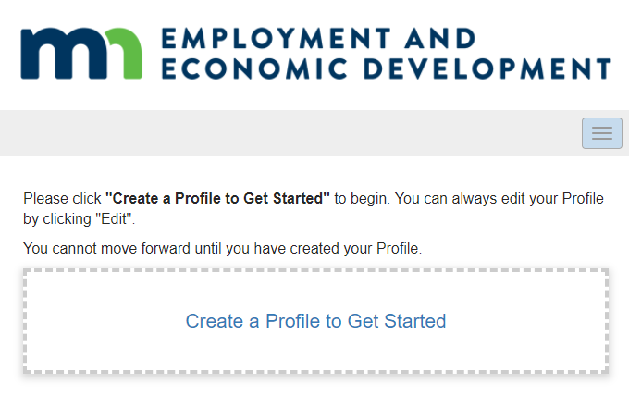
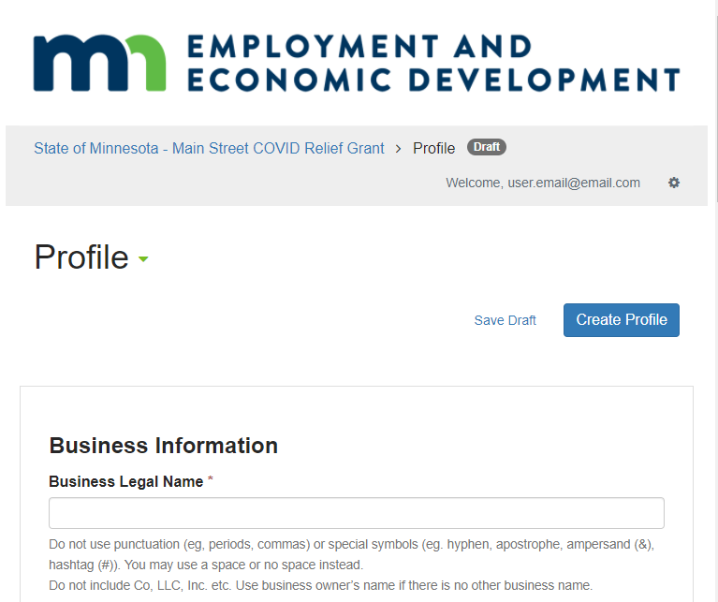
Completing the Application
Step 2: Create a Profile
Your profile is NOT your application

Slide 20
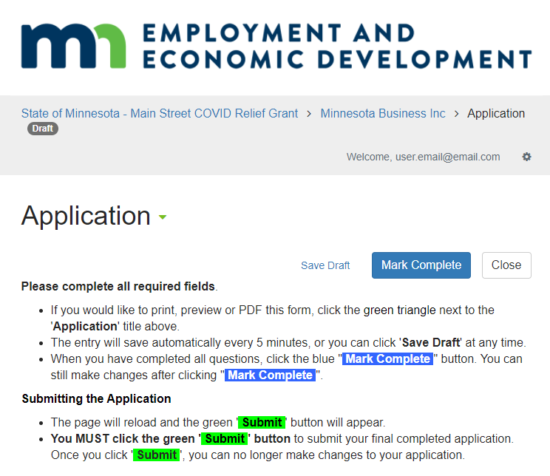
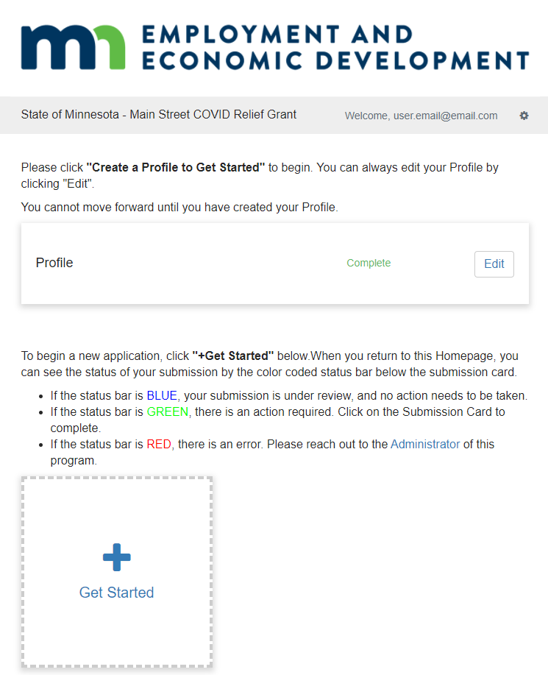
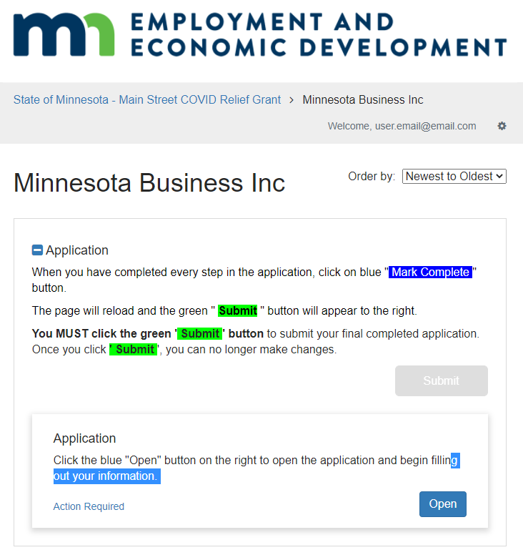
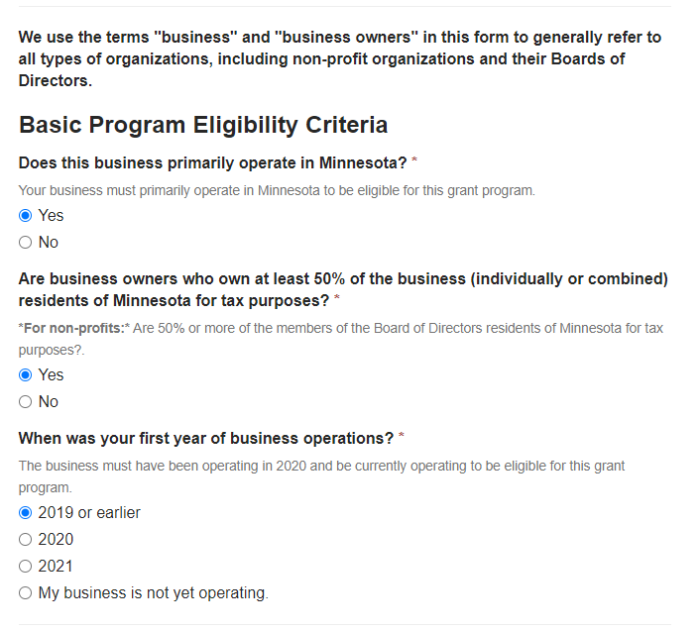
Completing the Application
Step 3: Start your application
You can start, stop, save and return to your application anytime during the application window (Sep. 20-29)

Slide 21
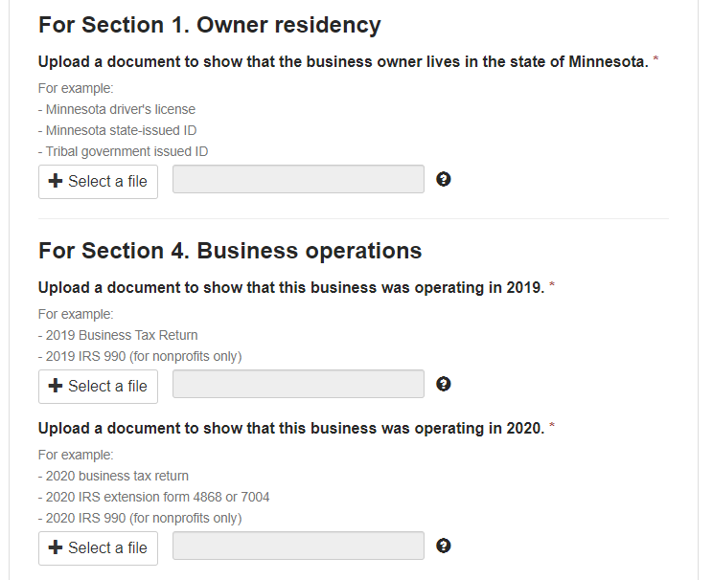
Completing the Application
Step 4: Upload Requirement Documents
You can upload only one file per field. Files can be as many pages as needed.
The file can be in any image or document format such as .PNG, .PDF, .JPEG, etc.
.PDF preferred!

Slide 22
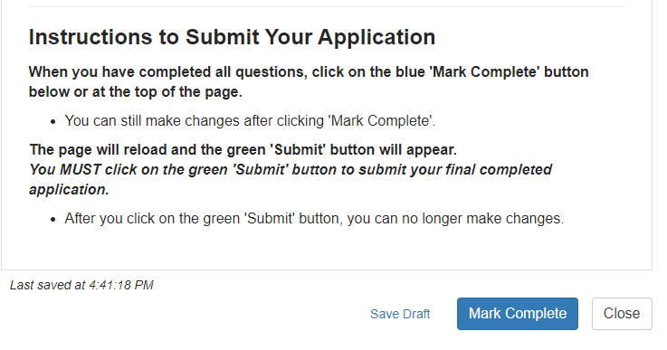
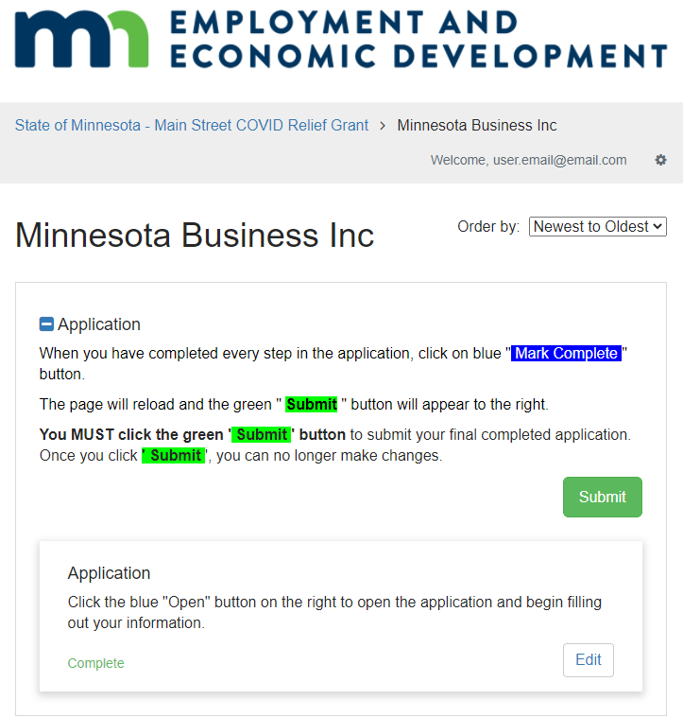
Completing the Application
Do not forget to click the green SUBMIT button
Step 5: Submit your application

Slide 23
Frequently Asked Questions
Residency
Q: Does “resident of Minnesota” mean permanent resident or citizen of the United states?
A: Resident of Minnesota means any individual who is domiciled in Minnesota or is domiciled outside the state who maintains a place of abode in the state and spends, in the aggregate, more than one-half of the tax year in Minnesota, unless the individual or the spouse of the individual is in the armed forces of the United States (Minn. Stat. 290.01). Immigration status is not a factor.
Q: How do nonprofit organizations meet the residency requirement? They don’t have owners like a for-profit business.
A: For the purpose of this program, you can use the residency of the board of directors of the applicant organization. For example, if 50% or more of the board of directors are residents of Minnesota then the organization meets the residency requirements of the program.

Slide 24
Frequently Asked Questions
Non-Profit Organizations
Q: How can I determine if my nonprofit organization is eligible for this program?
A: Nonprofits that earn revenue on an ongoing basis through a fee-for-service model similar to for-profit businesses and whose operations were restricted by an Executive Order to reduce the spread of COVID-19 are eligible for this grant.
This includes nonprofit theaters, concert venues, museums, arts organizations, fitness centers, and other organizations that generate revenue on an ongoing basis through a fee-for service model, such as ticket sales or membership dues that are not tax-deductible.
Q: My nonprofit organization was not able to sell tickets for our annual fundraiser due to COVID-19. Are we eligible for the program?
A: Nonprofits that rely on multiple sources of funding including annual fundraisers with ticket sales, but do not earn revenue similar to businesses, and/or were not directly restricted by an Executive Order to reduce the spread of COVID-19 do not meet the definition of eligibility for this program.

Slide 25
Frequently Asked Questions
Revenue
Q: I received one or more grants and/or forgivable loans in 2020. How does that count towards my businesses' revenue in 2020?
A: Generally, grants are counted like any other revenue received by the business and are subject to state and federal taxes. However, some financial assistance like Paycheck Protection Loans are treated differently and are not taxable. Note: we are unable to provide tax advice and applicants should discuss tax liabilities with their own tax advisors.
Q: My business lost more than 10% of revenue from paying customers during 2020 due to the COVID-19 outbreak compared to the 2019. However, I received enough financial assistance to make up the difference. Is my business eligible?
A: If your business was not directly restricted by an executive order and you received enough taxable financial assistance to make up for any revenue losses due to the pandemic your business will not meet the financial hardship requirement of this program

Slide 26
Frequently Asked Questions
Revenue (continued…)
Q: Compared to 2019 my business did not see a decrease in revenue compared to 2020. However, my cost increased significantly due to a number of factors. How can I show that my business faced financial hardship?
A: This program prioritizes businesses that faced significant revenue loss and/or whose operations were directly restricted by Executive Orders. A business that saw revenues increases, even while cost increased, and whose operations were not directly restricted by Executive Orders does not meet the definition of eligibility for this program.

Slide 27
Frequently Asked Questions
Self-Employed and Independent Contractors
Q: Are self-employed individuals and independent contractors eligible for this program?
A: Yes. They will count as business with one full-time-equivalent employee.
Employee Counts
Q: How is full-time equivalent employee defined and how is that calculated? How are part-time employees counted?
A: Full-time equivalent employee means an employee who works 40 hours or more, on average, each week. Part time employees can be counted in one of two ways:
1st Method: Calculate the average number of hours paid per week for a part-time employee during the year.
2nd Method: Each part-time employee equals 0.5 full-time equivalent employee whether they were paid for fewer or more than 20 hours per week.

Slide 28
For information
https://mn.gov/deed/mscrg
Submit your questions
MSCRG.DEED@state.mn.us
FAQ will be updated frequently
Notes:
Questions: FAQs page will be updated at least once a day until applications close

