Slide 1
Partnering with Minnesota’s Youth Workforce System to Enhance Participant Success
DEED Office of Youth Development
September 29, 2022

Slide 2
Objectives of Today’s Session
Learn more about structure of Minnesota’s Youth Workforce System
Learn about the programming available for youth facing barriers to self-sufficiency
Learn how two local Workforce Development Areas provide opportunities for youth from families receiving public assistance to build skills and experience through their programming

Slide 3
Today’s Presenters
Lynn Douma, Youth Program Coordinator, Minnesota Department of Employment and Economic Development (DEED)
Bridgett Backman, Employment Services Manager, Anoka County Job Training Center
Darcy Hokkanen, Program Coordinator, Anoka County Job Training Center
Sara Carrigan, Assistant Director, South Central Workforce Council

Slide 4
Minnesota’s Workforce System
State divided into 16 Local Workforce Development Areas (LWDAs) as directed by federal Workforce Innovation and Opportunity Act (WIOA)
Map of LWDAs can be viewed at: https://mawb-mn.org/workforce-development-areas
A Local Workforce Development Board (LWDB) in each area oversees programming and provides direction for meeting workforce development goals outlined in state and federal statute
LWDB chair and a majority of members from private sector – other members from labor, education, economic development, community-based organizations, adult or juvenile justice system, etc.

Slide 5
Overarching Goals of Youth Programs
Work Readiness: Helping youth understand and develop “soft skills” they will need at any job
Providing Quality Work Experience Opportunities: For many youth, this is their first job outside the home—especially for those with multiple barriers to employment.
Dropout Prevention: Many participants learn first-hand the importance of not only finishing high school, but also realizing that virtually any career pathway requires post-secondary education.
Identifying and Pursuing a Career Pathway Towards Self-Sufficiency

Slide 6
Barriers to Self-Sufficiency
All youth served in both Federal and State funded youth programs at DEED often face multiple barriers to self-sufficiency including:
Economically disadvantaged;
Pregnant or parenting youth;
Youth with limited English proficiency;
Potential (or actual) secondary school dropouts;
Youth offenders;
Public assistance recipients;
Youth with disabilities (including learning disabilities);

Slide 7
Barriers to Self-Sufficiency, continued
All youth served in both Federal and State funded youth programs at DEED often face multiple barriers to self-sufficiency including:
Chemically dependent youth or children of drug or alcohol abusers;
Homeless or runaway youth;
Youth with basic skills deficiency;
Youth with an educational attainment of one or more levels below grade level appropriate to age; or
Foster child/aged out of foster care

Slide 8
Who Is Served?
Across the major programs administered by DEED’s Youth Team:
Over 13,500 case-managed youth and young adults between the ages of 14 and 24+ served in SFY 21
7 of 10 youth served identify as BIPOC
7 of 10 youth are economically disadvantaged at enrollment
4 of 10 are basic skills deficient at enrollment
1 of 4 identify as a youth with a disability

Slide 9
Youth Workforce Programs
Workforce Innovation and Opportunity Act (WIOA)
Minnesota Youth Program
Minnesota Youthbuild Program
Youth at Work
Youth Support Services
TANF Youth Project

Slide 10
WIOA Young Adult Program
PY22 Funding Level: $8.9M; allocation formula in federal statute
Key Program Components:
  At least 75% Spent on Out-of-School Youth
  At least 20% Spent on Work Experience
  14 REQUIRED Program Elements
  Age Range 14-24
  How is Minnesota’s federal program unique:
  Minnesota consistently serves higher percentages of youth with significant barriers to employment/under-represented in workforce: homeless, foster youth, offenders, youth w/disabilities
  75 percent of WIOA Young Adults served are from BIPOC communities

Slide 11
Minnesota Youth Program
SFY 23 Funding Level: $4.0M (state funds)
Allocation Method: Funds allocated through a county-based allocation formula based on need – formula is in State law. This is the ONLY state-funded youth employment program available in all 87 counties.
How Performance is Measured: Worksite supervisors/employers assess work readiness skills on the worksite pre and post. Academic credit and service-learning credit often granted for work-based learning opportunities.
What Makes MYP Unique: Youth participants enroll in MYP for entry-level work experience and skill attainment then often move into WIOA Youth for more job specific focus. Each MYP dollar leverages approximately $6.00 of other federal, state and local funds. MYP funds allow WDAs to offer standalone summer youth employment, where WIOA Youth does not.

Slide 12
Minnesota Youthbuild Program
SFY 23 Funding Level: $1.0M
Relationship to federal YouthBuild funding: Minnesota’s $1M investment leverages $4M/year in federal funding
How Performance is Measured: Youth enter registered apprenticeship, post-secondary education and employment while earning industry recognized credentials.
What Makes Youthbuild Unique: Youthbuild is recognized by DOL/federal partners as a “pre-apprenticeship” training model.

Slide 13
Youth at Work Program
SFY 23 Funding Level: $3.8M
How Funding is Distributed: SFY22-23 Youth at Work RFP was released in January of 2021: 40 grantees were selected for funding. Received $17.75M in funding requests; only $3.8M available to award.
Program Priorities:
  Serve youth from communities of color and indigenous communities who are underrepresented in the workforce;
  Serve youth with disabilities;
  Provide youth with information about education and training requirements for careers in high-growth, in-demand occupations
Accomplishments:
  Over 7,000 youth served in SFY21
  77% of youth served from communities of color

Slide 14
Youth Support Services Program
SFY 23 Funding Level: $475,000
How Funding is Distributed: SFY22-23 Youth Support Service RFP was released in August of 2021 and received 45 applications serving youth.
  13 grantees selected for funding
  72% of funds allocated to the metro area, 22% allocated to Greater Minnesota, and 6% for a statewide project
Program Activities: Job training, Employment preparation, Internships, Job assistance to fathers, Financial literacy, Academic and behavioral interventions for low-performing students, and/or Youth intervention activities
Program Accomplishments:
  In SFY21, 797 participants received individual services and 2,229 participants received group services

Slide 15
TANF Youth Project
Funding level for 2022: $300,000 through an Interagency Agreement with DHS
Provides services to teen parents, ages 16-24, or younger youth, ages 14-18, receiving MFIP cash assistance
186 participants served in 2021; 58% teen parents and 42% younger youth receiving MFIP
Activities include:
  Career counseling/labor market information
  Work readiness training
  Work experience (uses employer pre- and post-assessment of work readiness skills on the work site)
  Introduction to career pathways
  Preparation for post-secondary education and long-term employment opportunities
  Financial literacy training

Slide 16
Co-enrollment Strategies
Co-enrollment allows limited resources to be used in the most effective way possible and serve the individual needs of participants
Example from TANF Youth in 2022 (151 served to date)
  20% co-enrolled in WIOA Youth Program (either in-school or out-of-school)
  40% co-enrolled in Minnesota Youth Program
  12% co-enrolled in Youth at Work Program

Slide 17

Anoka County Job Training Center
Bridgett Backman| Employment Services Manager and Darcy Hokkanen | Program Coordinator
Bridgett.Backman@co.anoka.mn.us | Darcy.Hokkanen@co.anoka.mn.us

Slide 18


Anoka County Job Training Center: Empowers
Empowers Program at Anoka County serves all of Anoka County as well referrals from local Partners serving youth experiencing homelessness.
Our Team is small but mighty! Manager, Program Coordinator and 2 Senior Vocational Counselors.

Slide 19

Program Highlights
Empowers Youth:
We focus on younger youth referrals from our MFIP
Team– age 14+.
Prepare youth with work readiness. Handbooks for the
youth and their worksite to use as guides for common
topics and reference.
First work experiences for most youth and their parent/parents.
Financial Literacy conversations and resources. Link to our website: https://www.anokacountymn.gov/3956/Money-Matters-Spending-Saving-Tips
Full family strategy with new immigrants through Project Focus.

Slide 20
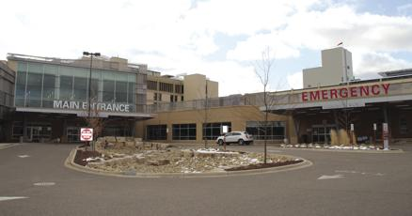
Success Stories
Individual success story: One youth (age 18) was placed at Mercy Hospital as a Dietary Aide/Messenger. After his placement ended, he was hired by the hospital as a Dietary Aide earning $ 17 an hour.
Siblings: We have experienced this with families
where we have served a youth and then the following
summer, we are seeing applications from siblings.
Project Focus

Slide 21
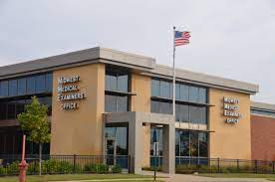
Empowers Sample Worksites
Sample of our worksites and tips to developing new sites: Mercy Hospital, Urban Air, SACA Food Shelf, Haven for Heroes, YMCA, Morris Bye Elementary, Savers, Mississippi Library, Little Voyagers Daycare. Several were hired by their site at the end of their placement.
Walk the Talk…we try to find positions within the County. We
have worked with the Library, Parks & Recreation – including
Bunker Beach Water Park, the Career Lab (our office in Blaine),
the Medical Examiners Office, and facilities across the County.
We are continually working on site development. We want to make sure the site works for the client. Younger youth sometimes select sites based on geographics and schedules that work around school commitments. Our goal is always to help them develop work skills that includes personal responsibility, communication skills and time management skills.

Slide 22
Challenging conversations
Self advocating
Identifying possible conflicts (i.e. culturally appropriate considerations such as gender roles, food, and holidays).
Dress Code: clothing/uniform care, personal space and hygiene.
Job Retention: when the youth wants to quit or when the site has concerns.
Fun Fact
Over 78% of the funding goes directly to youth wages

Slide 23

South Central Workforce Council
Sara Carrigan| Assistant Director
sara@workforcecouncil.org

Slide 24



South Central Young Adult Programs
Minnesota Valley Action Council is the youth provider in the 9 counties of South Central MN
  Blue Earth, Brown, Faribault, Le Sueur, Nicollet, Martin, Sibley, Waseca & Watonwan
WIOA Youth, MYP, TANF Youth, Youth at Work, Youth Intervention Program and Martin & Waseca Internship Program

Slide 25



Work Experiences
Youth placed in a career interest area
Financial literacy
Focus on demand industries
Youth learn essential workplace skills (soft skills)
Career exploration, leadership skills and mentoring
Internships
131 worksites in 2021
Academic credit
Cultural awareness training for worksite supervisors

Slide 26
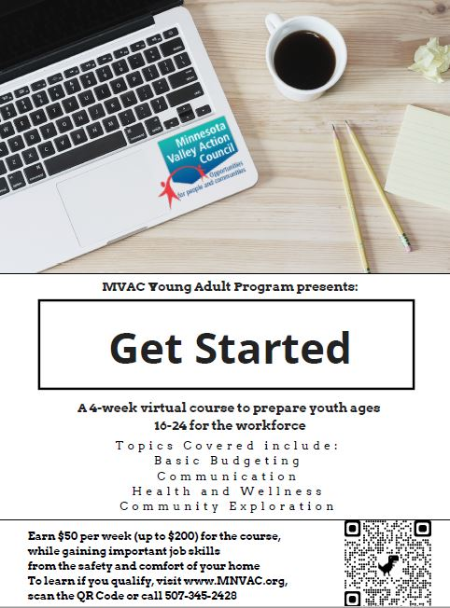
Get Started
Virtual four-week program focused on preparing youth for the world of work
Training in communication skills, budgeting, health and wellness, and community resources
Youth received a $50 stipend for each week of completed assignments, earning up to $200
Youth also learn technology skills, dependability, time management skills & build self-confidence

Slide 27

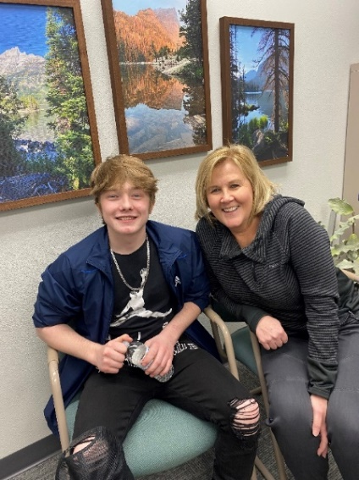
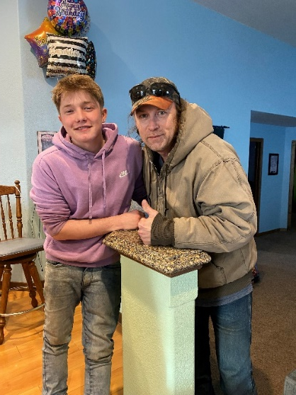
Success Story - Matt
Foster care starting at the age of 3
Moved around a lot
Entered a group home prior to turning 18
Young Adult Program
  Employment to save money to move in with his brother
    Get Started Course/Work experience
  Driver’s License
  GED
  https://flipgrid.com/s/EqcRP75W1ujj

Slide 28
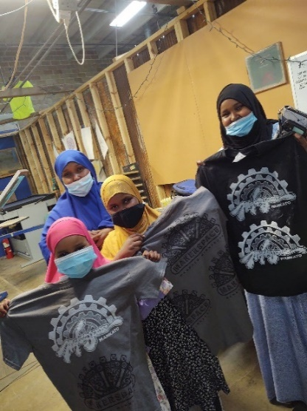
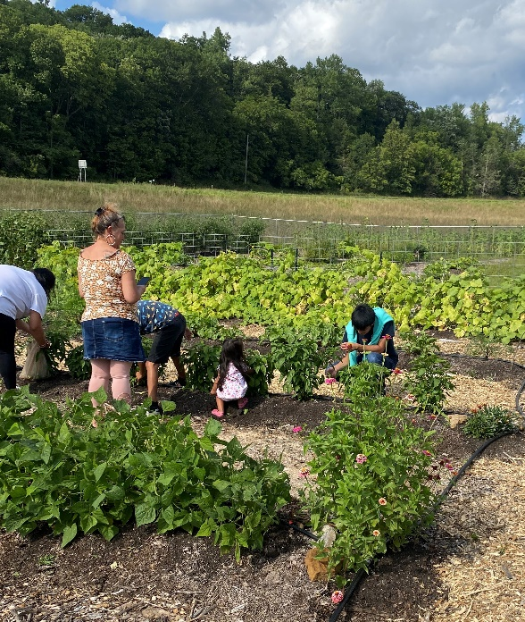
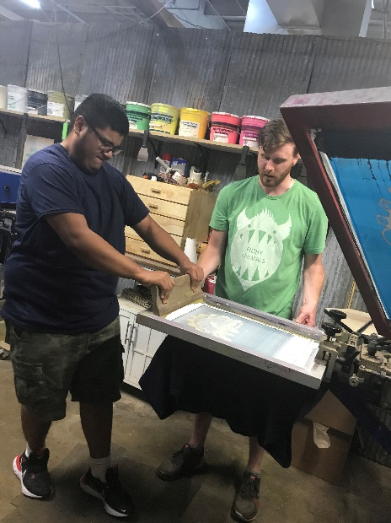
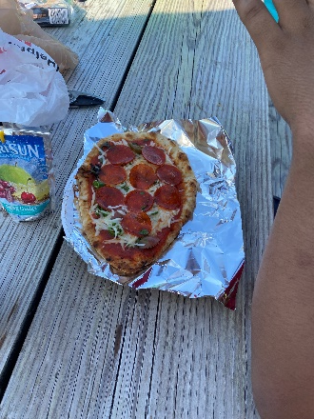
Strategies for serving at risk youth
Youth at Work (BIPOC focus)
  Invite families to meetings and events, importance of family involvement.
  Youth & family event -inspirational story from BIPOC presenter
  Worksite – Cultural Awareness training
  Social justice component
  Promote leadership opportunities

Slide 29
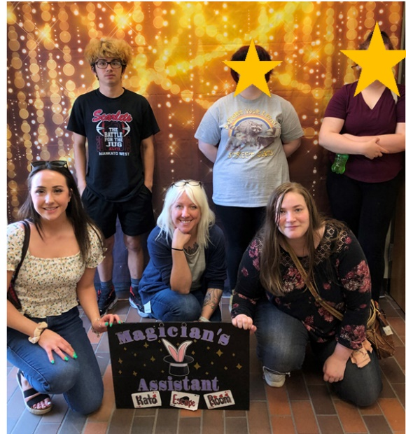
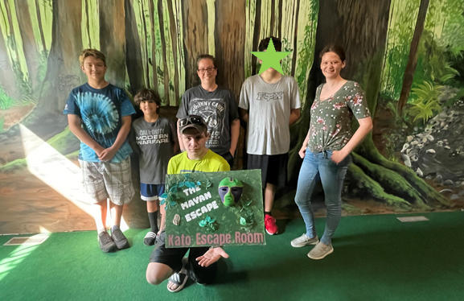
Strategies for serving at risk youth
Foster care youth
  Youth in foster care event
    Connecting with other youth
    Sharing experiences
    Team building
    Leadership skills

Slide 30
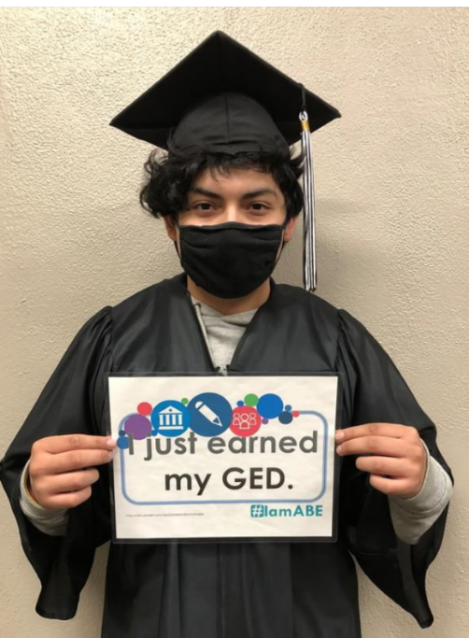
Youth Services
Assessment
  Assess education, employment, transportation, childcare, health care, legal and housing
Career Assessments: MN Careers, Vision, Dreams and Future, CAPS, COPES, COPS, MCIS/Naviance, Occupational Research Packet for post secondary training
Youth Competency System
  Basic Skills
  Work Readiness Skills – career exploration, job search, work habits, daily skills
  Occupational Skills
Cesar
Work Experience
GED
Exploring post-secondary options

Slide 31
Partnerships
Cross Referrals
Developing and building relationships between agencies
CareerForce Partners Training Day
Adult Career Pathways Networking Event
Whole Family Approach
Email distribution list
“Coming together is a beginning, staying together is progress, and working together is success.” - Henry Ford

Slide 32

TANF Youth Success Story
Referred from county case manager in November 2020
Mother of two daughters
High school drop out
Interest in finding employment & GED
Lost custody of her daughters
Chemical dependency
Attended treatment
Work experience followed by unsubsidized employment
Reunited with daughters
Earned GED in March 2022

Slide 33
How to Get Youth Connected
Visit Office of Youth Development Website for contact information of program providers: https://mn.gov/deed/programs-services/office-youth-development/
Online directory of service providers: http://apps.deed.state.mn.us/assets/youth/services/mypproviders.shtml (MN Youth Program) or http://apps.deed.state.mn.us/assets/youth/services/providers.shtml (WIOA Young Adult)
Contact DEED for assistance in locating a service provider – Lynn Douma, Youth Program Coordinator, Lynn.Douma@state.mn.us

Slide 34
Questions?

Slide 35
Thank You!
Lynn Douma, Program Coordinator
Lynn.Douma@state.mn.us
651-259-7536
mn.gov/deed/youth

