Slide 1
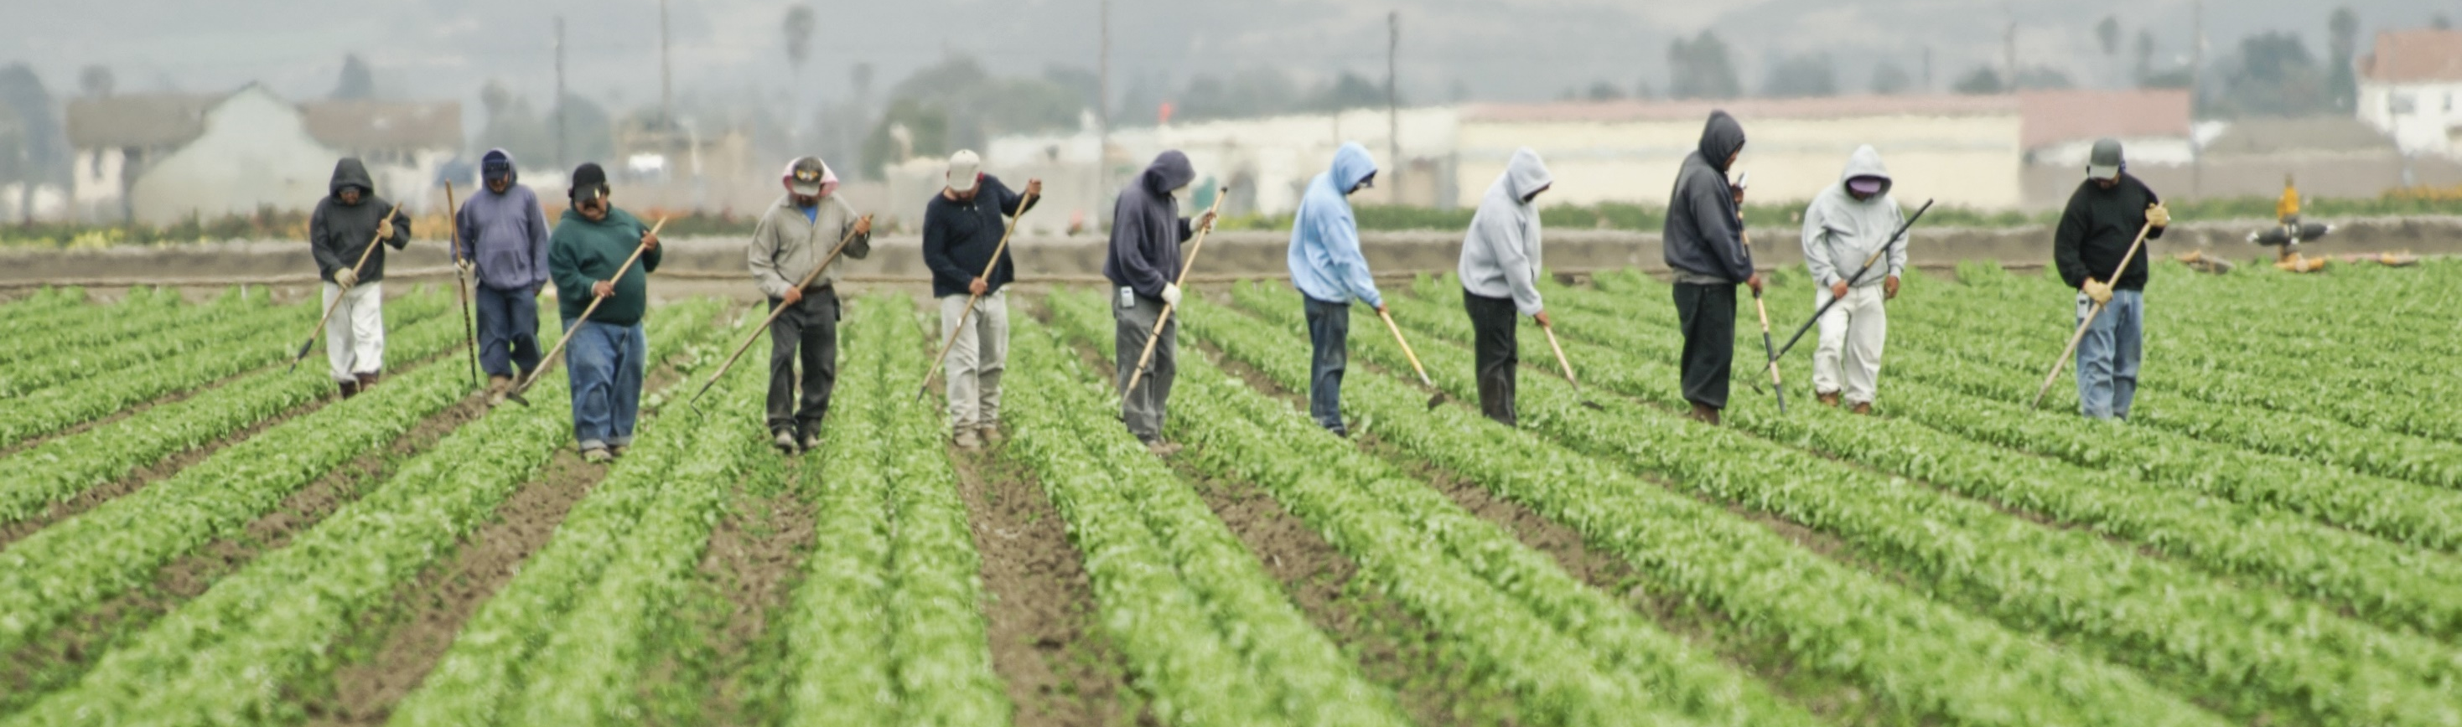
Agricultural Worker Wellness Committee
July 11, 2022

Slide 2
AWWC Membership
DEED is being filled
SMIRLs has sent name

Slide 3
Survey Results

