Slide 1
Minnesota’s Rural Electric Cooperatives
Non-Profit member-owned electric utilities;
Providing electric service in low-density, high-cost rural areas;
Where for-profit utilities won’t go.

Slide 2
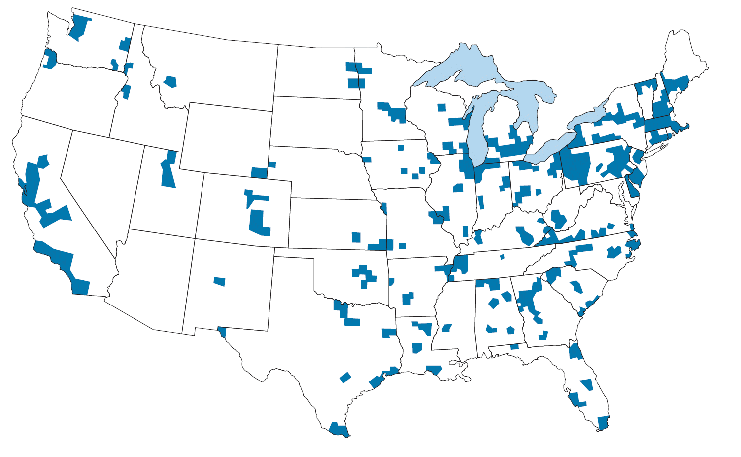
1935 – Availability of Electricity Before Co-Ops?

Slide 3
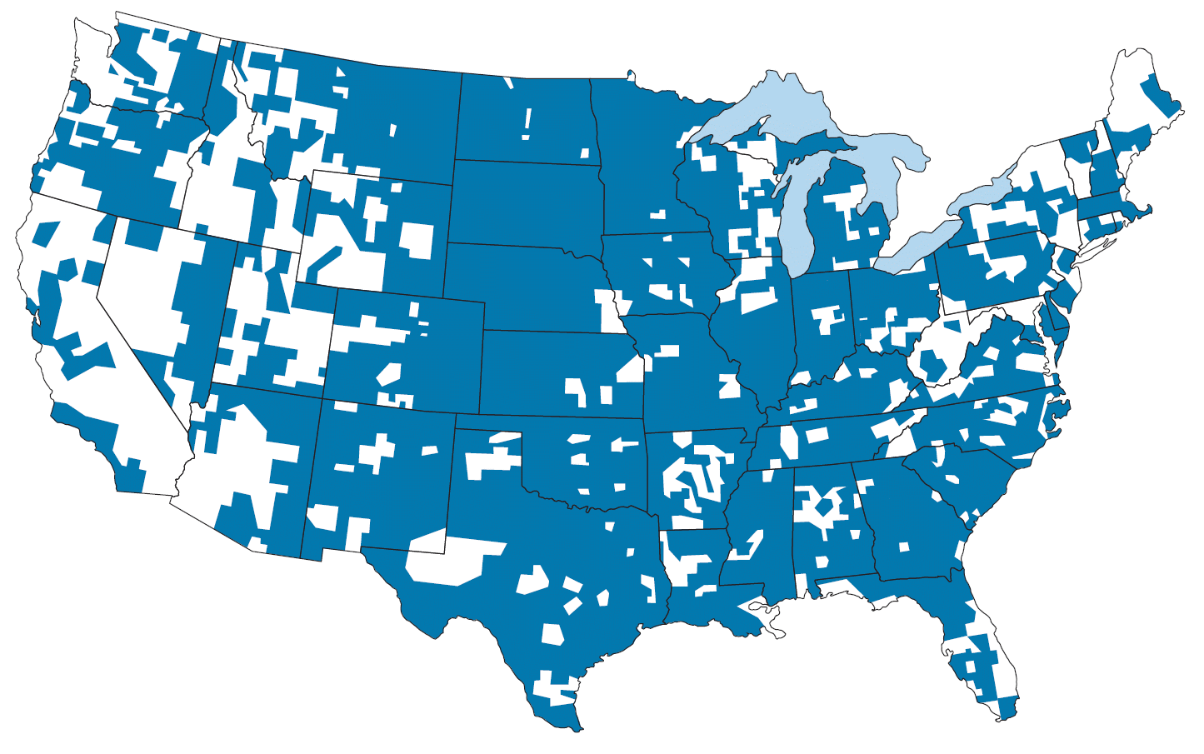
1950 – Availability of Electricity After Co-Ops

Slide 4
Who are MN’s Electric Cooperatives?
6 G&T
Co-ops
44 Distribution
Co-ops
726,000 Member/Owners

Slide 5
What Are Core Features of Co-Ops?
Member-Owned/Governed
Non-Profit/Return Any Excess Revenue
Serve Rural Areas Throughout MN

Slide 6
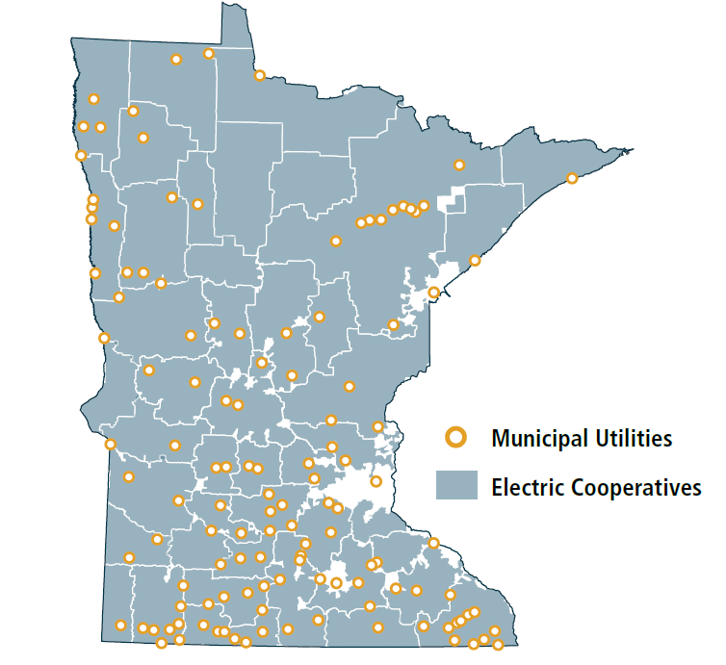
Where and Who Do Co-ops Serve?
Cover 85% of state’s land
Provide reliable electricity service to 1/3 of state’s population
Operate 135,258 miles of electrical distribution lines – more Xcel Energy, Minnesota Power & Otter Tail Power combined.

Slide 7
How Do Co-Ops Compare to Other Electric Utilities?
MN Coops
6 mem/ml
121,000 miles of distribution lines
MN IOUs
38 cust/ml
70,000 combined miles of line
MN Municipals
48 cust/ml

Slide 8
What is the Broadband Opportunity?
Opportunity: Leverage existing cooperative utility easements for broadband infrastructure in rural MN
Barrier: Uncertainty over whether co-ops can use these existing easements for broadband.
Action: Clarify in state statute that Co-ops can use these existing easements for broadband facilities/service

Slide 9
What Are Co-Ops Proposing?
Amend Section 308A.201 to include the following:
(c) A cooperative organized to provide rural electric power may, on behalf of itself, its subsidiary, or a business partner, provide broadband service by using an easement owned, held, or used by the electric cooperative. An existing easement does not limit the type, size or amount of broadband infrastructure that may be used to provide broadband service, nor is an electric cooperative required to obtain additional easements or pay additional compensation to a property owner who is party to an existing easement agreement in order to provide broadband service.

Slide 10
Have Other States Taken Action?
The following states are some of the states that have taken legislative action to make it easier for their electric cooperatives to use their easements and/or other assets to bring broadband to rural areas that are unserved or underserved:
Indiana
Georgia
Maryland
Alabama
Tennessee
Texas
Colorado
North Carolina

