Slide 1
Minnesota’s Disability Employment Initiative (DEI): Partners for Youth Career Pathways
Seventh Round of DEI Grants
August 2017

Slide 2
REFLECTION: Round Three Minnesota DEI Project
Expanding existing partnerships with state and local agencies and community stakeholders
Utilizing the National Collaborative on Workforce and Disability for Youth’s Guideposts for Success as a framework for youth assessment and coordinated service delivery
Formulating and implementing person-centered Integrated Resource Teams (IRTs)
Support from a state-based disability-focused intermediary organization (PACER Center) for:
material development;
staff development;
parent training;
community stakeholder activities

Slide 3
Goals of the DEI
Improve employment outcomes and increase the number of individuals with disabilities who earn credentials.
Provide more and diversified job-driven training opportunities.
Facilitate academic and employment transition among youth.
Incorporate flexible approaches to designing and providing training and supportive services, including customized employment strategies to help job seekers with significant disabilities.
Build effective community partnerships and collaborations across multiple service delivery systems and the effective blending and braiding of resources.
Promote more active engagement with the business sector.

Slide 4
Department of Labor (DOL)’s Support for DEI
“America works best when we field a full team, and that means making sure that everyone has access to opportunity in our dynamic economy. The grants we are awarding today will help to strengthen partnerships that ensure employers know that it is what people with disabilities CAN do that matters most.”
-Fmr. Secretary of Labor Thomas E. Perez

Slide 5
Lt. Governor’s Support of DEI
“Minnesota is forecasted to have a shortage of more than 100,000 workers by 2020. That means we can’t afford to waste any of our talent. This grant will help Minnesotans with disabilities get the training they need for good jobs in growing industries. I want to thank the Minnesota federal delegation and our partners at the U.S. Labor Department for providing this grant. We are committed to making further progress to ensure we build an economy that works for everyone, everywhere in Minnesota.”
-Lt. Governor Tina Smith

Slide 6
DEED’s Support of DEI
“Providing people with disabilities the opportunity to use their talents in a meaningful job is critical to the work we do. This funding will not only help them find employment but also give them access to the high quality of life that can come with earning a paycheck.”
- Commissioner Shawntera Hardy

Slide 7
Objectives of Minnesota’s DEI
Strengthen partnerships and strategically align youth and adult career pathways systems to effectively serve youth with disabilities through multiple entry and exit points;
Build capacity of WDA staff to support at least 300 youth with disabilities to participate in career pathways system using the Guideposts for Success best practices framework and an Integrated Resource Team (IRT) approach.

Slide 8
Objectives of Minnesota’s DEI Cont.
Utilize innovative intergenerational family support approach to promote successful outcomes for youth with disabilities participation in career pathways system and programs;
Implement specific strategies to address the state’s employment gap for individuals from diverse cultures; and
Increase the state’s number of employment networks (ENs) and the number of Social Security disability beneficiaries participating in career Pathways programs.

Slide 9
Minnesota DEI Proposal Required Elements
Youth Focus
Three implementation sites: Rural MN Concentrated Employment Program, Central Minnesota Jobs and Training Services, and Southwest Minnesota Private Industry Council.

Slide 10
Minnesota DEI Proposal Required Elements Cont.
Designate a Disability Resource Coordinator (DRC) to implement the strategic approach of the MN DEI project.
Review and upgrade programmatic and physical access to the local Workforce Centers.
Become an active Employment Network.
Identify ways to sustain successful strategies of the DEI after the grant ends.

Slide 11
Use of DEI Funds
Recruitment and Outreach
Assistive Technology
Support Services
Tuition Payments for Skill Training
Wages/Stipends for Participants
Financial Literacy
Salary and Fringe for Staff, including DRC
Partnering Activities/Meetings
Travel
Data Collection
Administration
Other, as included in the Local Plan

Slide 12
Activities to Accomplish Minnesota’s Objectives
PACER Center Activities:
Create a Individual Planning Tool for DRCs and Integrated Resource Teams to use based on The Guideposts for Success, Minnesota elements of Personal Learning Plans, and current career pathways research and practice.
Identify and refer youth with disabilities to participate in project.
Provide professional development to WDA staff.
Develop print and web resources for families related to career planning.

Slide 13
Activities to Accomplish Minnesota’s Objectives (continued)
PACER Center Activities:
Train families of youth on career pathways, SSA work incentives, employment and postsecondary planning.
Develop youth self-advocacy skills
Provide multicultural advocates and other community cultural liaisons to conduct outreach and serve diverse youth.
Develop career pathways graphics to be used on WorkForce Center websites and social media outlets.

Slide 14
Activities to Accomplish Minnesota’s Objectives (cont.)
Ticket to Work Activities:
Implementation site identification of Ticket holders (not only youth customers)
Ticket Holder agreement to assign the Ticket to DEED Employment Network (EN) or site EN
Services provided according to Individual Service Strategy (ISS) or Employment Plan
Quarterly follow-up following placement
Partnership Plus agreement with Vocational Rehabilitation Services (VRS)

Slide 15
Minnesota DEI Website
DEED Homepage
Contents:
Minnesota’s Technical Proposal and Fact Sheet
Data Sharing Agreement
DEI Partners: Contact Information
Local DEI Plans
Quarterly reports
Ticket to Work Resources

Slide 16
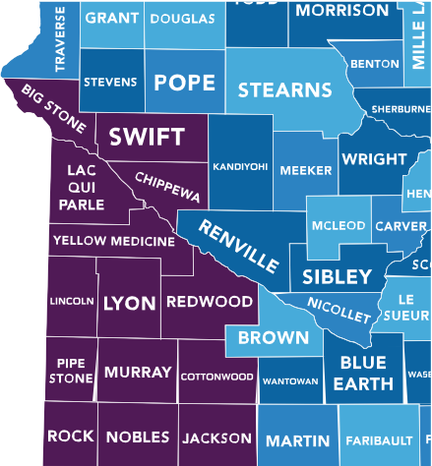
Southwest MN Private Industry Council Highlights
Creating Integrated Resource Teams (IRTs) with participants
Working on becoming an Employment Network
Serving many youth with various barriers to employment

Slide 17
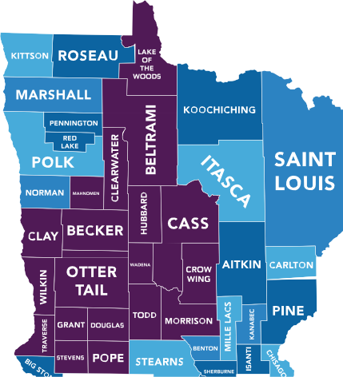
Rural MN Concentrated Employment Program Highlights
Integrating IRTs into day-to-day youth programming
Working on becoming an Employment Network
Staff successfully completed CWIC trainings

Slide 18
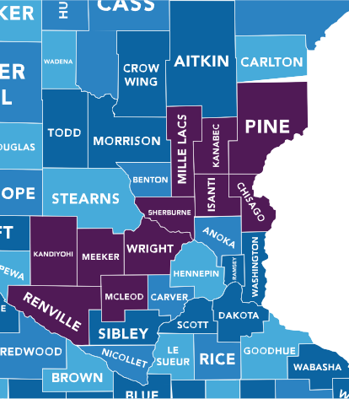
Central Minnesota Jobs and Training Services Highlights
Developing DRC training to help staff better facilitate IRTs and other service strategies for youth with disabilities.
Members of a national “Ticket Team” who provide peer support for agencies becoming an Employment Network.

Slide 19
PACER Center Highlights
Offered parent/family workshop on Guideposts for Success at a Workforce Center
Presented workshop on assistive technology
Provided staff development on Guideposts for Success

Slide 20
Contact Information
Cory Schmid– DEI Project Coordinator
Cory.Schmid@state.mn.us
Jenny Nelson – DEI Project Data Coordinator
Jenny.Nelson@state.mn.us
Lynn Douma – Ticket To Work
Lynn.Douma@state.mn.us
Kay Tracy – Director, Office of Youth Development
Kay.Tracy@state.mn.us

