Slide 1
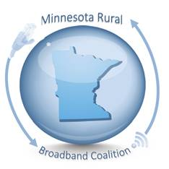
Minnesota Rural
Broadband Coalition

Slide 2
MN Rural Broadband Coalition - History
Blandin Foundation – 2015 Broadband Conference
Blandin Convened a meeting of Stakeholders for a common goal – one voice
Representatives from various industries such as health care, education, economic development, providers, business, townships, counties, cities, utilities, agriculture.
Bipartisan Representation

Slide 3
More than 90 Coalition Members
Arrowhead Health; Arrowhead Regional Development Commission; Association of Minnesota Counties; Barbara Dröher; Chisago County HRA/EDA; Citizens Utility Board of Minnesota; City of Winthrop; Clay County; Cloquet Valley Internet Initiative; Cloquet Valley Internet Initiative; Coalition of Greater Minnesota Cities; CoBank; Community of Minnesota Resorts; Community Technology Advisors Corp; Consolidated Telephone Company; Cooperative Lights; Cooperative Network; Cooperative Network Services; Development Services, Inc.
East Central MN Educational Cable Cooperative; East Central Regional Development Commission; Economic Development Association of Minnesota; EssentiaHealth; Finley Engineering; Fond du Lac Tribal Communications; GPS 45:93; Great River Energy; Greater Minnesota Partnership; Growth and Justice; Hay Creek Township; Headwaters Regional Development Commission; Hiawatha Broadband Communications; IMPACT 20/20; Institute for Local SelfReliance; Iron Range Economic Alliance; Isanti County; ISD 317 Deer River; Jody Kramer, CPA; Kanabec County EDA; Kandiyohi County Economic Development; League of Minnesota Cities
Leech Lake Tribal Telecommunications; Le Sueur County Broadband Coalition; Lincoln County EDC; Meeker Cooperative; Meeker County EDA; MidMinnesota Development Commission; MiEnergy Cooperative; Mille Lacs Energy Cooperative; Minnesota Association of Professional County Economic Developers; Minnesota Association of Small Cities; Minnesota Association of Townships; Minnesota Corn Growers Association; Minnesota Farm Bureau; Minnesota Farmers Union; Minnesota Library Association; Minnesota Municipal Utilities Association; Minnesota Public Broadband Alliance; Minnesota Rural Education Association; Minnesota Rural Electric Association; Minnesota Soybean Growers Association; MN Association of Community Telecommunications and Administrators; MN River Valley Education District; MN Rural Counties Caucus;
MN Telecom Alliance; MVTV Wireless; Neighborhood National Bank; Nemadji Research Corporation; Nobles County Economic Opportunity Network; North Region Health Alliance; North Star Township; Northeast Service Cooperative; Northland Foundation; Northwest Minnesota Foundation; NW Regional Development Commission; PCs for People; Project FINE; Range Association of Municipalities and Schools; Redwing Ignite; Redwood County; Region 5 Regional Development Commission; Region Nine Development Commission; Schools for Equity in Education; Sherburne County EDA; Sourcewell; Southern Minnesota Beet Sugar Cooperative; Southern Minnesota Initiative Foundation; Southwest Initiative Fund; Southwest Regional Development Commission; SPIRE Credit Union; Treacy Information Services; Turtle Island Communications; Upper Minnesota Valley Regional Development Commission; West Central Initiative; Winthrop EDA

Slide 4
MN Rural Broadband Coalition Our Work
The Coalition is a statewide organization that holds regular meetings to discuss the needs and priorities of Coalition members.
The number one priority is to advocate for multi-year funding for the Border to Border Broadband Program.
Vast majority of our members are from rural communities—our regular meetings are an excellent way for rural leaders to share information and network without having to wait for an annual conference or meeting.
The Coalition brings together industries or organizations that might not normally interact—EDAs, cooperatives, banking and finance, health care, agriculture, education, counties, cities, townships, and more.
Provide resources and education to members about opportunities to expand broadband in their communities
Annual Broadband Day on the Hill at the State Capitol with a full day of activities, speakers, and direct advocacy.
The Coalition engages the Legislature, Governor, agencies, and the Task Force directly on broadband funding and policy issues.

Slide 5
MN Rural Broadband Coalition Legislative Recap
2018 Legislative Session
2019 Legislative Session
2020 Legislative Session
Hire a lobbyist to advocate for funding and raise Coalition’s profile at Capitol
Not a budget year but some surplus funds were available.
$15 million included in “Omnibus Prime” supplemental budget
Vetoed by Governor Dayton, no funding for the grant program
Built strong bipartisan relationships with legislators
2018 Task Force recommended Legislature spend $70m per biennium to meet speed goals
Coalition worked with Rep. Rob Ecklund (DFL) and Sen. Mark Koran (GOP) to introduce $70m bill for 2020-21 biennial budget
Both bills were in the House and Senate top 10 bills
$40 million funded ($20m/$20m for 2020/2021)
Surplus funds may be available for supplemental budget
November Report: $1.3 billion surplus, will be reassessed in February
$70m recommendation, $70m bill in 2019, Office of Broadband receives $70m in applications, only $40m funded
$30 million funding gap

Slide 6
MN Rural Broadband Coalition 2020 Funding Goal
Goal: The Minnesota Rural Broadband Coalition and its supporters request the 2020 Legislature to fund the Border- to-Border Broadband Development Grant program with $30 million base funding in the 2020 supplemental budget to achieve the state’s 2026 broadband speed goal of 100 megabits per second (Mbps) download and 20 Mbps upload. Consistent and stable funding of the grant program is important to allow economic development agencies, local governments and others to be creative and collaborative in their approach to providing broadband services to these areas.

Slide 7
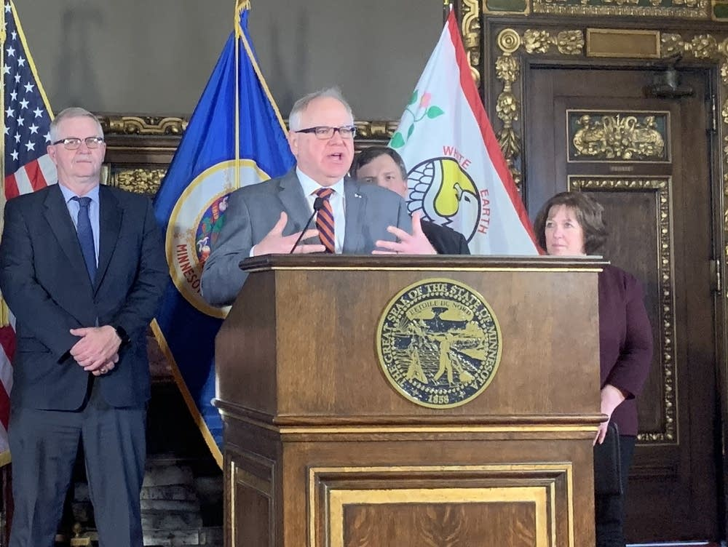
Governor Walz Announces Broadband Grants

Slide 8
MN Rural Broadband Coalition 2020 Funding Goal
2020 Funding Bill Authors
House: Representative Rob Ecklund (DFL-International Falls)
Senate: Senator Rich Draheim (R-Madison Lake)
Bill will be introduced on February 11th, first day of the 2020 legislative session
Committees:
House: Greater Minnesota Jobs and Economic Development Finance Division
Chair, Representative Gene Pelowski (DFL-Winona)
Senate: Agriculture, Rural Development, and Housing Finance
Chair, Senator Torrey Westrom (R-Elbow Lake)
Final goal: inclusion of $30 million for broadband in the 2020 supplemental budget bill

Slide 9
MN Rural Broadband Coalition Policy Work
The Coalition introduced a policy bill in 2019
Included two major items:
Changes to the challenge process
Adjusting the 50/50 grant match
After working on it for several months, the Coalition thought a larger conversation about broadband policy that included more stakeholders was necessary—didn’t pursue the bill further in 2019
The Coalition won’t be pursuing a policy bill in 2020 but will weigh in and provide feedback as policy items come up at the Legislature or the Task Force

Slide 10
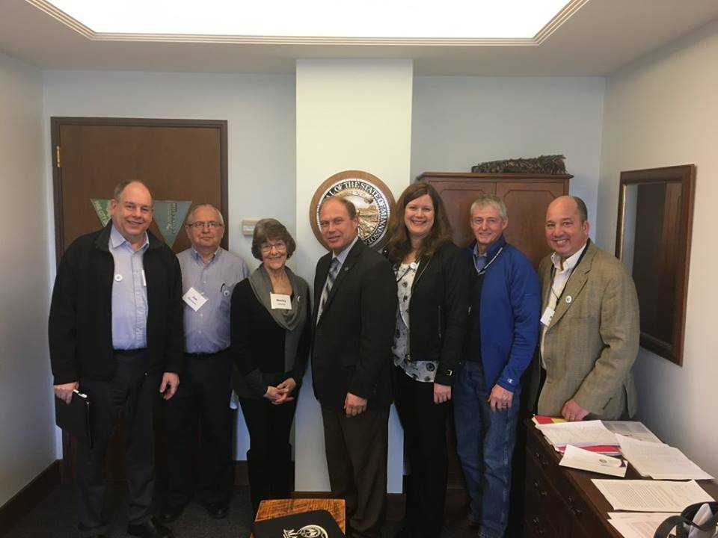
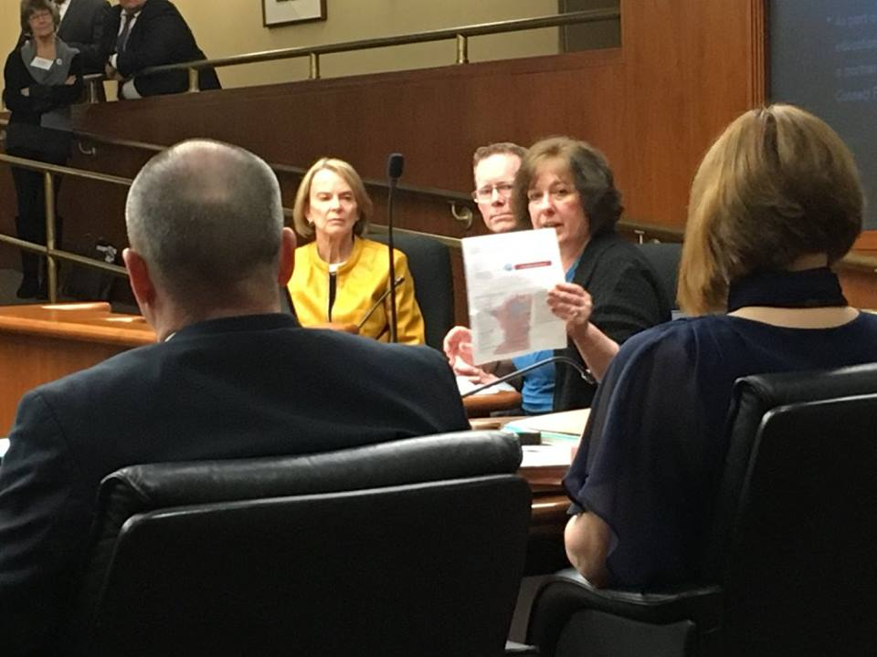
Broadband Day on the Hill – March 12
Broadband Day on the Hill
House – Job Growth and Energy Affordability and Finance Taxes

Slide 11
On Behalf of the MN Rural Broadband Coalition Thank you.

