Slide 1
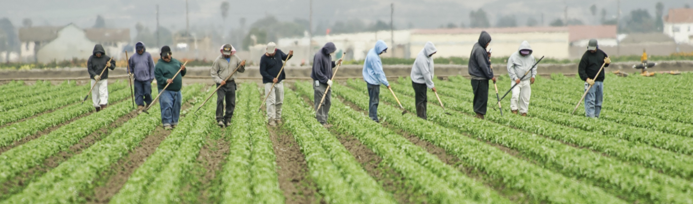
Seasonal Agricultural Worker Cross-Agency Workgroup
Susan Bishop, Migrant Seasonal Worker ICS Response Lead, MDH

Slide 2
What is it?
Formed in Spring of 2020 in response to pandemic
Cross Departmental members based on connection to agricultural workers
Evolution of the work from formation to Governor’s Committee
MDH
DEED
DLI
MDA
DHS
LPH
Employers
Community Orgs
Notes:
An interdepartmental team convened in hopes of preparing for the upcoming season – the team included DEED, MDH, DLI, MDA. During the chaos of the pandemic, members of the team frequently changed.
In the first few months, we tried to get our hands around the migrant seasonal farmworker universe - we learned about some of the gaps and disjointedness inherent in the migrant and seasonal farmworker system. We learned
Housing is treated differently – some is employer provided, in some cases, workers find housing in communities. Some housing camps are inspected by the health department; some are inspected on a complaint basis by Fed. DOL Wage and Hour division.
Workplace conditions –
Data on migrant farmworkers is difficult to come by and not sure of its reliability
Problem solved for specific instances during COVID
We found that services/assistance for MSFWs were not seamless even before COVID
As we neared the end of summer and continued to discuss next steps, the team decided that proposing a Governor’s Committee might help with the following season as well as address gaps in the system regardless COVID
And so the initial concept of the Governor’s Committee on the Safety, Health, and Wellbeing of Agricultural and Food Processing Workers was drafted.
MDH identified migrant seasonal agricultural workers as a priority focus population early in the response because of their essential role in the MN agricultural industry and the high risk of COVID-19 transmission among workers in both working and housing environments.

Slide 3

Accomplishments
Employer connections
Brick walls – recognition of gaps
Connection across silos and stakeholders
Governor’s Committee formation
Notes:
Employer Connections: In May 2020 and April 2021, we held an agricultural employers forum pertaining most specifically employers of foreign workers (H2A visas) and migrant seasonal farmworkers
Provided resources and sounding board. Distributed guidance to employers, created connections between MLRs and MDH, in 2021 connected employers to vaccine resources.
Brick Walls: early in the pandemic, we thought we could propose an EO for worker safety and protections, or a rule-making process through MNOSHA like other states had done, Oregon (rule-making for social distancing, worker pods, etc..), and California (an Executive Order for agriculture. With help from DLI we learned that our state couldn't do that. We focused on guidance from MDH, and staying connected between agencies, and emergency responses for outbreaks.
Connection across silos and stakeholders: we settled into a regular pattern of meeting and a (relatively) consistent set of attendees, and we all better understood the role of each agency and each of us. We developed working relationships and each of us was connected to other key stakeholders, and could report out at our meetings. We shared up to date information on outbreaks as they happened and kept the Gov's office, DLI, community groups and local public health in the loop with what we knew.
Governor's committee formation: it was clear that no single agency could take the lead on migrant worker safety during COVID, and it was clear that some of the limitations of programs and services was happening, regardless of COVID, and we wanted better alignment and understanding from our agencies. So we had the idea of a working group to identify barriers and gaps and to ensure more coordination between agencies and with other key stakeholders.

Slide 4
Brick Walls and Sink Holes: Barriers
Agency barriers
Diffuse authority
Limited enforcement
Limited data
Coordination across sectors Communication
Workers issues
Housing
Working conditions
Communication
Medical care and costs
Lost wages
Clear COVID guidance
Rapidly changing information
Worker shortage
COVID safe transportation
Employer concerns
Notes:
The barriers that our working group encountered along the way are basically all the issue areas that came up during the survey that AWWC members completed.

Slide 5
Supporting AWWC – Building Doors and Bridges
Potential of the Seasonal Agricultural Workers Cross Agency Group
Formal link between AWWC and SAWCAG
Would maintain consistency in the work as a bridge from ad hoc response to an established communications channel, improve cross-agency coordination
Helps to meet 2 objectives in EO:
Design a proactive strategy to deploy public, private and nonprofit compliance resources to protect and promote health, safety, and wellbeing.
Develop a communications system between agencies, employers, workers, their families and communities, community organizations, advocacy groups, etc.
Notes:
What now for the seasonal agricultural workers working group? Our focus has shifted to vaccinations and planning with communities and employers and local public health for clinics. Thank you to the many people on this group who played a big part in successful vaccination campaigns.
With the Governor's emergency powers coming to an end, many Governor's office staff and staff at other agencies are transitioning back to previous roles. Some other cross-agency working groups established through the Governor's office have stopped meeting and are writing final reports about what they did. (The Community Resiliency and Recovery working group, for example, Maureen served on, maybe you know others.)
We (the working group members) still find it valuable to meet together, and lately have been focused on vaccines, and on the AWWC. We think our work together continues to have value, and we are asking the AWWC if you agree and if so, would you recommend that our cross agency working group be continued, and support the work of the AWWC.
We likely need to ask for a motion and resolution for this.

Slide 6
Questions for Discussion
How can the working group better partner with community groups and employers to build bridges? To communicate better?
What else do you wish you knew about interagency coordination and communication? What experiences have you had with state agencies in these areas?
Do you have examples of good coordination across agencies or in complex situations? Who else can we learn from?
From our survey results:
“Minnesota has good laws, agencies, and personnel policies, we should make sure those are known, understood, and working (or not) before devising new ones.”
“If current laws aren't working, perhaps the gap isn't in policy it's in process, procedure, and community. The companies, the communities, and the workers (and our industry) should be motivated and excited to solve the issues and build a stronger pipeline of workers."
Notes:
The cross agency working group has been meeting weekly, and sometimes includes community group and non-state entities, including some folks here. We'd love to have a discussion about how we can use the working group to improve communications and outreach, and cross-agency coordination. Here are a few quotes from our survey results on this topic.

