Slide 1
Energy Transition Advisory Committee
City of Cohasset & Virtual - September 27, 2022
Impacted Community- Coal Plant

Slide 2
1) Organization
Call to order
Roll call

Slide 3
Agenda
Call to Order and Roll Call
Welcome by Itasca Economic Development Corporation, President Tamara Lowney
Presentation by Brett Schwartz, NADO
Presentation by Josh Skelton, MN Power
Approve August 30, 2022 Minutes – Roll Call vote
Draft Plan Presentation – Consensus to move forward
Consensus to move forward
Next steps
Survey Analysis Team
August Stakeholder Survey Analysis
ETAC Draft Plan Stakeholder Survey and survey dates - Consensus
Old Business Discussion
Public Comment
Old Oak Park Heights APA Award – Congratulations!
Next Meeting – October 25, 2022 at 11am, Prairie Island Native American Community
Adjourn – Roll call vote

Slide 4
2) Welcome by Itasca Economic Development Corporation, President Tamara Lowney
Population
Impacts
City Planning for the Power Plant transition
Words of Wisdom
Notes:
Tamara

Slide 5
3) Presentation
Brett Schwartz, Associate Director
National Association of Development Organizations

Slide 6
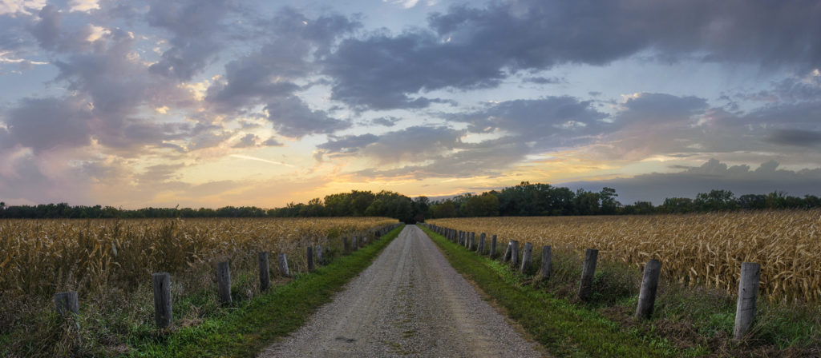
Presentation to the Minnesota Energy Transition Advisory Committee
Brett Schwartz, NADO Research Foundation
September 27, 2022
Region Nine Development Commission

Slide 7
The NADO Research Foundation provides education, research, and training designed for RDO executive leadership, staff, and policy board members. It examines new and innovative practices in regional development and strives to improve the organizational and professional capacity of regional development organizations and their partners.
NADO provides advocacy, education, research, and training for the nation’s regional development organizations (RDOs). NADO and its members promote regional strategies, partnerships, and solutions to strengthen the economic competitiveness and quality of life across America’s local communities.
www.NADO.org

Slide 8
Regionalism Works
Regionalism is a committed effort to improve communities through increased coordination and collaboration, maximizing efficiency through united approaches while preserving individual aspirations.
Steve Etcher, Former Executive Director, Boonslick Regional Planning Commission (MO)
New River Valley Regional Commission (VA)

Slide 9
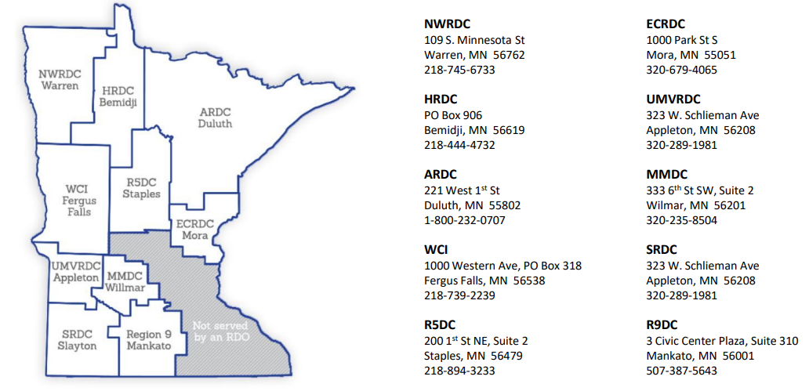

Slide 10
National Resources for Energy Communities
https://energycommunities.gov/
www.cedscentral.com
www.naco.org
https://eda.gov/arpa/coal-communities/
https://smartgrowthamerica.org/nuclear-closure-assistance/
www.diversifyeconomies.org

Slide 11
Resilience: The ability of a region or community to anticipate, withstand, and bounce back from shocks, disruptions, and stresses including:
Weather-related disasters or hazards / Impacts of climate change
The closure of a large employer or military base
The decline of an important industry
Changes in workforce / effects of automation
COVID-19 response & recovery
Much more…

Slide 12
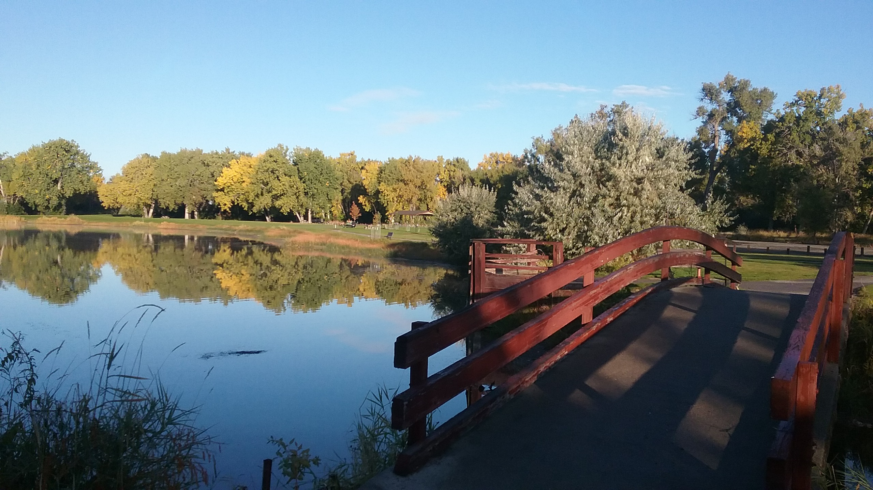
Not Just Bouncing Back…Bouncing Forward
“Another way of looking at resilience is the ability not only to bounce back but also to “bounce forward” - to recover and at the same time to enhance the capacities of the community or organization to better withstand future stresses.”
- Urban Land Institute – After Sandy

Slide 13
Places that successfully diversify their economy tend to…
Leverage state, federal, private resources
Not Just $$
Continuously seek resources to close gaps
Maintain and Build Local Capacity
Among staff and community leaders
Incorporate a broad array of perspectives
Think regionally
Look and work beyond their own silos (Traditional ED v. Other ED approaches)
Slide courtesy of Erik Pages, EntreWorks Consulting

Slide 14
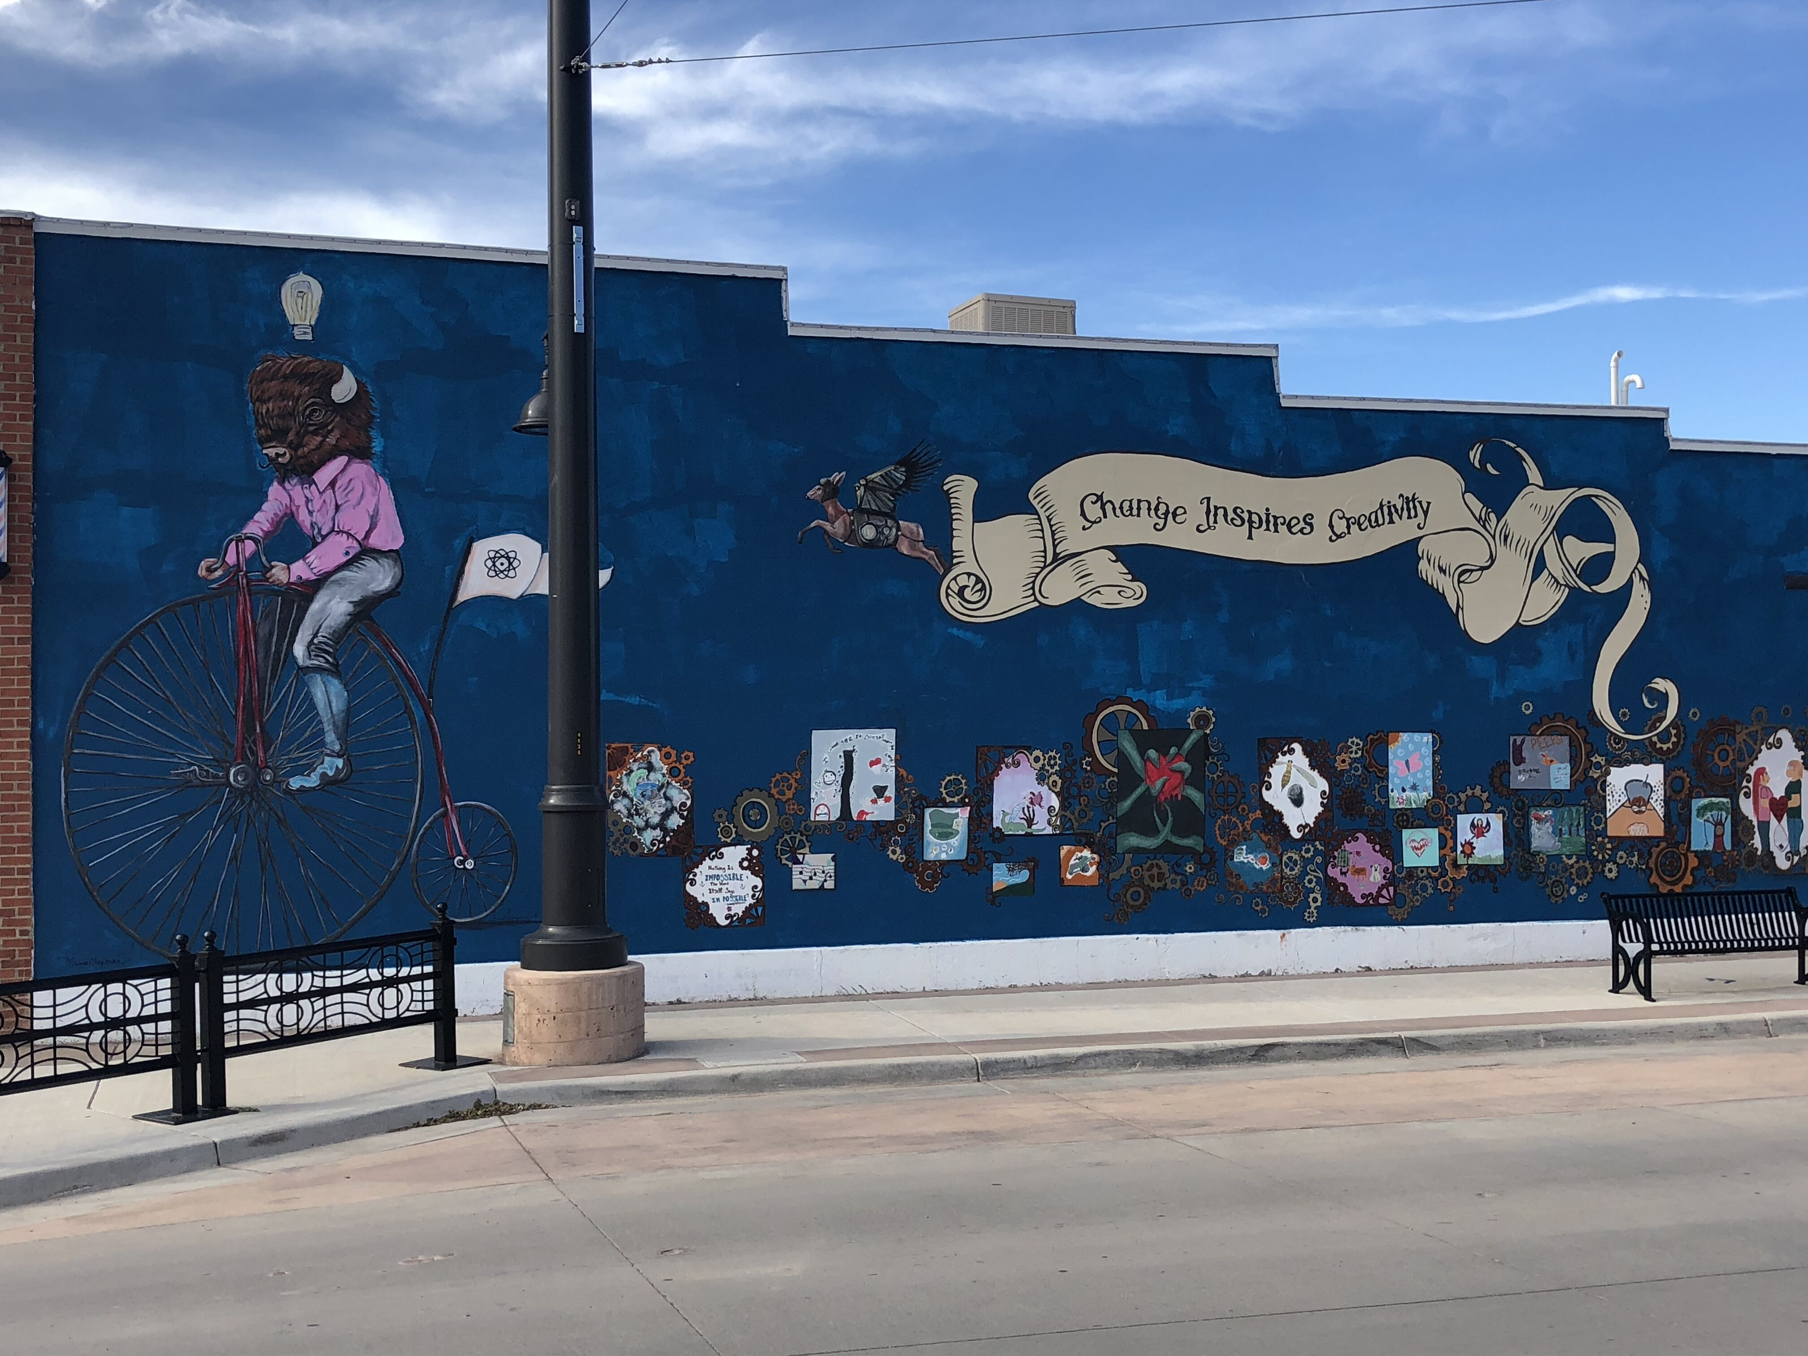
Change Inspires Creativity

Slide 15
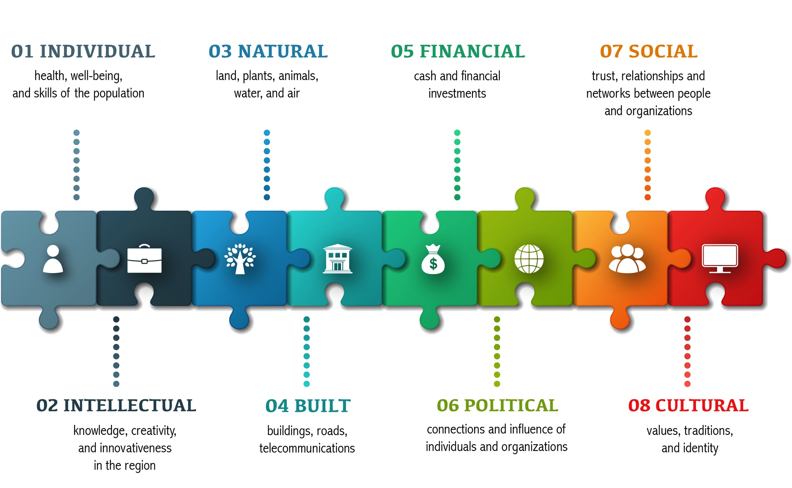
Explore Multiple Forms of Wealth in Your Region
All Forms of Capital Are Needed for a Resilient Region!
Graphic credit: Rural Development Initiatives

Slide 16
Key Actions to
Support Economic Diversification
Cooperate
Observe
Adapt Leverage

Slide 17
The Cheat Sheet: Final Thoughts
No Secrets!
Communications and transparency are vital to create community trust and attract investment.
Execute in the Short-term/Plan for the Long-term.
Effective short-term plans to “stop the bleeding” build local trust and buy-in for longer term efforts. Early wins help!
Hit for Singles, Not Home Runs.
Immediately serving affected workers is necessary. But, the goal must be to diversify local/regional economies.
Do It Yourself!
While federal and state governments may provide resources, the future of the region belongs to its residents.
Regionalism works.
Economic activity does not respect political boundaries – neither should economic adjustment activity.
Thinks Assets, Not Gaps.
Assess full range of local assets and build strategies to catalyze them.
Slide courtesy of Erik Pages, EntreWorks Consulting

Slide 18
Brett Schwartz Associate Director NADO Research Foundation
bschwartz@nado.org
www.NADO.org www.CEDSCentral.com

Slide 19
4) Presentation
Josh Skelton, Chief Operating Officer
MN Power

Slide 20
5) Approve August 30, 2022 Minutes
Approval for the August ETAC meeting is requested.
Roll call vote

Slide 21
6) Draft Plan Presentation
a) Review the draft ETAC plan & Consensus to move forward
b) Next Steps

Slide 22
6) Draft Plan Presentation
Next Steps – Detail:
Sept 27 – rough draft ETAC consensus to move forward
Sept 28 – Stakeholder Survey out
Oct 6, 4pm - Stakeholder Survey input concluded
Oct 10 – Stakeholder Survey Committee meets, analyzes and submits info to Task Forces
Oct 11 to 14 Task Forces review results; make any modifications to their portion of plan
Oct 17-19 – final draft review with writing committee
Oct 21 – ETAC Packets out with final draft of ETAC plan
Oct 25 –ETAC mtg final plan consideration
Post Oct 25 – DEED Comms put report in a user-friendly format, copy editing complete. Release of the report.

Slide 23
6) Draft Plan Presentation
Consensus to move the draft plan forward

Slide 24
7) Survey Analysis Team
a) August Stakeholder Survey Analysis
b) ETAC Draft Plan Stakeholder Survey and survey dates - Consensus

Slide 25
8) Old Business/Discussion

Slide 26
9) Public Comment

Slide 27
10) Oak Park Heights APA Award

Slide 28
11) Next Meeting
October 25, 2022 at 11am
Virtually and at
Prairie Island
Native American Community

