Slide 1
Partnerships to Grow Broadband

Slide 2
The Start
2021 Formation of SLC Broadband Grants
County Planning Grant: Up to $25,000 to assist communities with planning for and securing funds for broadband infrastructure
Ex: Feasibility Studies, engineer plans, surveys
County Infrastructure Grant: Up to $400,000 to assist communities with financing broadband infrastructure
Ex: Materials and labor for installation

Slide 3
The Partnership
The Broadband Roadshow
Meet with communities to educate and guide them through the process
Match maker with service providers. Ultimate goal of service providers applying for Border-to-Border funding to build infrastructure.

Slide 4
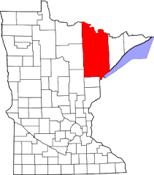
The Struggle
Size: Encompasses 6,860 square miles
Larger than three states: Rhode Island, Connecticut, and Delaware.
Households: 88,360 residential locations
Density: 13.1 people per square mile
Terrain: Rocky terrain, many lakes, and abundant forests
Rural: Small rural communities do not have funds to put towards project
Cost to construct is high
Source: www.census.gov

Slide 5
The Progress
Successful projects need multiple funding sources to get off the ground:
IRRR - SLC – DEED - Service Provider Investment
Cumulative Allocations
Planning Grant: $75,000
Ex: Pike Township $4,300 for a feasibility study
Infrastructure Grant: $1.36 million
Ex: Rice Lake/CTC $400,000 to connect 219 locations
Households/Businesses Assisted
931

Slide 6
The Road Ahead
23,734 households without access
Estimated cost $227 million to serve all
Low-Density Pilot
Pilot needs to continue
Continue to foster great relationships with services providers expanding in the area

Slide 7
Questions?

