Slide 1
AT&T’s Network Investments for the ‘Big Game’
Presented by Paul L. Weirtz
President, AT&T Minnesota
February 8, 2018

Slide 2
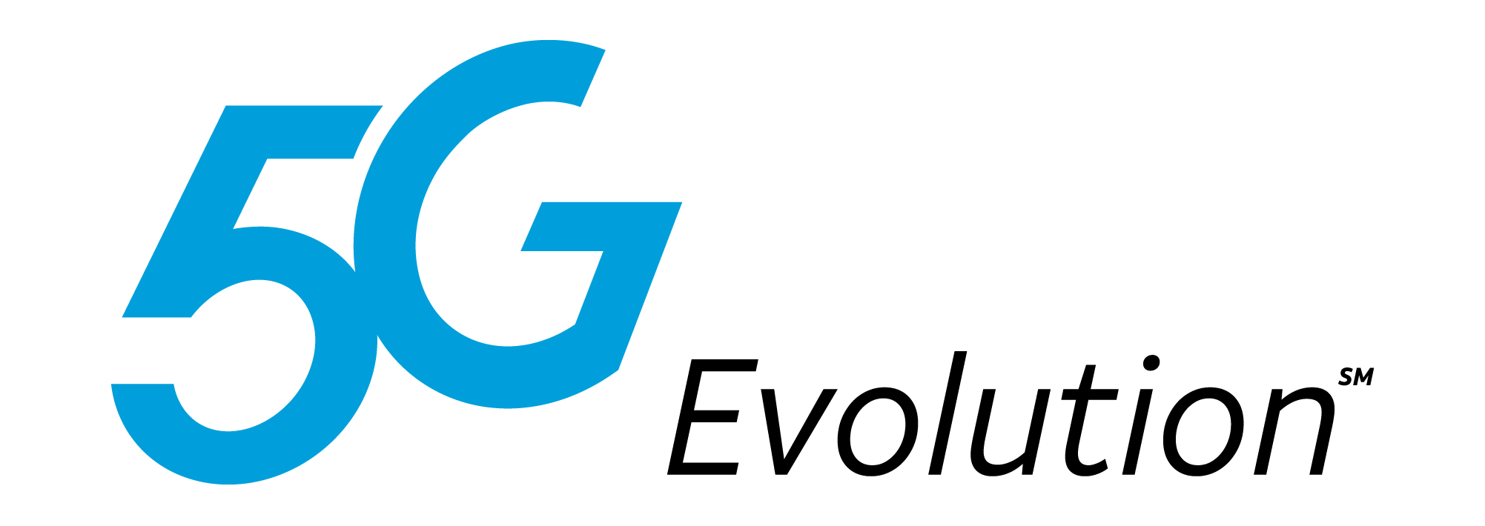
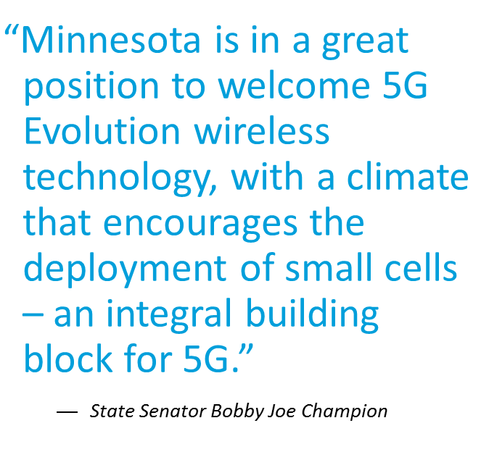
5G Evolution
AT&T launches 5G Evolution in Minneapolis in time for Big Game.
  AT&T is providing 5G evolution speeds -- its latest network technology -- in some parts of Minneapolis, including areas near the host stadium.
  When announced, Minneapolis was just the 3rd announced 5G evolution market for AT&T in the country besides Austin and Indianapolis.
  5G Evolution means ultra-fast wireless speeds.
  5G Evolution offers customers a taste of the future of entertainment and connectivity on their devices.
  Truly wireless solution, take faster speeds on the go
  Small cells are an important ingredient for both 5G evolution and the path to 5G.
  This is a major step on our journey to deliver standards based 5G mobile networks as soon as late 2018.

Slide 3
The future of 5G
Next Generation Mobile Network
  5G Evolution is laying the foundation for mobile 5G.
  5G simply stands for fifth generation and refers to the next and newest mobile wireless standard.
  AT&T expects to be the first U.S company to introduce mobile 5G service in a dozen markets by late 2018.
  5G will mean faster speeds and lower latency.
  5G will transform the way you work, play and enjoy entertainment.
  5G promises to take people places they’ve never been by unlocking new experiences like augmented realities, virtual presence, driverless cars, telemedicine, and connected homes.
  Customers will see much lower latency on 5G networks. Lower latency means customers will be able to click a button and see instant action in an online game.
“5G’s promise of greater speed and overall network performance brings huge opportunities.”
  John Donovan, Chief Executive Officer, AT&T Communications

Slide 4
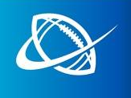
Network Investments
AT&T invests more than $40 million in wireless network in Minneapolis & Twin Cities for Game Day & Beyond.
  To prepare for the Big Game and beyond, AT&T has made significant network investments in and around downtown Minneapolis and the Twin Cities, as well as at the host stadium.
  We’ve been working for over a year to boost the network in Minneapolis for the Big Game. We’ve done this through a series of permanent and temporary upgrades across the city.
  Over the past year, AT&T has invested over $40 million in our network – including 122 additional new or enhanced cell sites in Minneapolis, St. Paul and Bloomington areas.
  We’ve made significant upgrades to the DAS at the host stadium. It now provides nearly 220% more LTE capacity than fall 2017.
  We’ve placed over 800 antennas in the stadium.
  We deployed 10 temporary Cell on Wheels (COWS) throughout Minneapolis.
  We’ve also upgraded or installed new DAS at 16 locations throughout Minneapolis area, including hotels, arenas, airports and convention center.
These network enhancements in Minneapolis won’t go away after the Big Game.
They’re permanent and will continue to benefits customers beyond February.

Slide 5

Selfies Soar at the Big Game
The Big Game breaks big records on AT&T’s network.
  Football fans used more than 50 Terabytes (TB) of mobile data at game-related events between Jan. 27 – Feb. 4 in the Minneapolis area.
  That’s the equivalent of streaming all the halftime show songs on repeat for over 15,000 hours.
  From kickoff to the halftime show to the final play, fans used over 7.2 TB in and around the stadium. That’s equal to over 20.6 million super selfies from the stands.
  We saw more than 218 GB of data traffic cross our mobile network during DIRECTV NOW’s Super Saturday Night concert. That’s equal to streaming a Jennifer Lopez song for more than 12 days non-stop.
  AND this season, total data usage jumped from 211 TB to 263 TB, a 25% increase from last season. 263 TB is enough data to fill 8,200 smartphones. That many smartphones would stretch across more than 12 football fields.
Football fans used more than 50 Terabytes of mobile data during the week-long events.
Fans used over 7.2 TB in and around the stadium during the Big Game. That’s equal to over 20.6 million selfies.

Slide 6
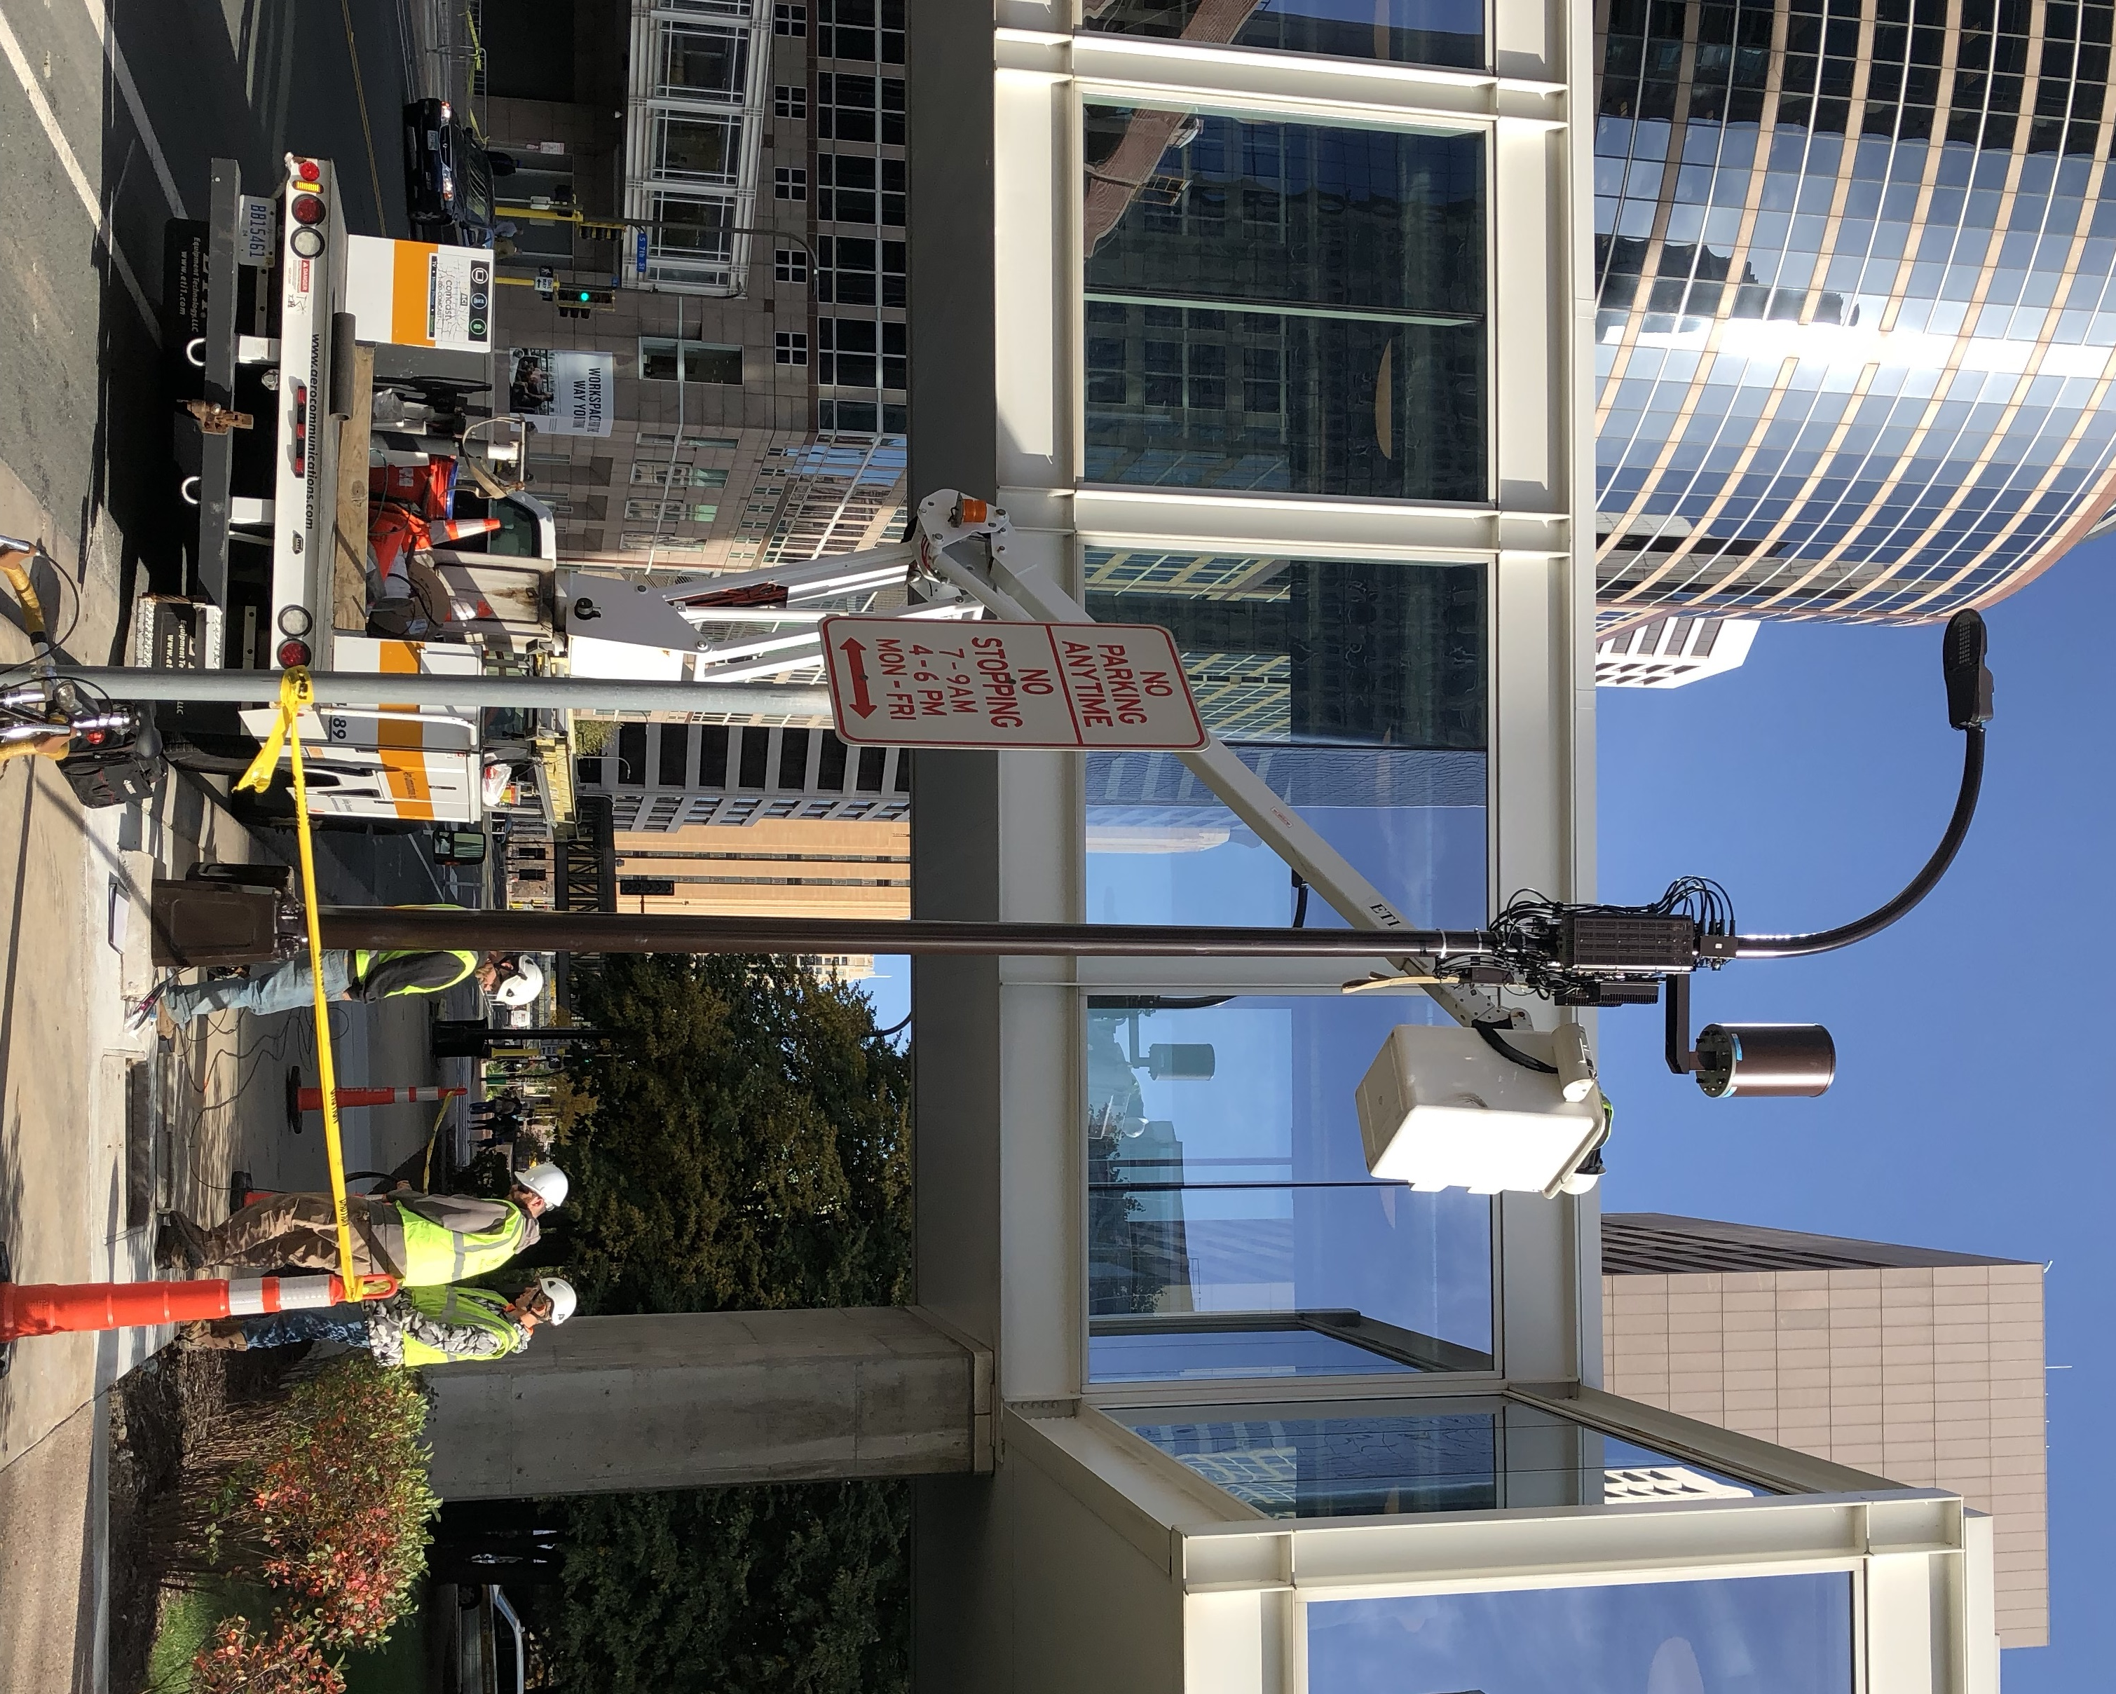

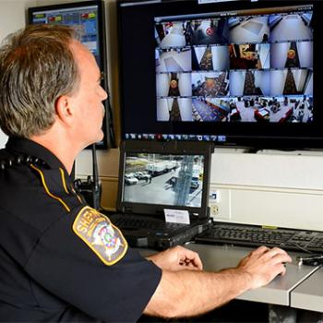
What is coming for 2018
AT&T plans to continue its network investments across Minnesota in 2018.
  Thanks to its continued investment, AT&T has the most wireless coverage in Minnesota.
  The company will continue its investments in Minnesota in the following ways in 2018:
  Network investments focused on expanding capacity and speed at sites throughout Minnesota.
  Continuing to expand areas in the Twin Cities with 5G Evolution speeds.
  Deployment of additional small cells in Minnesota. AT&T has already installed a number of small cells in Minneapolis, and we plan to add more in the coming months Minneapolis and other communities.
  FirstNet: AT&T will continue its work to build, operate and maintain a highly secure wireless broadband communications network for MN’s public safety at no cost to the state.
First AT&T small cell installed in downtown Minneapolis in October 2017.
High-speed, nationwide wireless broadband network dedicated to public safety.

