Slide 1
COVID-19 Vaccine Roll Out Food and Agriculture Workers
Edwin Torres | COVID-19 Vaccine Outreach Director
5/17/21

Slide 2
Every Minnesotan Age 16 years and older is eligible to get their shot

Slide 3
Agriculture workers
Who: Approximately 20,000 people working on large and small farms as owners, employers, seasonal, migrant, and guest workers
Progress: Gathering information on arrival of, and needs of workers from employers, migrant labor representatives, and community organizations that serve migrant families.
Primary Approach:
Identify employer and community site opportunities to offer vaccines
Conduct community outreach efforts modeled on Food Processing vaccine strategy
Targeted Strategies:
Tailored strategies for seasonal, migrant, and foreign Ag workers
Utilize the Mobile Vaccine units to target hard to reach populations

Slide 4
Map of Seasonal, Migrant and Foreign Worker Agriculture Sites

Slide 5
Vaccine Equity Update
5/17/21

Slide 6
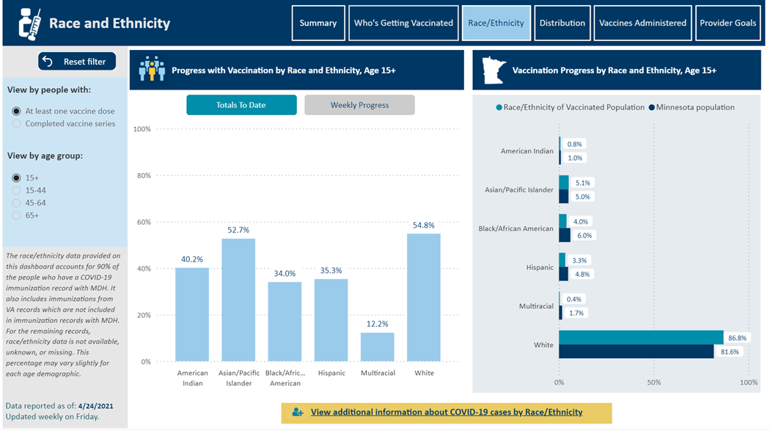
MN Vaccination by Race & Ethnicity

Slide 7
MN Vaccination by Race & Ethnicity

Slide 8
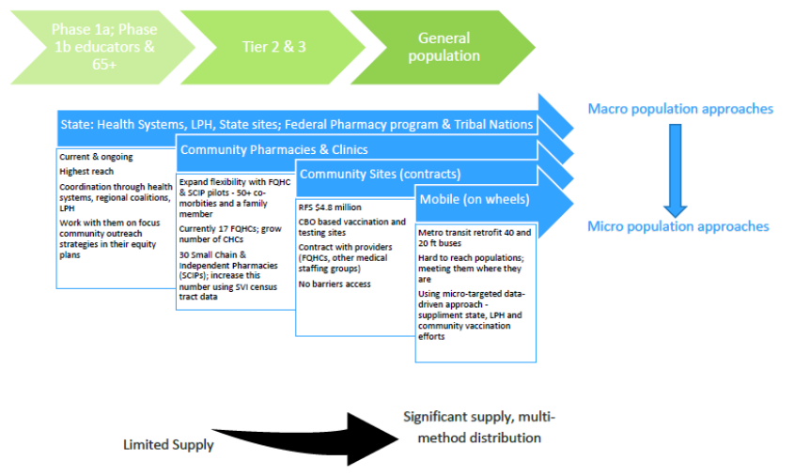
Vaccine Access
Notes:
The mobile vaccine units that MDH is working on implementing is a new category of provider and we are currently seeking weekly capacity estimates for them. The capacity estimate for these units is eight buses at 200 doses per bus per day for 5 days a week.
The remaining health care is independent hospitals and clinics that are not affiliated with one of the big 10 health care systems. This data is difficult to break out.
The remaining pharmacies are independent pharmacies that are not affiliated with the big 10 health care systems or the big pharmacy chains. This data is difficult to break out.
The state sites estimate is assuming 6 metro sites at 9000 doses per week and 6 greater MN sites at 2000 doses per week.

Slide 9
Vaccine Access Equity Framework Goals
Define and Track Equity-Focused doses
Set goals for Equity-Focused doses
Coordinate and help target equity efforts across the state

Slide 10
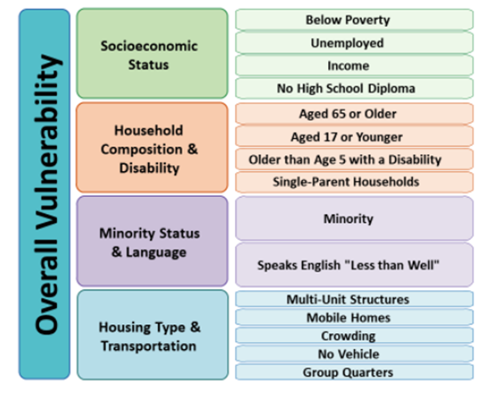
The Social Vulnerability Index

Slide 11
Define an Equity Metric
MDH Recommendation: Use CDC’s Social Vulnerability Index (SVI total theme) Metric combined with immunization uptake data to guide our equity strategy and allocation.
The initial strategy with this metric will focus on High SVI Zip Code areas (defined by quartiles) with low immunization rates

Slide 12
Demographics of MN SVI Zip Code Quartiles
 | Q1 SVI (High) | Q2 SVI | Q3 SVI | Q4 SVI (Low)
Race/Ethnicity
American Indian or Alaska Native | 57% | 22% | 11% | 10%
Black or African American | 55% | 20% | 15% | 10%
Hispanic or Latinx | 47% | 22% | 17% | 14%
Asian or Pacific Islander | 41% | 18% | 19% | 23%
White | 18% | 23% | 28% | 30%
Multiple | 31% | 23% | 23% | 23%
Other | 28% | 23% | 24% | 24%
Other Characteristics
Limited English Proficiency | 62% | 17% | 12% | 8%
Living with Disabilities | 31% | 26% | 24% | 19%
MN Medicaid MA/MNCare enrollees | 43% | 23% | 17% | 15%
Total Population | 29% | 22% | 22% | 26%

Slide 13
Statewide COVID-19 Burden by SVI Zip Code (as of 05/03/2021)
 | Q1 SVI (High Vulnerability) |  | Q2 SVI |  | Q3 SVI |  | Q4 SVI (Low Vulnerability)
Indicator | Number | Percent | Number | Percent | Number | Percent | Number | Percent
COVID-19 Cases | 118,449 | 32% | 83,575 | 23% | 78,243 | 21% | 88,990 | 24%
COVID-19 Hospitalizations | 7,566 | 39% | 4,272 | 22% | 3,684 | 19% | 3,778 | 20%
COVID-19 Deaths | 1,069 | 39% | 636 | 23% | 528 | 19% | 511 | 19%
Total Population | 1,612,434 | 29% | 1,248,704 | 22% | 1,225,355 | 22% | 1,467,333 | 26%

Slide 14
Vaccine Access Equity Framework Goal
Our equity allocation goal for the state and our vaccinating partners will be that 40% of all doses administered should be targeted to the communities hit hardest by the COVID-19 pandemic
MDH Guidance - Doses targeted towards the following can be counted towards the equity allocation goal:
- High SVI zip code areas/residents
- Minnesotans in Focus Communities (BIPOC, LGBTQI+, People with disabilities and unique health needs), Homeless Minnesotans, Minnesotans in a Corrections Facility, Migrant workers, MA/Medicaid/MNCare enrollees

Slide 15
FEMA Vaccination Site Updates
5/17/21

Slide 16
Site Focus
Providing no barrier vaccination opportunities for Minnesotans - Everyone is eligible
Operating as Type-2 pilot site at Minnesota State Fairgrounds in Ramsey County.​
2,000+ doses daily at fairgrounds.​
Up to 1,000 doses daily at community-based mobile immunization clinics
8 weeks long total, first 6 weeks of Pfizer
Opportunity for ages 16-17

Slide 17
Accommodations
Translations in multiple languages on site
American Sign Language interpreters on site
Language line phone and app available for any language
Accommodation requests identified in registration portals
Wheelchairs
Golf carts
ADA specific parking
2-drive thru lanes for ADA accommodations
On-site registration capabilities

Slide 18
Outreach
Scheduling an appointment
Walk-up's welcome
Online direct scheduling through Vaccine Connector
Sending out appointments for those within it already
MDH Hotline, 833-431-2053
Multiple languages, ability to make ADA/translation (including ASA) accommodations
Key Recruitment Partners:
Local Public Health
MDH Cultural, Faith and Disabilities Branch Staff & other MN state government staff
MDH COVID Community Connectors & Public Engagement Contractors
Other community-based organizations
Elected officials

Slide 19
Mobile Vaccine Units Update
5/17/21

Slide 20
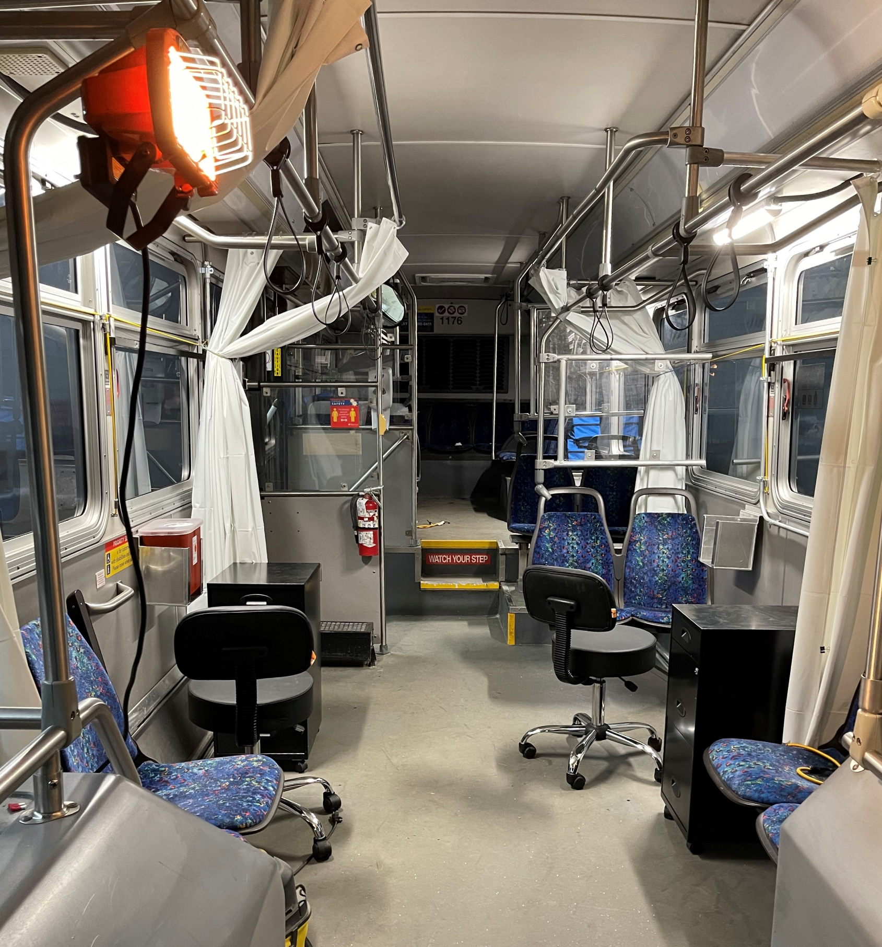
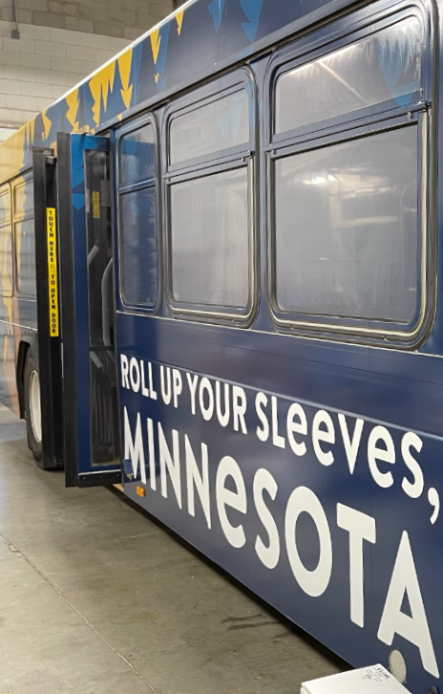
Timeline
MARCH
High level approval
APRIL
Wk of April 12: pilot launch with staff
MAY
JUNE - AUGUST
Bus retrofit starts
Logistics planning
Staffing – vax, training, scheduling, etc.
Wk of April 19: community launch
Build out fleet to 6 buses for full scale deployment
Full scale deployment
Discuss needs
Identify gaps
Bus retrofit continues
Discuss needs
Identify gaps
Site ID + scheduling begins
Site ID + scheduling
Site ID + scheduling
Site ID + scheduling
Community Intake form goes live

Slide 21
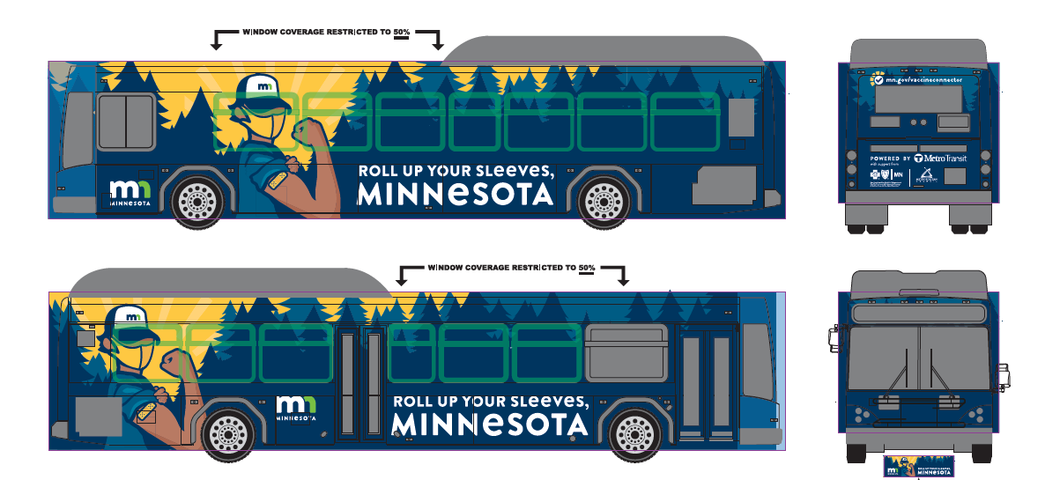
Where we've been
April 12 – Pilot week (1 bus)
April 19 – Community clinics (2 buses)
May 3 – community clinics (+3rd bus)
Low income, multifamily housing sites in Little Canada and Maplewood
Hmongtown Market in St. Paul
EMERGE Community Development in North MPLS
Pilot week at BCBS to vaccinate our staff and volunteers
Project for Pride in Living – North MPLS
April 26 – Community clinics (2 buses)
Vail Place – MPLS & Hopkins
Hallie Q. Brown Center in Rondo neighborhood in St. Paul
Senior Support Services in Brooklyn Center
Hennepin Healthcare for the Homeless – Avivo shelter
Low income, multifamily housing complex in Richfield
Hmongtown Market in St. Paul
Low income, multi-family housing in Moundsview, St. Paul, Richfield, Robbinsdale, and Landfall
Sacred Heart Church St. Paul
Maple Grove Hindu Temple
Emergency food shelf in Oakdale

Slide 22
Where we're going
May 10 – Community clinics (+4 bus)
May 17 – Community clinics (+5 & 6 bus)
Low income, multifamily housing sites in Brooklyn Park, Little Canada, MPLS, Maplewood, Bloomington,
Low income, multi-family housing sites in Landfall, St. Paul, Mound, Burnsville, Bloomington, MPLS,
Hallie Q. Brown Center in Rondo neighborhood in St. Paul
Gretens Greenhouse in Inver Grove Heights
Organizations for Liberians in Minnesota in Brooklyn Park
Avivo (unsheltered) HQ in MPLS
Svhel Vegetable Farm in Foley, MN
Tserha Aryam Kidist Selassie TAKS in MPLS
Watt Munisotaram Temple in Hampton
Community ACtion Partnership in Ramsey and Washington Counties
Sundanese American Community in St. Anthony
Ramsey County Libraries in St. Paul
Senior Support Services in Brooklyn Center
Hmongtown Market in St. Paul
Reviving the Islamic Sisterhood in MPLS
Excelsior United Methodist
Hope for the Community in Elko New Market
Broadway Family Medicine in MPLS
New Life Church in Roseville
Mobile home park in Chaska
Food shelf event in Red Wing
Todd County – 4 events in small, rural communities

Slide 23
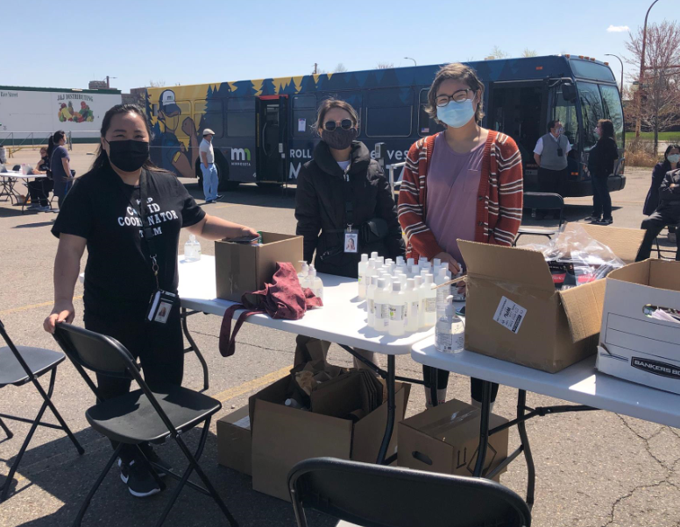
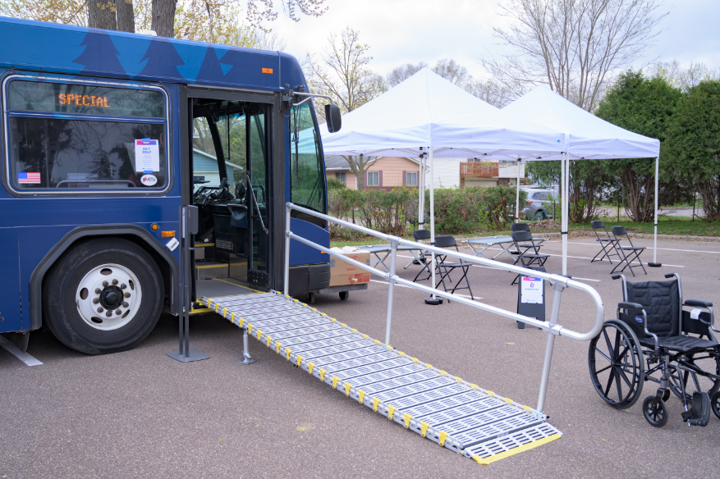
Free Covid 19 Mobile vaccine clinic

Slide 24
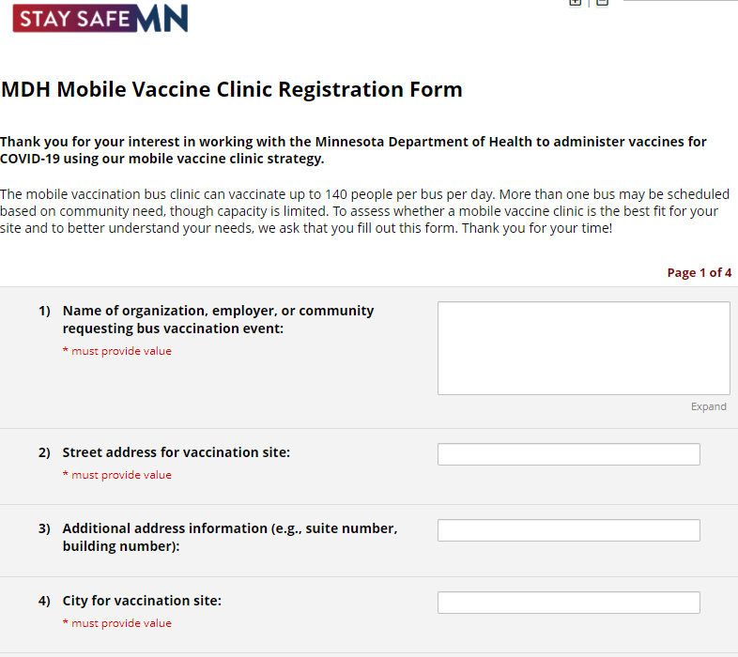
Scheduling and Deployment
Mobile unit scheduling:
State/LPH ID and outreach
Local community partner request: https://redcap-vac.web.health.state.mn.us/redcap/surveys/?s=XYWXWHE3EF
Requirements and expectations:
Vaccine access gap clearly identified
Location, transportation, technology, comfort, language, accessibility, etc.
Gap cannot be addressed by other providers (LPH, clinics, pharmacies, etc.)
Local community partner expected to help with mobile unit event planning
Logistics planning (parking, electricity, bathrooms, etc.)
Community outreach (language needs, sign ups, communications, etc.)
On-site, day-of clinic
Greater MN travel approach
Cluster of sites to visit for 1 week/4 days of clinics using a "hub"model

Slide 25
Other Key Updates
5/17/21

Slide 26
Key updates
Anyone can directly book an appointment to receive their Vaccine using the Vaccine Connector at any of the State-run facilities
Continuing to work with CCCs/Diverse Media partners/Community based organizations for all things Vaccine outreach/hesitancies/accessing the Vaccines
1,200 BIPOC retailers/grocery stores/liquor were mailed information in English/Spanish/Somali/Hmong on how to vaccinate their workers

Slide 27
Thank you!

