Slide 1
WORKFORCE ONE (WF1)
How to Enroll, Open, and Exit Cases
Capturing Your OPIOID DWG
Case Management Details
amy.carlson@state.mn.us
Performance and Data Coordinator

Slide 2
Participant Eligibility
At least ONE of the answers to these two questions MUST BE YES
Did the individual you want to enroll voluntarily disclose that they have been impacted by the opioid crisis according to the procedures of Section 14 of TEGL 4-18? And/or
Will the individual be accessing career, training, and supportive services aimed at boosting the number of qualified professionals in fields that can have an impact on the OPIOID crisis?

Slide 3
What's in this Workforce One Guide?
How to search for participants
How to enroll participants
How to enter a new program application
How to complete program eligibility
How to complete program enrollment
How to complete the online Employment Plan (IEP)
What activities are available
What activities should be used and when
How to close and open activities
How to capture Measurable Skill Gains
What activities are considered credentialed
How to capture credentials
How to exit participants

Slide 4
THE HELP BUTTON IN THE TOP PANEL
If you are ever unsure of what type of information needs to be entered on any page and any field of WF1
Click on “Help”
Every page in WF1 has a “Help” feature that explains and defines everything within the current WF1 screen you are in

Slide 5
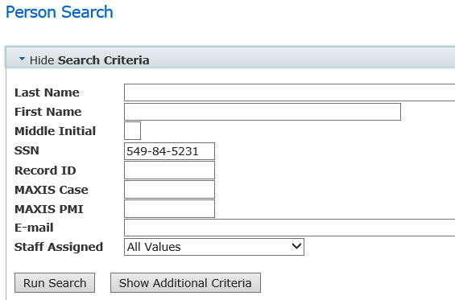
PARTICIPANT RECORD SEARCH
Log into WF1
Click on “Search” in the top panel
Select “Person” from the drop-down list
Enter the participant’s Social Security Number in the “SSN” field
Click on “Run Search”

Slide 6
PARTICIPANT RECORD SEARCH
If search results are found, click on the individual’s name.
(Skip to page 19)

Slide 7
PARTICIPANT RECORD SEARCH
If you receive a message that says “No results found” this means the individual has never been case managed in a program using WF1
Click on “Add New Person” to create a new shell record

Slide 8
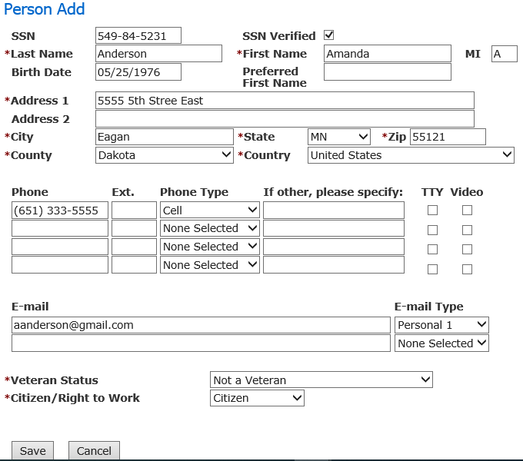
ADDING A NEW PERSON RECORD
To ensure accurate and complete case management reports Always enter as much information as you can, even if the data entry is not required
Fields with an asterisk (*) mean data entry is required
Click “Save”

Slide 9
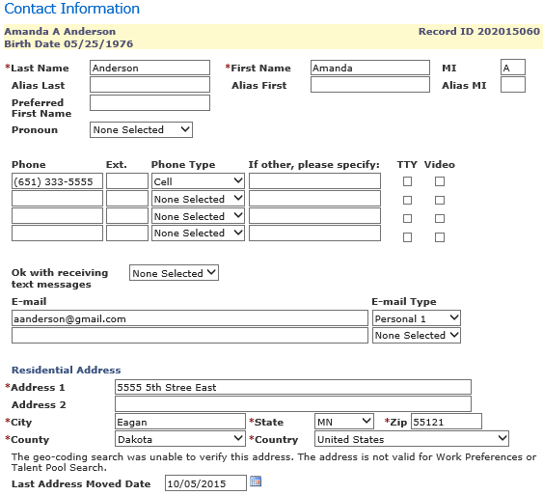
ADDING A NEW PERSON RECORD
The individual is now assigned a WF1 ID number
This number will be used as an ID instead of SSN
Continue filling in data in all areas you have information

Slide 10
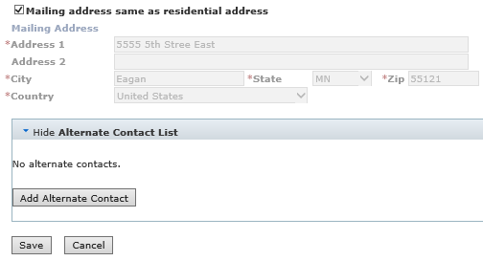
ADDING A NEW PERSON RECORD
If you were provided alternate contact information, click on “Add alternate contacts” and enter the contact information for the person your participant provides you that:
Does not live with them
Will be able to assist you in locating them if their contact information unexpectedly changes

Slide 11
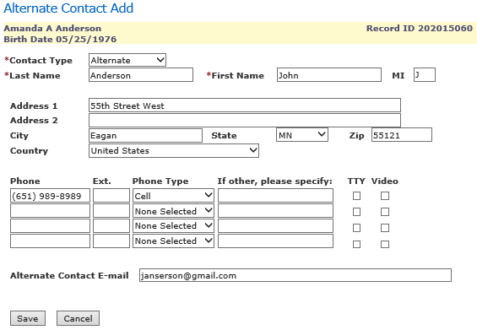
ADDING A NEW PERSON RECORD
Enter as much contact information your participant can provide
This information will only be used if you are unable to reach your participant at the phone number, address, or email they provided you
Click on “Save”

Slide 12
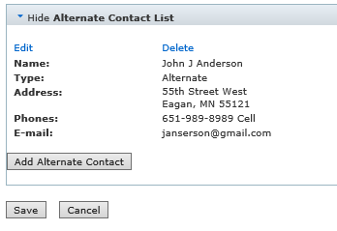
ADDING A NEW PERSON RECORD
Click “Save”

Slide 13
ENROLLING PARTICIPANTS Frequently Asked Questions
What is WF1?
DEED’s case management tracking system. Anything that is not entered in WF1 is not visible to DEED and will not show in official reports as taking place.
When should enrollment in Workforce One happen?
Immediately after confirming an individual’s eligibility for the program
Prior to applying any funds towards an individual’s case
When should I use the top and side panels of WF1?
Top Panel: NOT case specific. Direct your questions about this panel to Amy Carlson at DEED: amy.carlson@state.mn.us, 651-259-7542
Side Panel: Case specific. Use to navigate through a participant’s record and perform case management data entry requirements

Slide 14
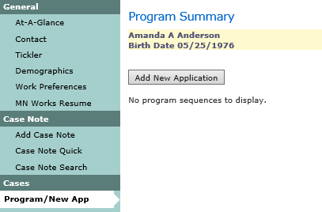
NEW PROGRAM APPLICATION
2
1
1. Select “Program/New App” in the side panel
2. Click on “Add New Application

Slide 15
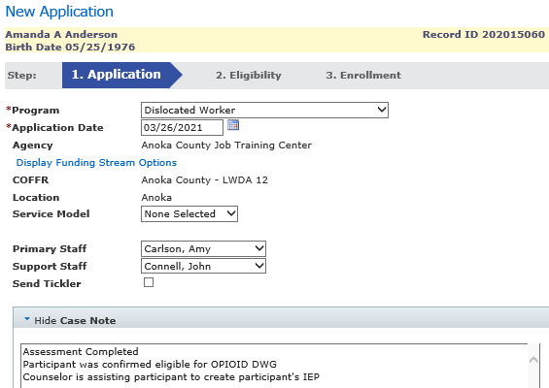
NEW PROGRAM APPLICATION
Program name: Dislocated Worker (DW)
Application Date: Date they signed their DW application
Primary Staff: Assigned Counselor
Support Staff: Person who will also be entering data on the case or coverage for Primary
Enter a case note
Press “Continue to Eligibility”

Slide 16
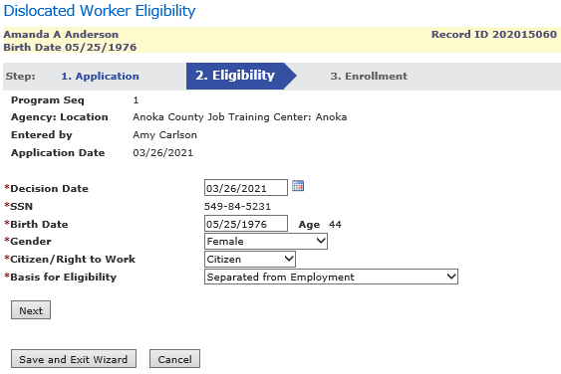
PROGRAM ELIGIBILITY
Enter information on all fields. Some information will auto populate from screens you have already completed
Press “Next”

Slide 17
PROGRAM ELIGIBILITY – OPIOID DWG
Eligible Participants
An individual eligible to receive services through a Disaster Recovery DWG must be one of the following, per 20 CFR 687.170(b):
temporarily or permanently laid off as a consequence of the disaster;
a dislocated worker as defined at 29 U.S.C. 3102(3)(15);
a long-term unemployed worker; or
a self-employed individual who became unemployed or significantly underemployed as a result of the disaster or emergency.

Slide 18
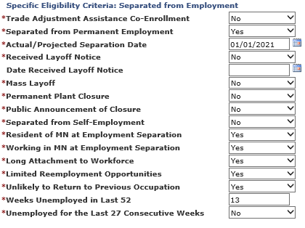
PROGRAM ELIGIBILITY Temporary or Permanent Layoff
Fields with an asterisk (*) mean data entry is required
Select “Yes” for Separated from Permanent Employment
Enter separation date

Slide 19
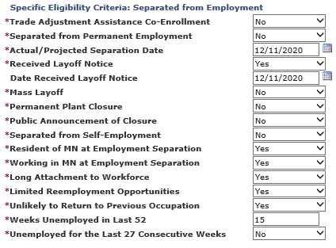
PROGRAM ELIGIBILITY Long-Term Unemployed
Fields with an asterisk (*) mean data entry is required
If prior job was temporary, select “No” for Separated from Permanent Employment
Weeks Unemployed must be at least 15 weeks

Slide 20
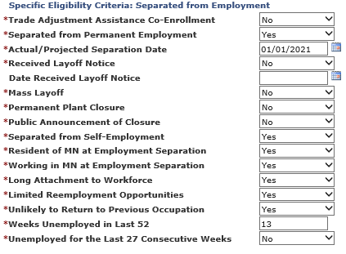
PROGRAM ELIGIBILITY Self-Employed
Fields with an asterisk (*) mean data entry is required
If prior job was self-employment, select “Yes” for Separated from Self-Employment
Separation dates should be based on the individual’s self-employment

Slide 21
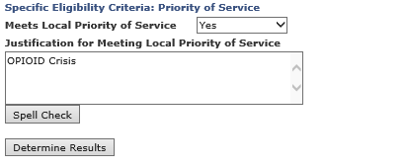
PROGRAM ELIGIBILITY
If the participant is eligible for OPIOID DWG they are automatically a “Priority of Service”. Select “YES”
Your justification for Priority of Service is “OPIOID Crisis”
Click “Determine Results”

Slide 22
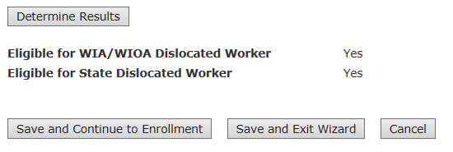
PROGRAM ELIGIBILITY
Determination Results should appear as “Eligible”
Click on “Save and Continue to Enrollment”
If the determination shows not eligible for WIA/WIOA Dislocated worker, look back at your data entry to confirm it was all entered correctly
If nothing appears to be incorrect, contact your manager or Amy Carlson for guidance

Slide 23
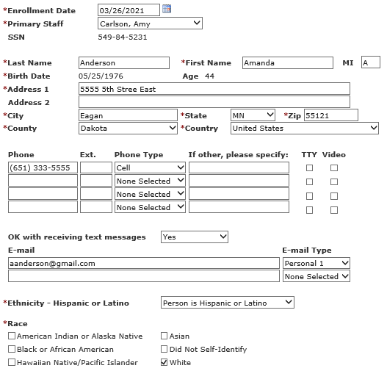
PROGRAM ENROLLMENT
Complete all blank fields that you can
Use participant’s self-reported information to capture demographic details
Continue through the enrollment screen by scrolling down

Slide 24
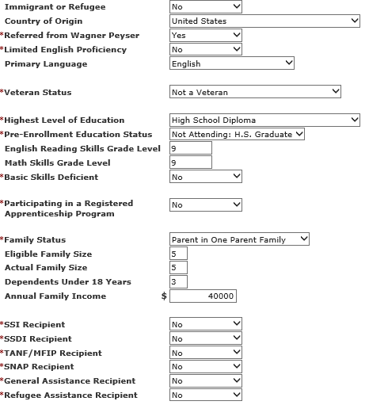
PROGRAM ENROLLMENT
Continue completing all fields if the information is known
The more information you enter at enrollment, the better your grant reports will be!

Slide 25
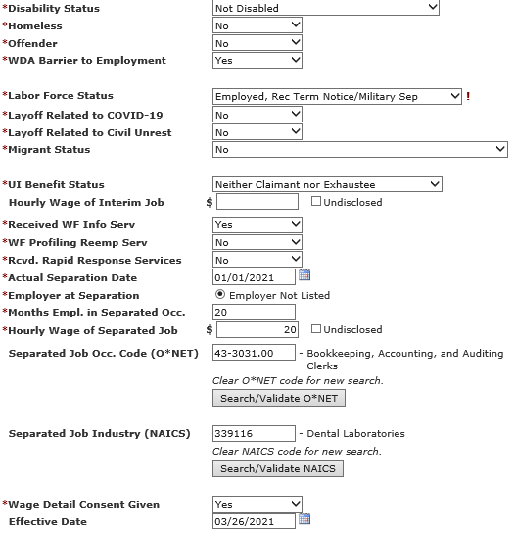
PROGRAM ENROLLMENT
Continue completing all fields if the information is known
The more information you enter at enrollment, the better your grant reports
Enter the O*NET and Industry code for the participant’s previous occupation

Slide 26
PROGRAM ENROLLMENT
“Staff Assisted Assessment” is the “Activity Type” since it determines the participant’s eligibility
OPIOID FUNDING STREAMS: Anoka WDA-12 1123000 OMNI, City of Duluth WDA-04 1043000 OMNI, CMJTS WDA-05 1053000 OMNI, or SE WDI WDA-08 1083000 OMNI
Click “Enroll” or “Enroll and Add Another Activity”

Slide 27
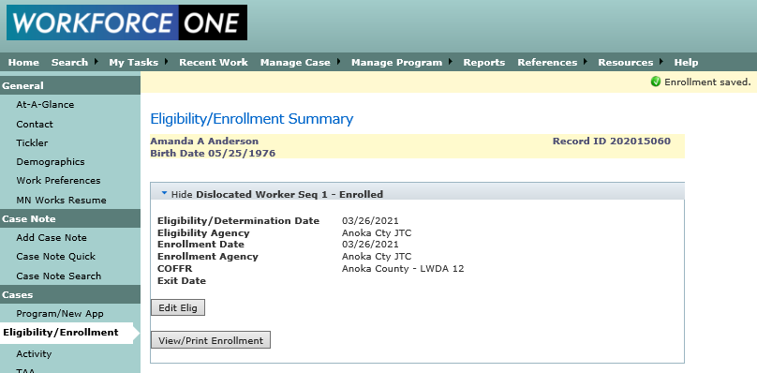
The participant is now enrolled!

Slide 28
ONLINE EMPLOYMENT PLAN
Multiple options that can be included within the plan; these are the most common
See the IEP Policy for requirements
https://apps.deed.state.mn.us/ddp/PolicyDetail.aspx?pol=411
(2) Click on

Slide 29
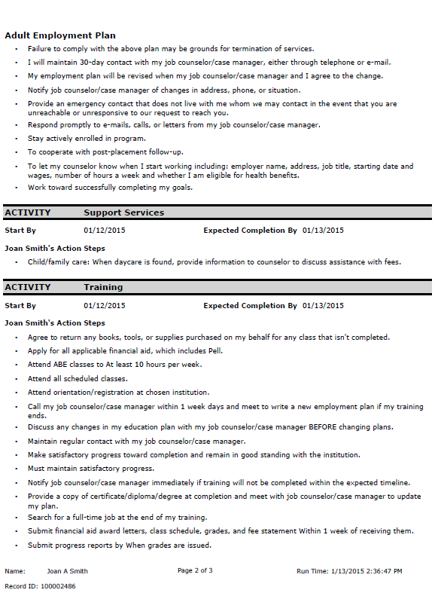
ONLINE EMPLOYMENT PLAN
See the IEP Policy for requirements
https://apps.deed.state.mn.us/ddp/PolicyDetail.aspx?pol=411
(2) Click on

Slide 30
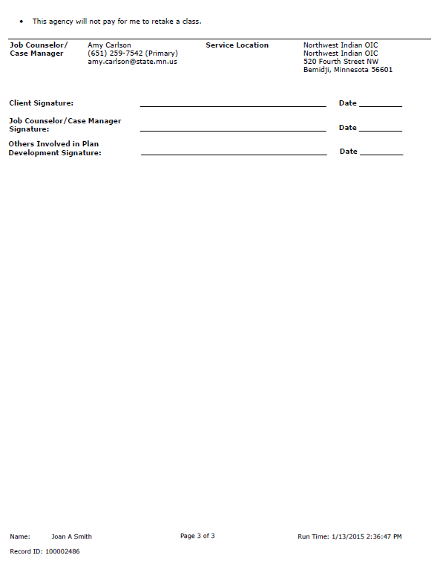
ONLINE EMPLOYMENT PLAN
Make sure to print the entire document
Counselor and Participant both need to sign the IEP before it is official
Give a signed copy to the participant
Put a signed copy in the case file
Only valid without update for one year
(2) Click on

Slide 31
Individual Employment Plan (IEP) Requirement
An annual review must occur between 335 – 395 days after the most recent signatures date
Since the IEP is a living document it must be updated whenever
An Obstacle or Barrier has been overcome
Goals/Objectives are achieved
Situations/Life changes

Slide 32
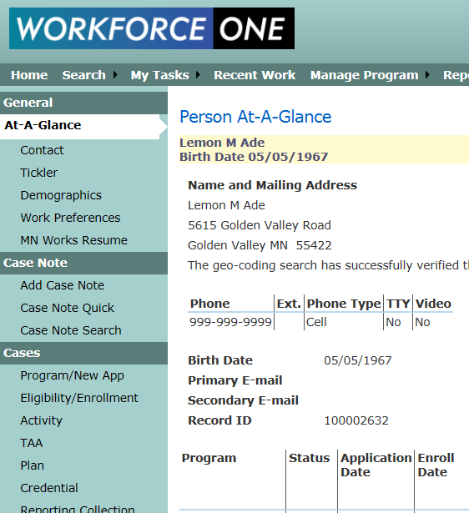
Individual Employment Plan (IEP) Requirement
Must be captured in WF1 with a plan approval date no later than the start date of the first training activity
Notes:
No training or support services costs may be obligated, incurred or expended until the participant is enrolled in WF1 and an IEP has been completed.

Slide 33
What Should be Case Noted?
Date and manner of the contact
Details of significant events impacting the customer’s participation
IEP activities and progress toward goals, including updates and changes in this living document
Participation in associated programs or activities
(e.g. Veterans Program, State Services for the Blind, Trade Adjustment Assistance, Vocational Rehabilitation, etc.)

Slide 34
Case Notes
Information provided verbally by service providers about the customer’s participation or progress
Purpose of the contact, information provided, description of outcomes, and next steps
Information on contacts with other program staff
All Support Service and Training fund approvals
Documentation for each disbursement must be included, including cost to provider (not value of service)
Documentation must show how approval was consistent with local policy

Slide 35
Communication and Contact
How often do you need to communicate with your participant?
Counselor needs to attempt communication with their participant at least every 30 days
Counselor needs to case note in the participant’s Workforce One record at least every 30 days detailing the attempt to communicate
If no live contact has occurred for 90 consecutive days, the counselor MUST exit the participant

Slide 36
Definition of LIVE CONTACT
One-to-one contact between the provider’s staff and the participant
In-person conversation
Telephone conversation (or voicemail from participant)
Electronic message including email, text message (SMS), instant message (IM), or message sent via social media (e.g. Facebook, Twitter, etc.)
Postal mail update from participant
Mass emails and/or mass mailings are not case specific and will not fulfill the monthly contact requirement

Slide 37
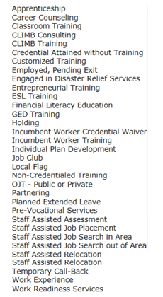
Activities in Workforce One
DW ACTIVITIES
Activities in WF1 represent the services your participant is receiving during their enrollment period
If your participant is engaged in Disaster Relief Employment
1. Open the Engaged in Disaster Relief
Services activity
2. Open the Work Experience activity
* Select “Transitional Job” as the type
of Work Experience
* Enter all the employment details
related to that disaster relief
employment

Slide 38
Workforce One (WF1) ACTIVITIES
Activities capture the services you are providing your participant
And
The funding source supporting that service

Slide 39
WORKFORCE ONE (WF1) ACTIVITIES
WF1 Activities track
What your participant has done, is doing, and (whenever possible) what they plan to do next
The provider funding the service and who approved the participant to receive the service
When your participant started receiving the service and when they no longer needed the service
Where they received the service and employer/training details related to the service
The funding source supporting the service

Slide 40
WORKFORCE ONE (WF1) ACTIVITIES
The funding stream selected within the activity captures what funding source is supporting that service
Most participants are eligible for multiple funding sources when enrolled in the WIOA Adult and Dislocated Worker programs
Most participants access more than one fiscal year allocation or funding stream during their enrollment and sometimes they access multiple at the same time
***This is not only allowable, it is encouraged***
for seamless case management and holistic service delivery

Slide 41
WHY IS THE FUNDING STREAM ENTERED IN ACTIVITIES?
Accurate reporting on what each funding source is providing participants
Reports to the Department of Labor and other key stakeholders that participants are receiving holistic services
Easier to demonstrate participants can, are, and need to access multiple funding sources
Easier to discuss funding shortages and how they affect more than one funding source
Better alignment with how funds are reported and tracked with mass layoff projects as well as other DEED grant programs
Better supports reporting on standalone grant contracts, rather than master contracts

Slide 42
KEEP IN MIND
Activities cannot be financially supported by a grant that is not yet active or one that has expired
Funding streams have a specific start date and a specific expiration date
The Activity start date must be a date between the selected funding stream’s start and end date
Activities cannot have an end date that is after the selected funding stream’s end date

Slide 43
Activity Data Entry Timeliness at Grant End
If a participant will continue receiving a service that is financially supported by an expiring grant, DO NOT EXIT THEM.
Since the participant is continuing services…
Close the activity with the same end date as the expiring grant’s end date
Open a new activity with the new grant’s start date as its start date
The only time a participant is exited out of the program
is after 90 days of no service

Slide 44
Basic Career Services (ALL participants) Individualized Career Services (ALL participants) Follow-up Services (Participants exited to employment)
What services must be provided to participants?

Slide 45
Basic and Individualized Career Service Activities in Workforce One
Career Counseling | Engaged in Disaster Relief Services (DW ONLY)
ESL Training | Financial Literacy Education
Individual Plan Development | Job Club
Pre-Vocational Services | Staff Assisted Assessment
Staff Assisted Job Placement | Staff Assisted Job Search in Area
Staff Assisted Job Search out of Area | Staff Assisted Relocation
Work Experience | Work Readiness Services

Slide 46
What Training Activities need a
Measurable Skills Gain Captured?
Apprenticeship | Classroom Training
Credential Attained without Training | Customized Training
Entrepreneurial Training | GED Training
OJT – Public or Private | Incumbent Worker Training

Slide 47
What Training Activities need a
Credential Captured?
Apprenticeship | Classroom Training
Credential Attained without Training | Entrepreneurial Training
GED Training | Incumbent Worker Training

Slide 48
What Activities are not used in ANY Performance?
Holding | Planned Extended Leave
Local Flag | Partnering
Temporary Call-Back
(See your “DISLOCATED WORKER PROGRAM ACTIVITY DEFINITIONS AND PERFORMANCE STATUS” handout for more information on all activities)

Slide 49
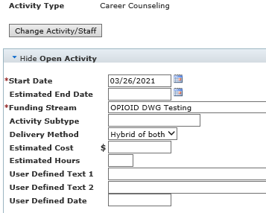
OPENING CAREER SERVICE ACTIVITIES
Start dates should be the date the participant will begin the specific activity
Make sure to select the correct funding source for each activity
Enter a case note about the service
Click “Save”

Slide 50
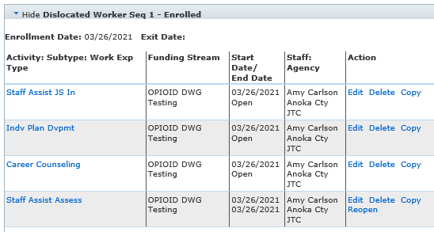
ACTIVITY TAB VIEW
Individual Plan Development, Career Counseling, and Job Search activities should all be opened as soon as the person is enrolled
These type of activities will usually remain open throughout the case management period

Slide 51
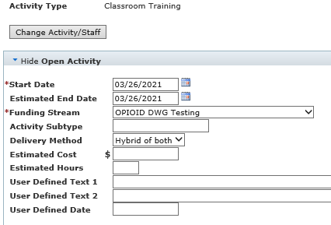
OPENING TRAINING ACTIVITIES
Start dates should be the date the participant will begin CLASSES
Estimated end dates should be the date you approve the training to end
Make sure to select the correct funding source for each activity
Scroll down to continue data entry

Slide 52
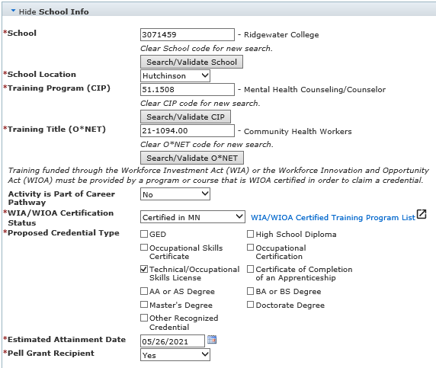
OPENING TRAINING ACTIVITIES
Select the school name
Select the school location
Select an accurate O*NET code
Select the correct WIOA certification status
Choose the credential type they will receive after training
Scroll down to continue your data entry

Slide 53
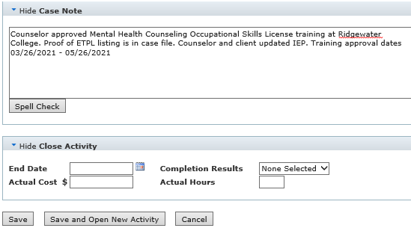
OPENING TRAINING ACTIVITIES
Enter a brief summary case note
Detail the approved training dates, program, and school
Explain the fact you provided the participant with the ETPL
Click “Save”

Slide 54
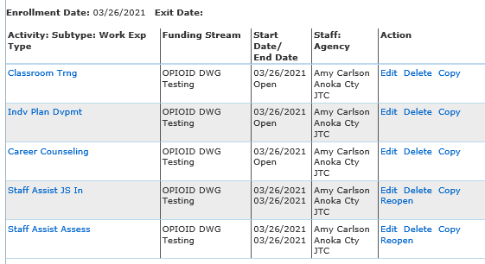
ACTIVITY TAB VIEW
To update, change, or close an activity click on “Edit” in the “Action” section of the activity you are changing.
Since the participant will not be looking for work while in training, click “EDIT” on the Job Search line and enter the end date of that activity (within 30-days of training start date)
The Job Search activity can be reopened at any time when the participant will again be looking for work

Slide 55
Measurable Skill Gains Data Entry Timeliness
MSGs must be entered into WF1 no later than
15 business days after receiving proof of a gain or within 365 days after the start of the fiscal year
Whichever is earlier

Slide 56
Five MSG Options
Educational Functioning Level Date: New documented assessments showing an increase in abilities;
Secondary Report Card Date: Documented attainment of a secondary school diploma or its recognized equivalent;
Post-Secondary Transcript Date: showing sufficient number of credit hours in accordance with academic standards;

Slide 57
Five MSG Options
4. Training Milestone: OJT or Apprenticeship progress report from the employer or training provider;
5. Skills Progression Date: Successful passage of an exam that is required for a particular occupation or progress in attaining technical or occupational skills

Slide 58
Where are MSGs entered in WF1?
“Measurable Skills Gain”
The ONLY place
to capture
MEASURABLE SKILL GAINS

Slide 59
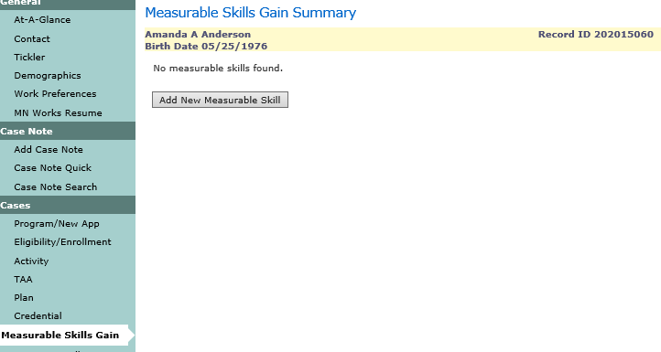
Reporting Collection
2. Click here
1. Click here

Slide 60
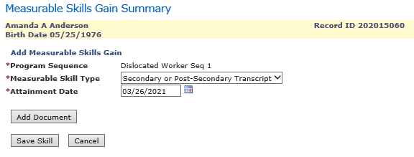
Select the Measurable Skill Type
Enter the Measurable Skill Attainment Date
Upload document showing proof of gain
Click “Save Skill”

Slide 61
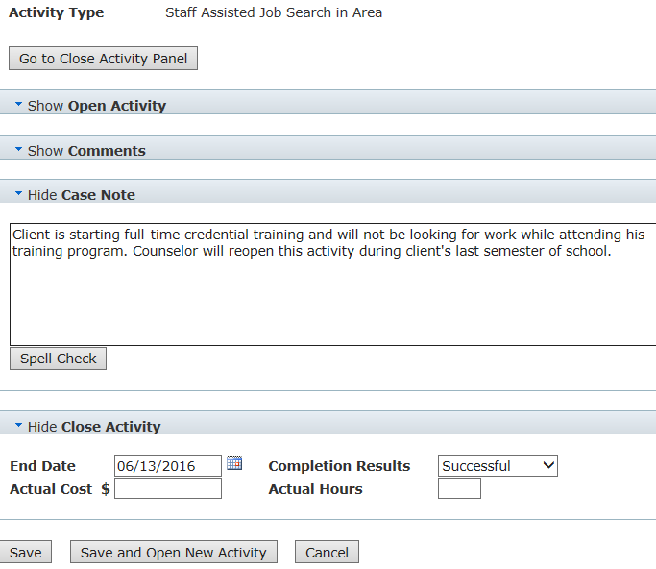
Closing Career Service Activities
Enter a quick case note explaining the reason you are closing the activity
Enter the last day the participant will be doing the activity
Enter the completion results
Click on “Save”

Slide 62
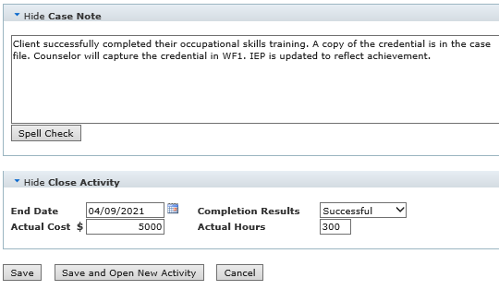
Closing Training Activities
Since everything related to the training was entered when you opened the activity….
Enter a quick case note explaining the reason you are closing the activity
Enter the last day the participant attended classes
Enter the completion status
Enter the cost the program paid towards the training
Click on “Save”
REMINDER: Nothing in this screen allows you to capture a credential

Slide 63
Credentials Attained Data Entry Timeliness
Credentials must be entered into WF1 no later than
10 business days after receiving a copy of the credential or within 365 days from the participant’s exit date
Whichever is earlier

Slide 64
CREDENTIAL SUMMARY SCREEN
The ONLY spot to capture a credential in WF1
Immediately after opening a credentialed training activity, a “Credential Pending” status is triggered for the case.
Nothing needs to be completed on this screen until the counselor receives a copy of the completed credential.
(Must be received and captured in WF1 within 4 FULL quarters after exit)

Slide 65
CAPTURING THE CREDENTIAL
Click on
“Edit”
After a copy of the credential is received, click on “Credential” in the side panel
Once in the “Credential Summary Screen” click on “Edit” and the following will automatically populate in the “Edit Credential” fields
* “Credential Type” is the Current credential status
* “Estimated Attainment Date” you entered in the activity
* “Associated Activity” the activity is related to

Slide 66
CAPTURING THE CREDENTIAL
Click on
“Edit Credential”
Click on the “Edit Credential” field and select the type of credential your participant completed from the drop-down list

Slide 67
CAPTURING THE CREDENTIAL
(1)
Enter “Attainment Date”
(2) Click on “Save”
Enter the “Actual Attainment Date” by completing one of the two methods below
* Manually enter the 2-digit month/day and the 4-digit year
* Click on the calendar symbol then select the month, day, and year
Click “Save”

Slide 68
THE CREDENTIAL IS CAPTURED!
REMINDER
The counselor needs to complete this task any time during the participant’s enrollment
or within 4 full quarters after the participant’s exit date for all AD/DW and TAA training activities!

Slide 69
The Pending Exit Activity
All participants must be exited from the program after 90 days has lapsed since last date of service
When the participant tells you they are no longer in need of services, all activities must be closed on the case and a new activity needs to be entered with the date of that conversation
85 days after that activities start date a tickler will be sent to the counselor as a reminder to process the exit

Slide 70
The Pending Exit Activity
The “Employed, Pending Exit” activity must be used when the participant will be exiting to employment due to required employment details within the activity
The “Pending Exit, Other” activity must be used when the participant will be exiting to other reasons

Slide 71
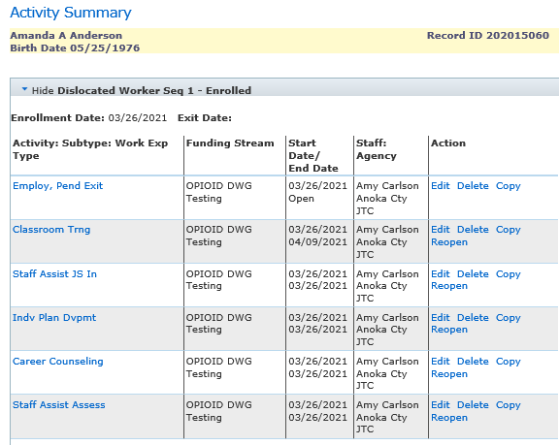
The Pending Exit Activity

Slide 72
Program Exit Data Entry Timeliness
All participants must be exited from the program after 90 days has lapsed since last date of service
All participant exits must be entered into WF1 no later than 100 days after the last date of service
The exit date in WF1 is
retroactive back to the last date of service

Slide 73
If the participant is exited with any of these exit reasons that participant will not be counted in performance outcomes
What does Exited with Exclusion Mean?
DOL Definition of Authorized Exclusion Based on TEGL 10-16 Attachment 2 |  | WF1 Exit Reason
Exits while receiving services due to incarceration in correctional facility or becomes resident of institution providing 24 hour support such as hospital or treatment center |  | Institutionalized
Exits after being called up to active duty for at least 90 days as member of National Guard or other reserve military unit. |  | Reservist Called to Active Duty
Participant is deceased |  | Death
Exits due to medical treatment expected to last longer than 90 days which would preclude employment or continued participation. |  | Medical Treatment

Slide 74
What WF1 Exit Reasons will be counted in
Performance Measures
DEED will check wage detail/Supplemental Wage Information and other performance indicator data for participants exiting with these final Exit Reasons |  | Programs Using
Called Back |  | Dislocated Worker
Cannot Locate |  | Dislocated Worker and Adult
Entered Armed Forces |  | Dislocated Worker and Adult
Entered Registered Apprentice Training |  | Dislocated Worker and Adult
Entered Unsubsidized Employment |  | Dislocated Worker and Adult
Family Care Problems |  | Dislocated Worker and Adult
Found Ineligible |  | Dislocated Worker and Adult
Moved from Area |  | Dislocated Worker and Adult
Program/Type Transfer |  | Dislocated Worker and Adult
Refused to Continue |  | Dislocated Worker and Adult
Remained Employed |  | Dislocated Worker and Adult
Retirement |  | Dislocated Worker and Adult
Started Business/Self-Employed |  | Dislocated Worker and Adult

Slide 75
They are eligible for follow-up services for 12 months after their exit date. How do you prove you had this discussion? Case Note it
What must you tell every participant
who exits to employment?

Slide 76
What are examples of Follow-up Services?
(Available to all participants exited to employment for 12 months after exiting)
Counseling regarding the workplace
Peer support groups
Referral to support services in the community
Provision of performance and program cost information for providers of training
Provision of information on opportunities for job advancement

Slide 77
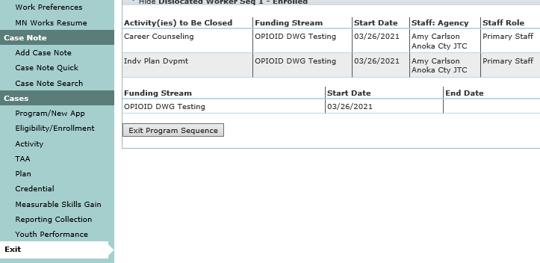
EXITING THE PARTICIPANT
(2) Click on
“Exit Program Sequence”
(1) Click on “Exit”
Click on “Exit” in the side panel when you are ready to close the case
Once in the “Exit Summary” screen, click on “Exit Program Sequence”

Slide 78
EXITING THE PARTICIPANT
(2) Click on “Next”
(1) Click on
the exit reason
Once in the DW Exit screen, click on the “Primary Exit Reason” field and choose the appropriate exit reason from the drop-down list
Click on “Next”

Slide 79
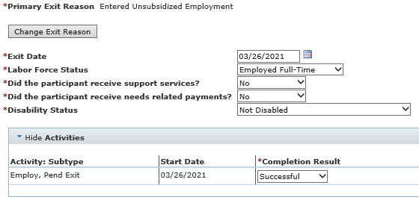
EXITING THE PARTICIPANT
Enter the “Exit Date”, which is the last date of service
Enter the “Labor Force Status” for the participant you are exiting
Both questions related to support services and needs-related payments will automatically populate depending on the recorded information during enrollment
Enter the completion results for all activities still showing active in this screen

Slide 80
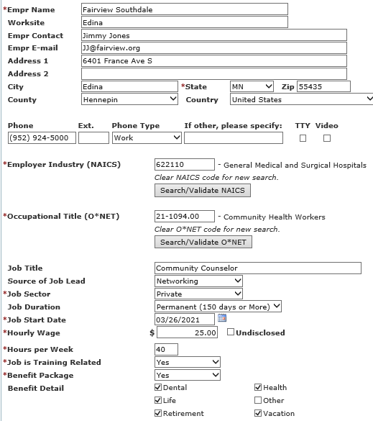
EXITING THE PARTICIPANT
(2) Click on
All employment details entered into the Employed, pending Exit activity will automatically be copied into the exit details to limit your need for data entry
Complete all known employer information
Click on “Search/Validate NAICS” to complete required “Employer Industry” field
Click on “Search/Validate O*NET” to complete required “Occupational Title” field

Slide 81
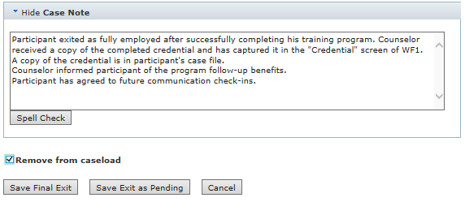
EXITING THE PARTICIPANT
Enter the exiting case note
Click on box next to “Remove from caseload” if you don’t want the case to show on your Home Page
Click on “Save Final Exit”
If there is a Pending Credential status still open at this time, a warning will automatically pop up

Slide 82
THE PARTICIPANT IS EXITED!
REMINDER
The ONLY staff with authorization to capture credential information in WF1 is the local-level case managing counselor
If there is still a “Pending Credential” status open at the beginning of the fourth quarter after exit, a tickler will be sent to the local level case managing counselor instructing them to capture the credential information before the end of that quarter
If the counselor does not capture the credential information within the timeframe allowed
IT WILL HAVE A NEGATIVE IMPACT ON YOUR CREDENTIAL MEASURE!

Slide 83
REQUIRED POST EXIT DATA ENTRY
If you use the Exit Reason: “Started Business/Self-Employed” OR
the participant is working for an employer not required to report wages
(Railroad, Federal jobs, Non-profits, etc.)
YOU MUST
Enter Supplemental Wage information into the participant’s WF1 record
during each of the following quarters
2nd Quarter After Exit and the 4th Quarter After Exit
If this data is not entered, the case will be a negative
in your 2nd and 4th Quarter Employment Measures

Slide 84
Acceptable File Documentation for Entered Supplemental Wage Data
Copy of the participants paystub relevant to the reporting period
Dates of employment
Name of employer
Employer contact information
IRS Form 1040-ES, other IRS form, or at least one of the following for each quarter after exit
A thorough list of individuals with whom the participant does business
A list of companies the participant purchases supplies or services from
Advertising materials the participant uses to market their business
(https://apps.deed.state.mn.us/ddp/PolicyDetail.aspx?pol=286: Handbook for Data Validators)

Slide 85
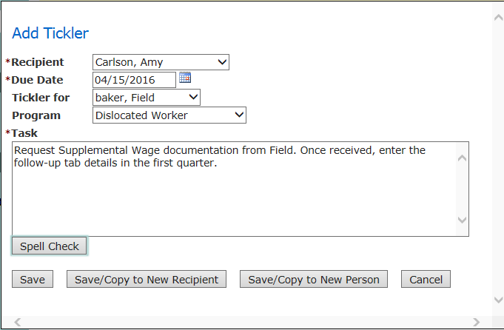
WF1 Tickler Creation for Supplemental Wage Data
Click “Tickler” on the side panel of the participant’s record
Enter the date you want to be alerted and the information the tickler needs to remind you to do
To limit your data entry duties, click on “Save/Copy to New Recipient”
Change the “Due Date” to the next date you need to confirm supplemental data, edit your task, and repeat

Slide 86
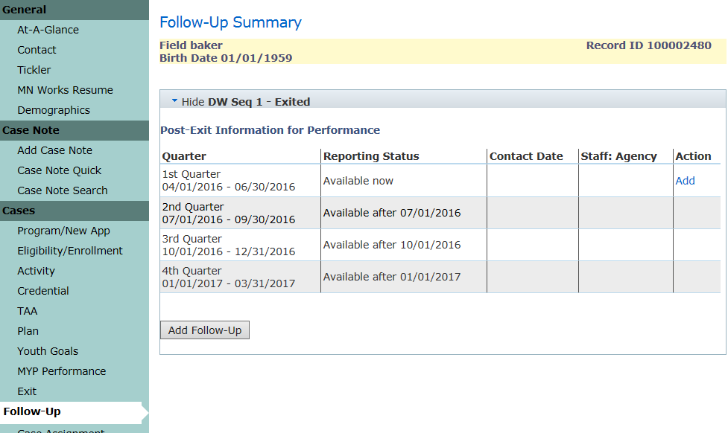
Supplemental Wage Data Entry
Click on “Follow-Up” in the side panel of the participant’s record
Click on “Add” in the “Action” column to the right on the 1st Quarter line

Slide 87
Supplemental Wage Data Entry
Enter the date you received the supplemental wage documentation from the participant
Select the “Supplemental Verification Type” in which the participant provided

Slide 88
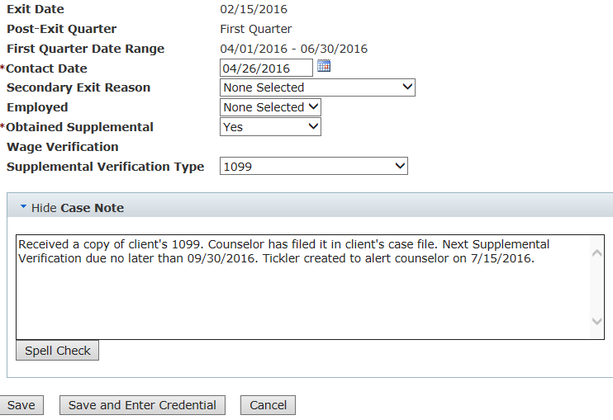
Supplemental Wage Data Entry
Case note
The type of verification used
Where the documentation can be found
The due date for next Supplemental Wage verification
Click “Save”

Slide 89
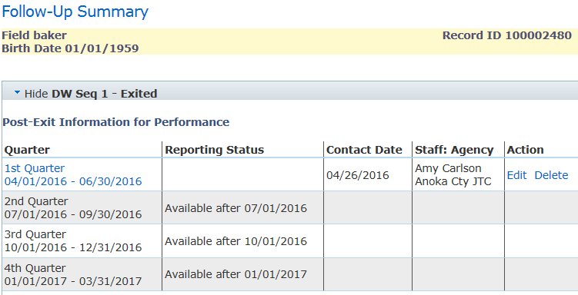
Supplemental Wage Data Entry
Your first “Post Exit Information for Performance” is finished!
Only three more to go!

Slide 90
Running WF1 Reports
1. Click here
1. Click here
2. Select here
2. Select here

Slide 91
Running WF1 Reports by Program or Fund
Program Level – Select this when you want the report to give you details on ALL participants who access the program regardless of funding source. In other words, this gives you “Total Dislocated Worker”
Funding Stream Category level – Select this when you want the report to give you details on participants who accessed federal funds only OR state funds only regardless of grant type
Funding Stream Level – Select this when you want the report to give you details on participants who accessed a specific funding stream. In other words, participants accessing a specific mass layoff project, DWG, or formula grant.
Custom Program – This will never give you information on WIOA Adult or Dislocated Worker participants. This is mainly used for Direct Appropriations.

Slide 92
REMINDERS
Workforce One is not a Performance tracking system it is a Case Management Tracking System
Workforce One is simply the starting point to performance indicators related to employment
Every case exited out of Workforce One with a Positive or Negative exit reason will be verified through Wage Detail
If wages are found the case is a positive exit
If wages are not found the case is a negative exit

Slide 93
REMINDERS
If a participant exits to Self-Employment
Supplemental Wage Information must be captured in WF1 during the 2nd and 4th quarters after the participant exits
Supplemental Wage Information is entered into the Follow-Up tab within the participant’s WF1 record
Allowable Supplemental Wage Information includes: Copies of quarterly tax payment forms from IRS, self-reported follow-up survey from participants, self-employment worksheets signed and attested to by the participant
If supplemental wage information IS found it will be a positive exit
If supplemental wage information is NOT found it will be a negative exit

Slide 94
Why participants with “positive” WF1 exit reasons might not be positive in official performance
* A pseudo Social Security Number was used on the case (please follow the correct procedure to create a pseudo ssn)
* Wages were not found in wage detail reports
* Supplemental wage information was not entered into
WF1’s Follow-Up tab
* DOL considers the original exit reason and/or the
secondary exit reason exclusionary

Slide 95
Risks of Using a Pseudo SSN
Post program earnings will not be determined, which will result in an automatic negative exit.
The search function in Workforce One encompasses many parameters: SSN, name, email address, MAXIS number and Workforce One Record ID or Birthdate. If a pseudo SSN is used, a later search for the person by SSN may not yield a result.

Slide 96
Procedure for Creating a Pseudo SSN
If an individual refuses to supply an SSN and/or adequate documentation then enter a 9 digit number based on this method:
Start the number with ”000” or “900”
Middle two numbers are the WSA /ISP number = AEOA – 21
Last 4 numbers are assigned in a sequential manner (ie, 0001, 0002, 0003, etc)

Slide 97
Why numerators and denominators might be different in Official Performance than expected
Participants who access multiple providers
If a participant accessed services from a provider then after exiting they reenrolled with a new provider
within 90 days
Performance counts
go back to the original provider

Slide 98
COMMON WF1 DATA ERRORS
The only time a participant exits the program is when they haven’t received a service in 90 days
REMINDER
DO NOT EXIT A PARTICIPANT WHEN GRANTS EXPIRE UNLESS THEY ARE TRULY NO LONGER A PARTICIPANT
Close activities accessing the expired funding stream with the date that grant ended
Open new activities and select the new funding stream within them. The activity start date is the date the new funding source began funding that activity

Slide 99
COMMON WF1 DATA ERRORS (Continued)
If the participant is simply waiting the 90 day timeframe because they are no longer in need of services the only activity open on the case should be
“Employed, Pending Exit”
REMEMBER:
OPEN ACTIVITIES SHOW THE PARTICIPANT IS CURRENTLY RECEIVING A SERVICE

Slide 100
COMMON WF1 DATA ERRORS (Continued)
Open WF1 Activities:
Are services the participant is currently receiving
Show the funding source supporting the service
The activity start date is the date the participant started receiving that service
Closed WF1 Activities:
Are the services the participant is no longer receiving
Show the funding source that was supporting the service
The activity end date is the date the participant stopped receiving that service

Slide 101
COMMON WF1 DATA ERRORS (Continued)
If a participant exits to Employment and their employer is required to submit wage detail
DO NOT ENTER SUPPLEMENTAL WAGE INFORMATION INTO THE PARTICIPANTS FOLLOW-UP DETAIL
If supplemental wage information IS found it will be added to the wages found in wage detail
This will artificially inflate wage information reported to DOL

Slide 102
COMMON WF1 DATA ERRORS (Continued)
If a participant was scheduled to begin training but before any training costs were applied the participant decided not to attended training
DO NOT SIMPLY CLOSE THE TRAINING ACTIVITY, DELETE IT!
If there is a training activity on record, reports will look for a captured credential
If there is not a credential captured, it will result in a a negative in the Credential Attainment Rate

Slide 103
What’s the Difference between PY and FY?
NOTHING BUT A TITLE
Program Year (PY): Titled with the year it began
Fiscal Year (FY): Titled with the year it ends
THIS MEANS
July 1, 2019 – June 30, 2020
IS Performance Program Year 2019 AND Fiscal Year 2020

Slide 104
Why numerators and denominators might be different than expected
Participants who only access State funds
If all activities on the participant’s case are associated with State Dislocated Worker funding
That participant will not be included in
WIOA Dislocated Worker measures
At least one activity on the case needs to be supported by WIOA Dislocated Worker funding

Slide 105
Why numerators and denominators might be different than expected (Continued)
Participant who only access WIOA funds
If all activities on the participant’s case are associated with WIOA Dislocated Worker funding
That participant will not be included in
State Dislocated Worker measures
At least one activity on the case needs to be supported by State Dislocated Worker funding

Slide 106
Why numerators and denominators might be different than expected (Continued)
Participant who access both WIOA and State funds
If there are activities on the participant’s case associated with both WIOA Dislocated Worker and State Dislocated Worker funding
That participant will be reported in both State and WIOA performance measures

Slide 107
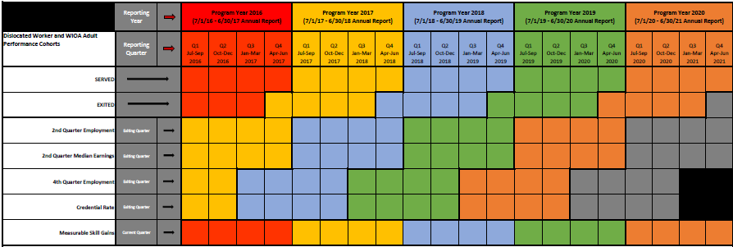
PY16, PY17, PY18, PY19, & PY20 WIOA Cohorts
See next couple of slides for directions on how to use this chart

Slide 108
Using the Cohort Chart
Finding Program Year (PY) Timeframes
The top colored section lists four program years in separate colors and the date range included in each of those program years.
PY16: red, PY17: yellow, PY18: blue, and PY19: green
Example: If you want to know what months are included in PY18, look at the top section in blue. This section tells you PY18 runs July 2018 - June 2019.
Finding Quarter (Qtr) Report Timeframes
The second colored sections separates each program year into that program year's quarter report date ranges.
Quarter 1: Jul-Sep, Q2: Oct-Dec, Q3: Jan-Mar, and Q4: Apr-Jun
Example: If you want to know what months are included in PY18 Quarter 1, look at the second colored section under the PY18 label (in blue) then find the first Quarter listed (on the left). This tells you PY18 Q1 runs July 2018 - June 2019.

Slide 109
Using the Cohort Chart (Continued)
5 Performance Indicators Measured in every Quarter and Annual report
The far left section in the chart lists these five Indicators
2nd Quarter Employment: based on the participants’ exit date and employer reported state and national wages in the 2nd quarter after exiting
2nd Quarter Median Earnings: based on the participants’ exit date and the median wage reported by employers (state and national wages) in the 2nd quarter after exiting
4th Quarter Employment: based on the participants’ exit date and employers reporting state and national wages earned in the 4th quarter after exiting

Slide 110
Using the Cohort Chart (Continued)
5 Performance Indicators Measured
Credential Rate: based on all participants who attended training during enrollment and the date the participants exited (4th quarter after the exiting quarter
Measurable Skill Gains (MSG): Only real time measure. Based on all participants who attended training that leads to a credential or employment at any time during their enrollment period and if they have a captured MSG during the reporting period

Slide 111
Using the Cohort Chart (Continued)
To find the date range for exiters included in each Annual Report for all exit based performance indicators
Follow the PY's color in which you want participant exit date ranges on down through the individual indicator section
Once you are in the indicator line you want the information on, look directly up to the quarter date section above it
The quarter date ranges listed above that program year’s color are the exit date ranges that indicator uses
Examples: PY18's 2nd Qtr Employment performance outcome includes participants exited July 2017 - June 2018. PY18's 4th Qtr Employment performance outcome includes participants exited January 2017 - December 2017.

Slide 112
Using the Cohort Chart (Continued)
To find the date range for exiters included in each Quarter Report for all exit based performance indicators
Follow the PY's color for the quarter in which you want date ranges on down to the individual indicator section
Once you are in the indicator line, look directly up from the PY colored quarter section you want to know to the dated quarter section above it
The quarter date range listed is the exit date range used for that indicator in that program year’s quarter
Examples: PY18's 2nd Qtr Employment performance outcome includes participants exited July 2017 - June 2018. PY18's 4th Qtr Employment performance outcome includes participants exited January 2017 - December 2017.

Slide 113
Using the Cohort Chart (Continued)
Reminder: The Measurable Skill Gains Performance Indicator is a Real-Time Measure
It includes all participants who attended training
It measures all those participants who have a skill gain and those that do not
The timeframe used in this indicator is the same timeframe for each Program Year the indicator is measuring
Examples: PY18's Measurable Skill Gains date range includes participants who attended training and are enrolled July 2018 - June 2019. PY18's Q1 Measurable Skill Gains date range includes participants who attended training and are enrolled July 2018 - Sept 2018.

Slide 114
Performance
Questions?
Amy Carlson
Performance and Data Coordinator
amy.carlson@state.mn.us

